Slide 1
Atomic Structure and Isotopes

Slide 2
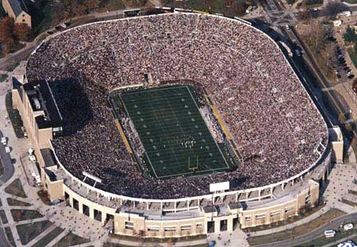
The size of an atom
Atoms are VERY small. They are measured in picometers (1 picometer = 1 x 10⁻¹² meters)
The nucleus of an atom is TINY compared to the whole atom.
IF an atom were the size of
a football stadium, its
nucleus would be the size
of a marble.

Slide 3
The Size of Subatomic Particles
Protons and neutrons have a mass of 1 amu (atomic mass unit) each.
1 amu = 1.66054 x 10⁻²⁴ grams
Electrons are much smaller than protons and neutrons. An electron has a mass of 0.0005486 amu.

Slide 4
The Charges an Symbols of Subatomic Particles
Protons (p⁺) have a positive electrical charge.
Electrons (e⁻) have a negative electrical charge.
Neutrons (n⁰) have no electrical charge.

Slide 5
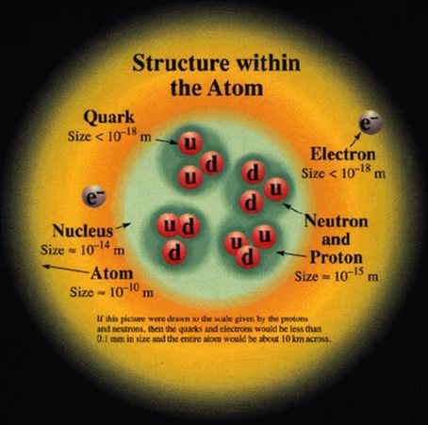
A little trivia about quarks (this is not required learning)
Protons and neutrons are NOT the fundamental particles of atoms.
Protons are made of two “up” quarks and one “down” quark.
Neutrons are made of one “up” quark and two “down” quarks.
Quarks are held together
by “gluons”

Slide 6
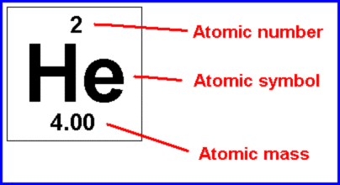
How to find # of protons, neutrons, and electrons in an atom
Atomic number = # of protons
Mass number = # of protons + neutrons

Slide 7
Mass Number vs. Atomic Mass
The atomic mass listed for an element on the periodic table is actually a weighted average of the masses of all the ISOTOPES of that element. (Isotopes are explained next.)
Mass number refers to the mass of a specific isotope of an element.

Slide 8
Atomic Structure
Mass Number:
# of Protons:
# of Neutrons:
# of electrons:
Ions: Charged particles
# of p⁺ ≠ # of e⁻
# of p⁺ and # of n⁰
What is the mass # of Arsenic with 42 n⁰?
33 p⁺ + 42 n⁰ = 75
Equal to the atomic #
Mass # - # p⁺ = # of n⁰
How many n⁰ does Ni-60 have?
60 amu – 28 p⁺ =32 n⁰
# of p⁺

Slide 9
What are Isotopes?
ISOTOPES are atoms of the same element with different numbers of neutrons.
Isotopes of an element have the same atomic number but different atomic masses.

Slide 10
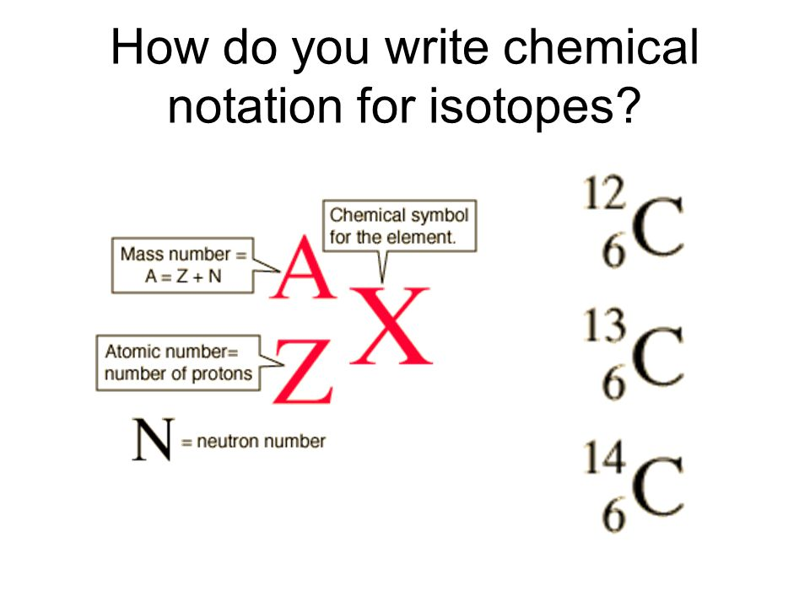
How to write isotopic symbols (carbon is used as example)

Slide 11
How to name isotopes (carbon used as example)
Carbon-12 or C-12
Carbon-13 or C-13
Carbon-14 or C-14

Slide 12
How to Use Isotopes to Find an Element’s Average Atomic Mass
1. Multiply each isotope's mass by its abundance (convert % abundance into decimal form first; for example, 82% would be 0.82 in decimal form). Do this for each isotope of the element.
2. Add together the products of the isotope masses and their abundances that you obtained in step one.

Slide 13
How Do We Use Isotopes to Find the Average Atomic Mass of an Element?
The equation looks like this:
(mass of isotope 1) (decimal abundance)
+ (mass of isotope 1) (decimal abundance)
+ (mass of each additional isotope) (decimal abundance)

Slide 14
Practice Problem
Vanadium is an element with two isotopes:
Vanadium-50 (mass = 49.9472 amu, 0.250%)
Vanadium-51 (mass = 50.9440 amu, 99.750%)
Find the average atomic mass of vanadium.

Slide 15
Practice Problem
Solution:
Average atomic mass =
(49.9472 amu)( 0.00250)
+ (50.9440 amu)(0.99750)
50.9415 amu

