Slide 1
Entropy and Spontaneity
Unit 8 (Goes with Chapter 16)

Slide 2
Entropy (symbol S): a measure of the disorder of a system.
For example, when a deck of playing cards is ordered by number and suit, they have a low entropy because they are highly organized.
When a deck of cards is thrown into the air and lands, it has a high entropy because it is now disorganized.

Slide 3
Why do we need to study entropy?
There are 3 Laws of Thermodynamics. So far you learned about the 1st Law, also known as the Law of Conservation of Energy, which states that energy cannot be created or destroyed in an isolated system.
This is the overarching idea behind our study of heat (q) and enthalpy (H) changes.

Slide 4
The other 2 Laws of Thermodynamics deal with entropy.
The 2nd Law of Thermodynamics states that the entropy of the universe is always increasing.

Slide 5
The 3rd Law of Thermodynamics states that the entropy of a system approaches zero as temperature approaches absolute zero (zero kelvins).

Slide 6
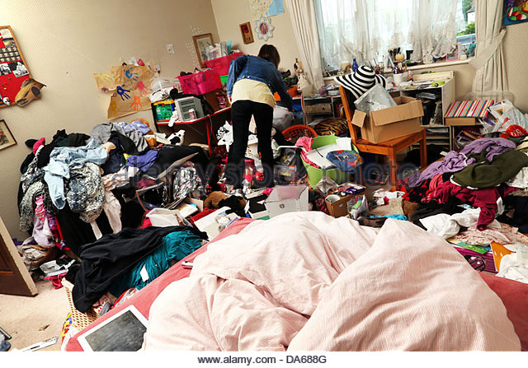
Law of Disorder: A system will spontaneously move in the direction of higher entropy (meaning increased disorder or randomness).
Thus, having a
messy bedroom
means that not
only are you a slob,
you are also a law-
abiding citizen. ☺

Slide 7
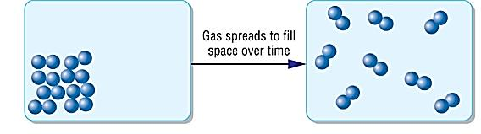
Here are 6 changes to a system that result in increased entropy:
1.) Endothermic phase changes
solid to liquid
liquid to gas
solid to gas (this is called sublimation)
Compare the relative kinetic energy and randomness of the particles before and after a change of state to predict Δ entropy.

Slide 8
2.) An increase in number of particles
Example:
    Decomposition reactions, where one reactant forms 2 or more products.
    H₂CO₃ → H₂O + CO₂

Slide 9
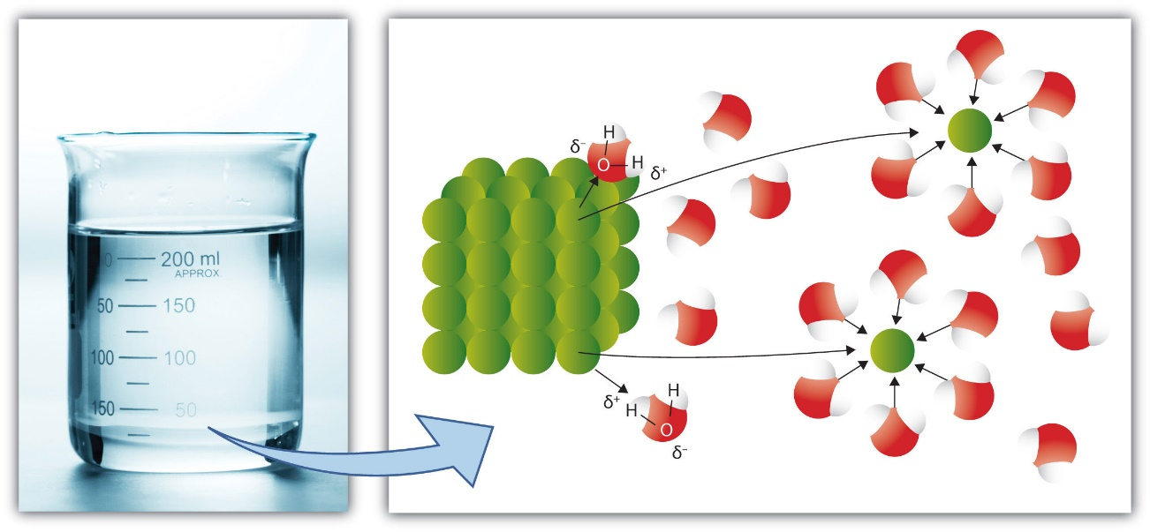
3.) Dissolving a pure substance
(This increases the positional entropy of the dissolved particles AND decreases the order of both the solvent and solute particles)

Slide 10
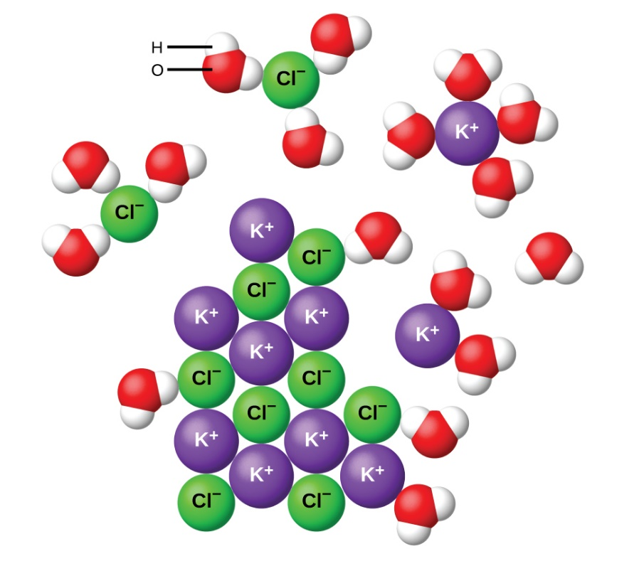
Dissolving an electrolyte also increases entropy by increasing the number of individual particles when the ions separate.
Example: KCl (s) → K⁺(aq) + Cl⁻ (aq)
  (One particle of KCl produces two particles of ions
  in solution)

Slide 11
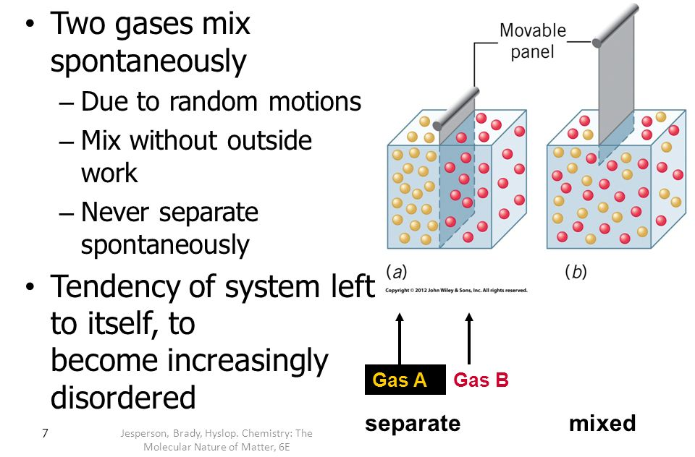
4.) Creating a mixture using two or more pure substances

Slide 12
5.) Increasing the number of moles of gas.
For example, in this rxn the number of moles of gas increases from 3 moles to 5 moles.
2SO_{3(g)} + CO_{2(g)} → CS_{2(g)} + 4O_{2(g)}
3 moles of gas
5 moles of gas

Slide 13
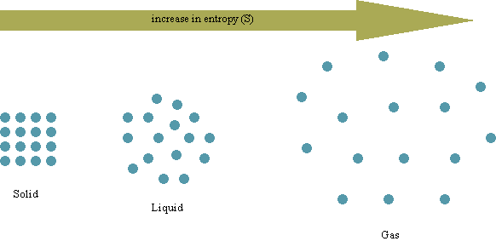
6.) Increasing the temperature
  When KE of particles increases, their rate of random motion increases
  This may also lead to changes of state

Slide 14
How to interpret changes in entropy ( ΔS ):
+ ΔS = increase in entropy
- ΔS = decrease in entropy

Slide 15
Does entropy (S) increase or decrease?
a. ClF _{(g)} + F_{2 (g)} → ClF_{3 (g)}
b. NH_{3 (g)} → NH_{3 (aq)}
c. CH₃OH _{(l)} → CH₃OH _{(aq)}
d. C₁₀H_{8 (l)} → C₁₀H_{8 (s)}
e. FeS _{(s)} → Fe²⁺_{(aq)} + S²⁻_{(aq)}
f. SO_{2 (g)} + H₂O _{(l)} → H₂SO_{3 (aq)}
Factors that increase entropy:
T increases
s → l → g
# of particles increases
Mixing pure substances
# of moles of gas increases

Slide 16
Does entropy (S) increase or decrease?
a. ClF _{(g)} + F_{2 (g)} → ClF_{3 (g)} ↓
b. NH_{3 (g)} → NH_{3 (aq)} ↑ ↓
c. CH₃OH _{(l)} → CH₃OH _{(aq)} ↑
d. C₁₀H_{8 (l)} → C₁₀H_{8 (s)} ↓
e. FeS _{(s)} → Fe²⁺_{(aq)} + S²⁻_{(aq)} ↑
f. SO_{2 (g)} + H₂O _{(l)} → H₂SO_{3 (aq)} ↓

Slide 17
Comparing Entropy Values between Substances in the Same State
Entropy increases as freedom of motion within a substance increases.
For two substances in the same state, the larger molecule has a greater # of possible rotations of its atoms, so it has a higher entropy value.

Slide 18
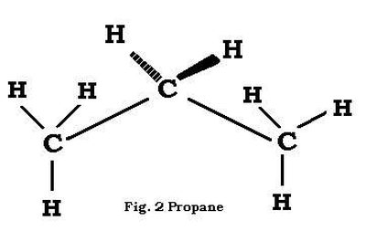

Comparing Entropy Values between Substances in the Same State
Example: When comparing Cl₂ (g) and C₃H₈ (g), propane has more atoms and thus more positional entropy.

Slide 19
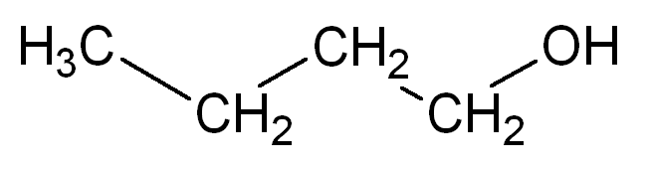
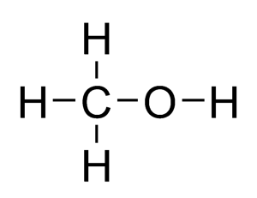
Which liquid has greater entropy, butanol or methanol?

Slide 20
Which liquid has greater entropy, butanol (l) or methanol (l)?
Answer: butanol has more atoms, thus greater entropy.

Slide 21
Spontaneous Processes
A spontaneous process is a change that occurs with no outside intervention.
If ΔS for both a system AND its surroundings is positive (ΔS_{universe} > 0), the reaction will ALWAYS be spontaneous. For example, combustion reactions have positive ΔS values for both the system and surroundings.
If ΔS_{sys} and ΔS_{surr} are NOT both positive, factors like ΔH and temperature will also affect spontaneity of a reaction.

Slide 22
Predicting Spontaneity
 | -ΔH_{sys} | +ΔH_{sys}
+ΔS_{sys} | always spontaneous | spontaneous at HIGH temps
-ΔS_{sys} | spontaneous at LOW temps | never spontaneous

