Slide 1
Chemical Naming Rules
Chapter 7

Slide 2
I. Metals and Nonmetals
Metals:
  Left of the stair-step line
  Cations
  Properties:
    Shiny luster
    Conduct heat and electricity
    Ductile (forms wires) and malleable (can be flattened)
    Give away e- to become more stable

Slide 3
I. Metals and Nonmetals
Nonmetals:
  Right of Stair-Step Line
  Anions
  Properties:
    Dull Luster
    Good Insulator / Poor conductors
    Brittle
    Tend to gain e- to become more stable

Slide 4
I. Metals and Nonmetals
Metaloids:
  Elements that touch the Stair-Step Line
  Have some metal and some nonmetal properties
  B, Si, Ge, As, Sb, Te, At

Slide 5
Chemical Formulas
Used to indicate the composition of a compound or ion

Slide 6
II. Naming Ionic Compounds
Made from groups of atoms with a charge called an “oxidation number”
1. monoatomic ions- one atom with a charge
H⁺, Cl⁻, Na⁺, Sr⁺², S⁻²
2. polyatomic ions-(see back of Periodic Table)
Ammonium (NH₄)⁺¹
Hydroxide (OH)⁻¹
Carbonate (CO₃)⁻²
Sulfate (SO₄)⁻²
Phosphate (PO₄)⁻³
Nitrate (NO₃)⁻¹
Nitrite (NO₂)⁻¹

Slide 7
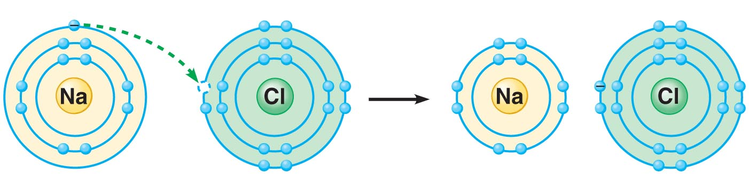
How Do Ionic Bonds Form? Na & Cl
+1
-1

Slide 8
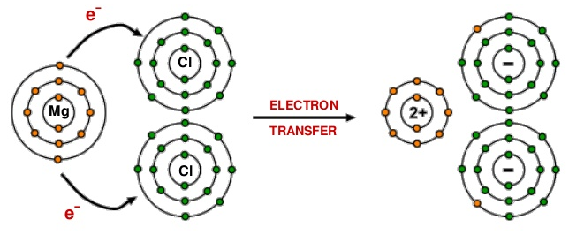
Example of Ionic Bonding: Mg & Cl

Slide 9
II. Naming Ionic Compounds
(+) metal ion attracts (-) nonmetal ion
Cation Anion
Compounds are formed which have no charge
  Naming Binary Compounds:
    cation anion-”ide”

Slide 10
II. Naming Ionic Compounds
If Group I or Group II Metal & Nonmetal
  Na Cl
  Na₂O
  Ca₃P₂
Sodium chloride
Sodium oxide
Calcium phosphide

Slide 11
II. Naming Ionic Compounds
Non-Group I or Group II Metals & Nonmetals
  Most of these metals have more than 1 oxidation number
  You need to indicate which one it is
    Use Roman Numerals to show the charge on the metal ion
    cation (Roman Numeral) anion-”ide”

Slide 12
II. Naming Ionic Compounds
FeCl₃
FeCl₂
AuBr₃
Cr₂O₃
V₃P₂
Iron(III) chloride
Iron(II) chloride
Gold(III) bromide
Chromium(III) oxide
Vanadium(II) phosphide

Slide 13
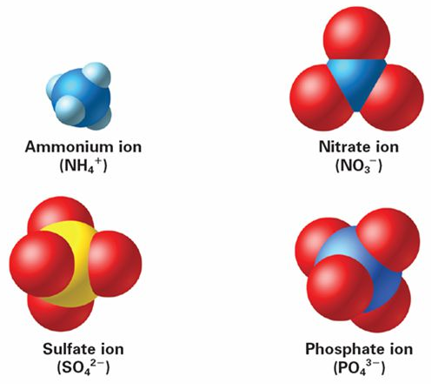
II. Naming Ionic Compounds
Compounds with
Polyatomic Ions

Slide 14
II. Naming Ionic Compounds
Compounds with Polyatomic Ions
  Polyatomic ion may be substituted for metal or nonmetal
  Never ever change ending of polyatomic ion
    Li₂SO₄
    Sc(NO₃)₃
    (NH₄)₂S
    NH₄(OH)
    lithium sulfate
    Scandium(III) nitrate
    Ammonium sulfide
    Ammonium hydroxide

Slide 15
Good Morning.
Caddy your phones, take out your Ionic Naming Activity, and open your workbook to page 65.
  Name the following:
        BaCl₂
        MoBr₆
        V₂(CO₃)₅
  Today we learn how to name molecules.

Slide 16
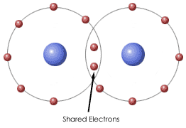
III. Naming Molecular Compounds
Two NONMETAL atoms will SHARE electrons, a COVALENT BOND forms between them.
Notes:
Gilbert Lewis, UC Berkeley, gave us shared e- pairs (1916), covalent bond (1939), valence bond theory, and dot structures.

Slide 17
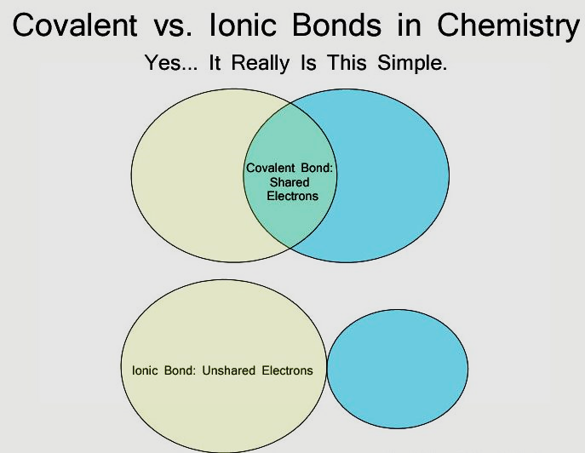
III. Naming Molecular Compounds

Slide 18
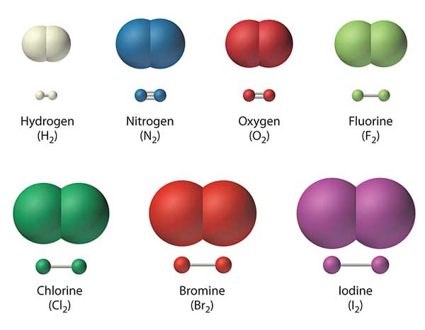
III. Naming Molecular Compounds
Groups of atoms with no charge
monoatomic – “1” atom not a molecule
  know: He, Ne, Ar, Kr, Xe, Rn
diatomic – "2” of same atom per molecule
  know: Br₂, I₂, N₂, Cl₂, H₂, O₂, F₂
(Br₂I₂N₂Cl₂H₂O₂F₂)
polyatomic - "many" atoms per molecule
  ex) H₂0, S₈, P₄, C₂H₆

Slide 19
III. Naming Binary Molecular Compounds
Nonmetal bonded to a Nonmetal
  Order of appearance – C, P, N, H, S, I, Br, Cl, O, F
2nd element name ends in “ide”
Three common nitrogen oxides – NO, NO₂, N₂O
Use Greek prefixes to indicate the number of each element
Drop the “a” or “o” at the end of a prefix when combined with oxygen
Prefixes
    1 – mono (omit mono on 1st element)
    2 – di 3 – tri
    4 – tetra 5 – penta
    6 – hexa 7 – hepta
    8 – octa 9 – nona
    10 - deca

Slide 20
III. Naming Molecular Compounds
Greek prefix-element Greek prefix-element-ide
  N₂I₃
  CO
  P₂O₅
  OF₆
  Dinitrogen triiodide
  monoCarbon monooxide
(mono is omitted)
  Diphosphorus pentaoxide
  Oxygen hexafluoride

Slide 21
Other Formulas to Know
Acids - source of H⁺ ion in water.
Know:
HCl Hydrochloric acid
HNO₃ Nitric acid
H₂SO₄ Sulfuric acid
H₃PO₄ Phosphoric acid
H₂CO₃ Carbonic acid
HC₂H₃O₂ Acetic acid
Others to Know:
CH₄ Methane S₈ Sulfur
NH₃ Ammonia P₄ Phosphorus

Slide 22
IV. Lewis Dot Structures
Can be used to show chemical bonding
Based on the Octet Rule—the rule of eight
Valence electrons are responsible for chemical bonding
  The outer most energy level electrons
  Atoms want to be stable like the Noble Gases (have the same # of e-)
    Atoms will gain, lose, or share e- to make this happen
    Gaining/losing e- cause ions and thus ionic bonding
    Sharing e- cause molecules to form and thus covalent bonding

Slide 23
IV. Lewis Dot Structures
B. Elements
  The location of the elements in the Periodic Table indicates the atoms # of valence e-
  Neon
Carbon
Nitrogen

Slide 24
IV. Lewis Dot Structures
C. Ionic Compounds (Salts)
  Ionic bonds form when e- are gained or lost
  Sodium + Sulfur → Sodium sulfide
  Strontium + Phosphorous → Strontium phosphide

Slide 25
IV. Lewis Dot Structures
D. Molecules
  Covalent bonds form when e- pairs are shared between non-metals
  Coordinate covalent bond - when one atom provides both e- in the bond
  Sulfur dichloride
Ozone

Slide 26
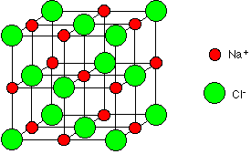
Ionic Compound Structure
Ionic compounds do not exist as individual formula units --- NaCl
MANY formula units come together in a repeating pattern to minimizes repulsion between like-charged ions.
The result is a CRYSTAL LATTICE .

Slide 27
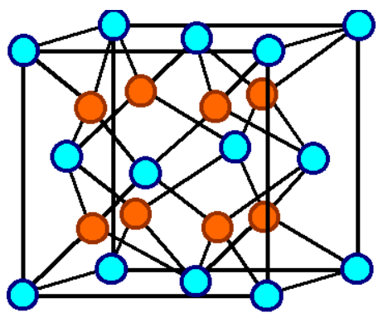
Ionic Compound Structure
MgCl₂

Slide 28
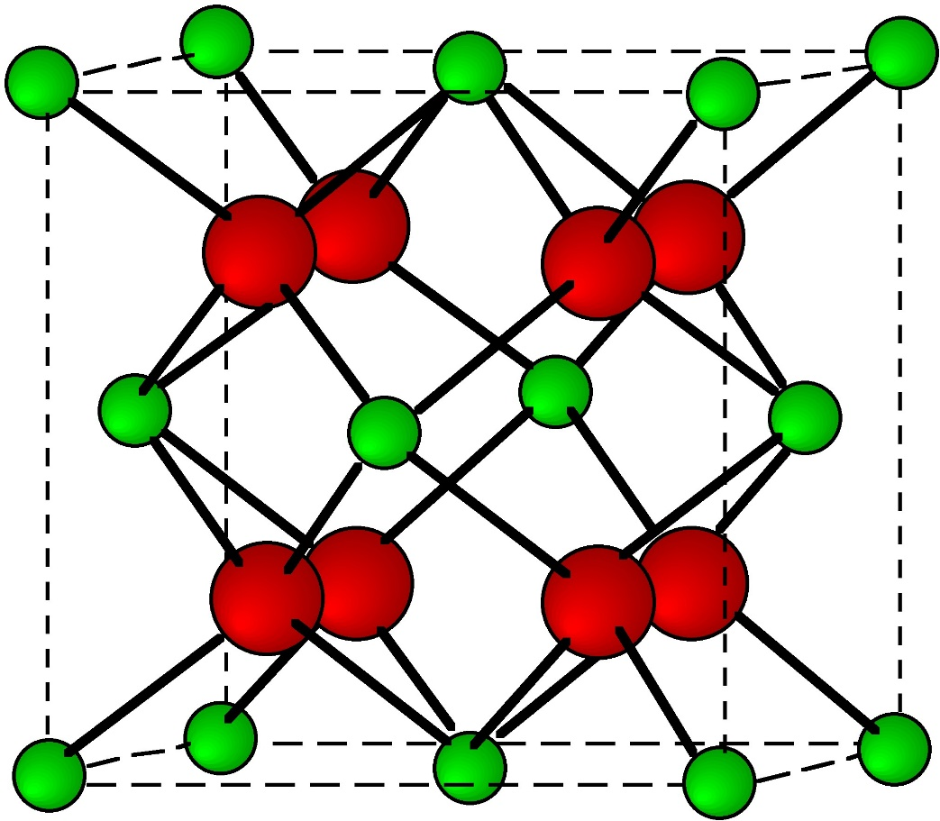
Ionic Compound Structure
AlCl₃

Slide 29
Ionic Compound Structure
Crystal lattices are held together by ionic bonds.
Lattice energy is the energy needed to break those bonds --- forming a gas
Video: 4 min

Slide 30
Ionic Compound Structure
Lattice energy depends on the sizes of the ions and their charges.
Lattice energy increases with…
  Decreasing ion size
  Increasing + or - ionic charge

Slide 31
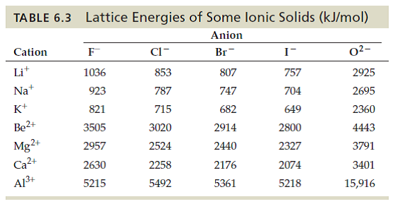
Ionic Compound Structure

Slide 32
Properties of Ionic Compounds
They are solids with very high MP and BP --- showing very strong bonds
They are rigid and brittle
Cannot conduct electricity until dissolved in water
  Solvating salts breaks them into ions
  Ions are free move and carry charges thru soln.

Slide 33
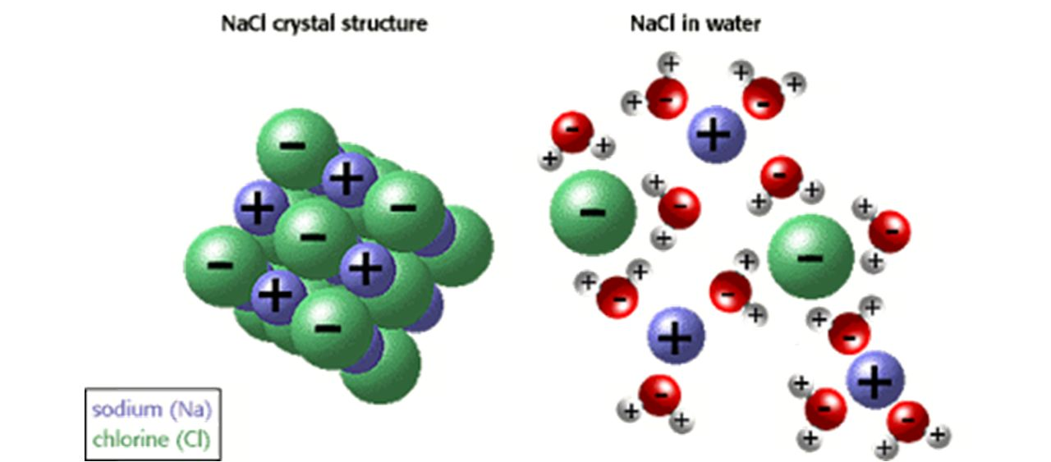
Solvation of a Salt

Slide 34
Properties of Molecular Compounds
They are solids, liquids, and gases with low MP and BP --- showing weak intermolecular forces
They are poor conductors of heat and electricity
  Do not form ions

Slide 35
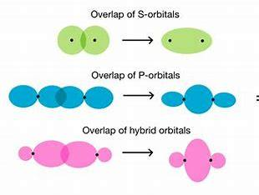
Single Covalent Bond – Sigma Bond

Slide 36
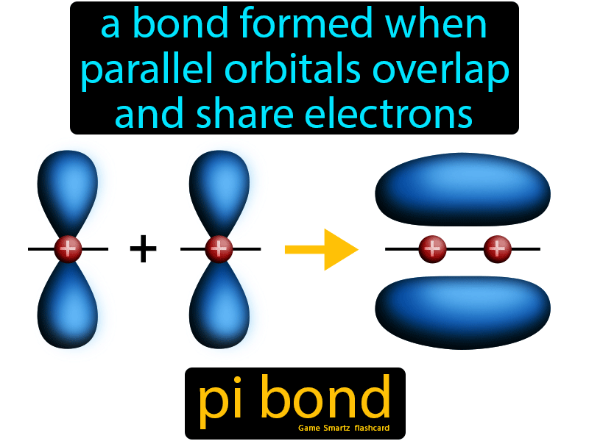
Double and Triple Covalent Bonds – Pi Bonds

Slide 37
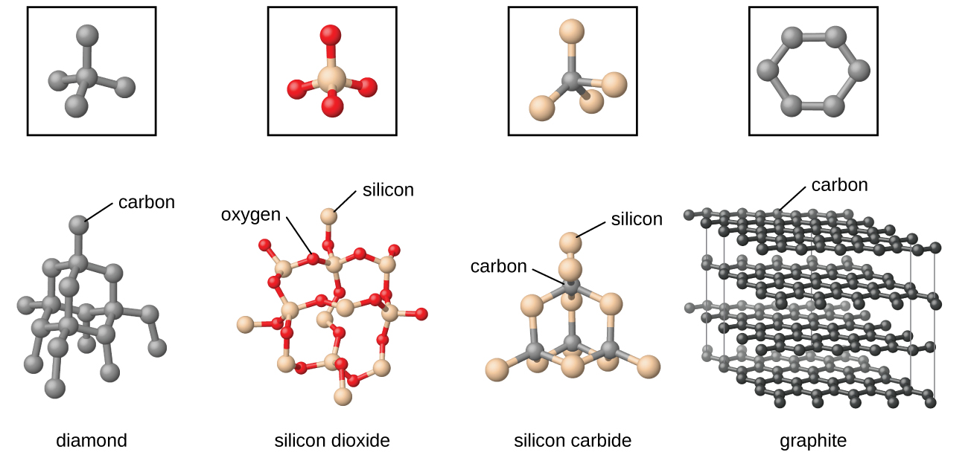
Covalent Network Solids
7min video

Slide 38
Molecular Shapes
The shape of the molecule effects how it reacts with other molecules
VSEPR – Valence Shell Electron Pair Repulsion predicts shape of molecule
e- pairs repel each other and result in fixed bond angles
Lone Pair e- occupy more space and push Shared Pairs a bit closer together

Slide 39
Molecular Shapes
Hybrid Orbitals form to account for molecular shapes
Valence orbitals blend to form new bonding and non-bonding sites
An s and p-orbital forms an sp hybrid-orbital → give 2 bond sites
An s and 3 p-orbitals form 4 sp³hybrid-orbitals → give 4 bond sites
An s, 3 p, and a d-orbital form 5 sp³d hybrid-orbitals → give 5 bond sites

Slide 40
Molecular Shapes
Atoms in the 3rd period and above can have an expanded octet
The d-orbital provides a space for 10 and 12 valence e-
VSEPR Intro
XeF₄

Slide 41
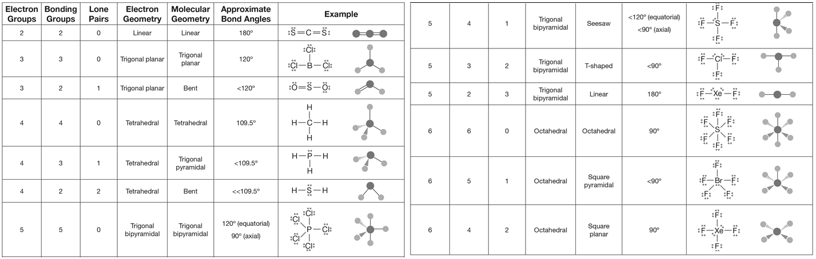
Molecular Shapes

