Slide 1
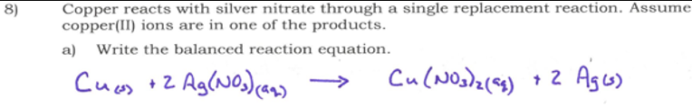
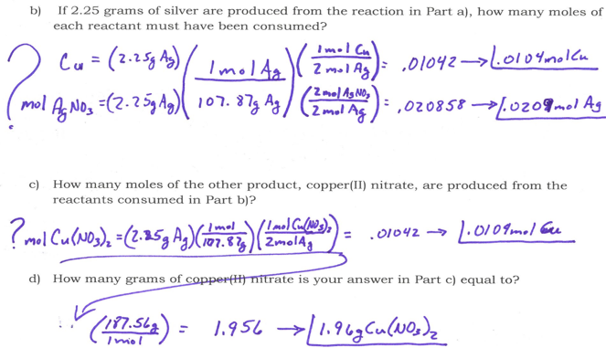

Slide 2
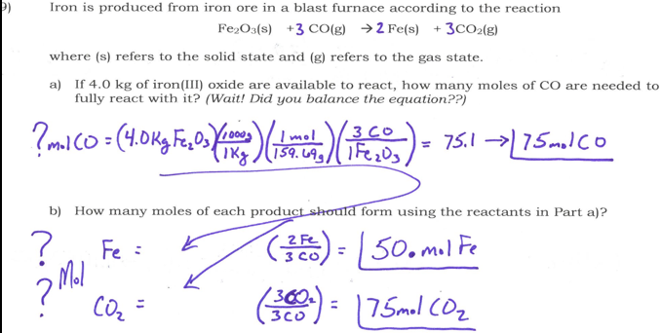

Slide 3
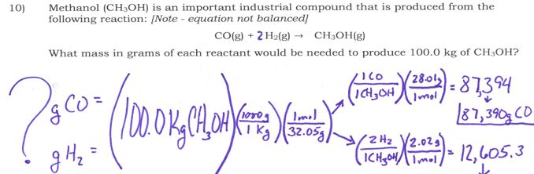

Slide 4
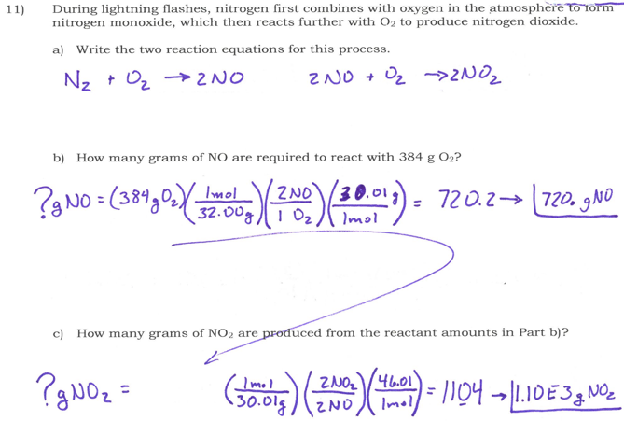

Slide 5
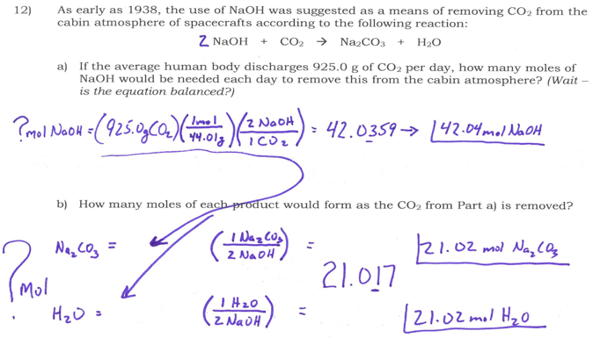

Slide 6
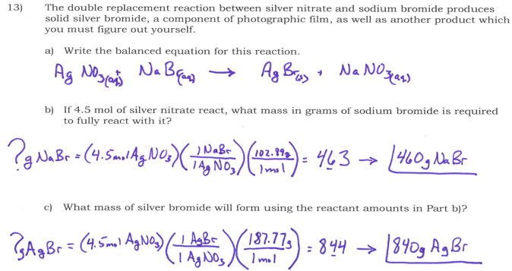

Slide 7
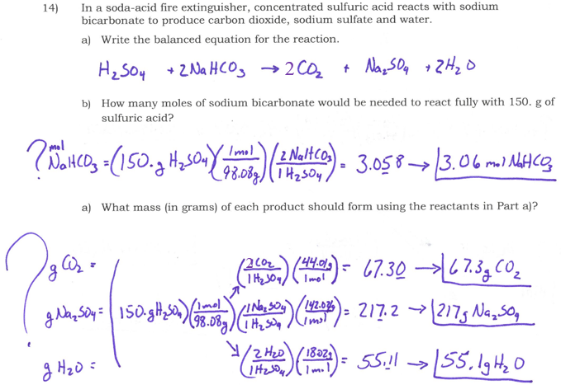

Slide 8
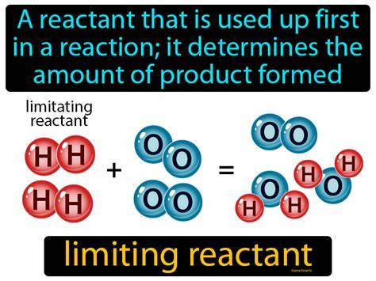
Limiting & Excess Reactants
When you have a chemical reaction of 2 or more reactants, you will have one all used up and the others with some left over.
              The one used up is called the Limiting Reactant.
              The ones left over are called Excess Reactants.

Slide 9
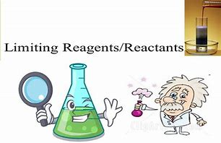
Limiting & Excess Reactants
To determine limiting reactant you will need to calculate the amount of product each quantity of reactant can make.
The one that makes the least is the limiting reactant.
The rest are in excess.
To calculate the excess, find the amount used by the limiting reactant and subtract it from the starting amount.

Slide 10
Limiting & Excess Reactants
Ex 1/ How many sandwiches can you make with 20 Br, 40 Hm, and 15 Ch if you use the following equation to make a sandwich?
          2Br + 3Hm + 1 Ch → 1 Br₂Hm₃Ch
  ?Br₂Hm₃Ch=(20 Br) ( 1 Br₂Hm₃Ch / 2 Br ) =10 Br₂Hm₃Ch
  ?Br₂Hm₃Ch=(40 Hm)(1 Br₂Hm₃Ch / 3 Hm)=13.3 Br₂Hm₃Ch
  ? Br₂Hm₃Ch=(15 Ch )( 1 Br₂Hm₃Ch / 1 Ch )= 15 Br₂Hm₃Ch
Br makes the fewest sandwiches and is the Limiting Reactant.

Slide 11
Limiting & Excess Reactants
Ex 1/ How many sandwiches can you make with 20 Br, 40 Hm, and 10 Ch₂ if you use the following equation to make a sandwich?
          4Br + 6Hm + 1 Ch₂ → 2 Br₂Hm₃Ch
  ?Br₂Hm₃Ch=(20 Br) ( 2 Br₂Hm₃Ch / 4 Br ) =10 Br₂Hm₃Ch
  ?Br₂Hm₃Ch=(40 Hm)(2 Br₂Hm₃Ch / 6 Hm)=13.3 Br₂Hm₃Ch
  ? Br₂Hm₃Ch=(10 Ch₂ )( 2 Br₂Hm₃Ch / 1 Ch₂ )= 20 Br₂Hm₃Ch
Br makes the fewest sandwiches and is the Limiting Reactant.

Slide 12
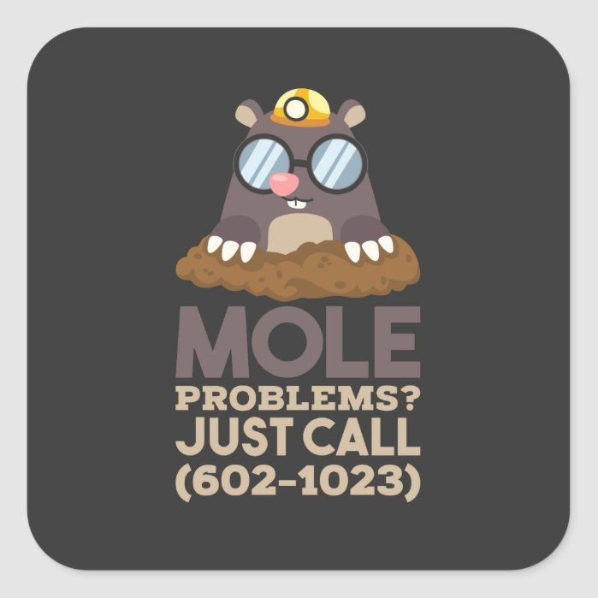
Limiting & Excess Reactants
How much of the other reactants are left over?
? Hm used = ( 20 Br ) ( 6 Hm / 4 Br ) = 30 Hm used
40 Hm to start – 30 Hm used = 10 Hm left over
? Ch₂ used =(20Br) (1 Ch₂ / 4 Br) = 5 Ch₂ used
10 Ch₂ to start – 5 Ch₂ used = 5 Ch₂ left over

Slide 13
Limiting & Excess Reactants
How much of the other reactants are left over?
? Hm used = ( 20 Br ) ( 6 Hm / 4 Br ) = 30 Hm used
40 Hm to start – 30 Hm used = 10 Hm left over
? Ch used=(20Br)(1 Ch₂ / 4 Br)( 2 Ch /1 Ch₂) = 10 Ch used
15 Ch to start – 10 Ch used = 5 Ch left over

Slide 14
Limiting & Excess Reactants
Ex2/ Sand (silicon dioxide) is usually quite unreactive but reacts readily with hydrogen fluoride in a double replacement reaction.
SiO_{2 (s)} + HF _{(g)} → SiF_{4 (g)} + H₂0 _{(l)}
If 5.0 moles of HF are exposed to 2.0 moles of SiO₂, which is limiting?
? SiF₄ = ( 5.0mol HF ) (1 SiF₄ / 4 HF ) = 1.25mol SiF₄
? SiF₄ = ( 2.0mol SiO₂ ) ( 1 SiF₄ / 1 SiO₂ ) = 2.0mol SiF₄
1
4
1
2

Slide 15
Limiting & Excess Reactants
HF is the Limiting Reactant b/c it made the least amount of product.
How much excess SiO₂ is there?
? SiO₂ used =(5.0mol HF)(1SiO₂/4 HF) = 1.25mol SiO₂ used
2.0mol SiO₂ to start–1.25mol SiO₂ used = .75mol SiO₂ excess

Slide 16
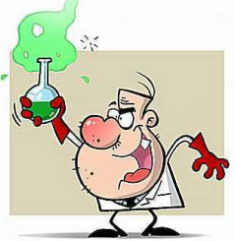
Limiting & Excess Reactants
Ex 3/ Sulfuric acid reacts with lithium hydroxide in a double replacement reaction.
H₂SO_{4 (aq)} + LiOH _{(aq)} → HOH _{(l)} + Li₂SO₄ _{(aq)}
If 30.0g of H₂SO₄ react with 25.0g LiOH, what is the limiting reactant?
2
2

Slide 17
Limiting & Excess Reactants
2
2
H₂SO_{4 (aq)} + LiOH _{(aq)} → HOH _{(l)} + Li₂SO₄ _{(aq)}
If 30.0g of H₂SO₄ react with 25.0g LiOH, what is the limiting reactant?
?mol HOH=(30.0g H₂SO₄)(1mol/98.08g)(2 HOH/1 H₂SO₄)
= .612mol HOH
?mol HOH=(25.0g LiOH)(1mol/23.95g)(2HOH/2 LiOH)
or… = 1.04mol HOH

Slide 18
Limiting & Excess Reactants
2
2
H₂SO_{4 (aq)} + LiOH _{(aq)} → HOH _{(l)} + Li₂SO₄ _{(aq)}
If 30.0g of H₂SO₄ react with 25.0g LiOH, what is the limiting reactant?
What is the mass of the excess reactant remaining?
? LiOH used=(30.0g H₂SO₄)(1mol/98.08g)(2LiOH/1 H₂SO₄)(23.95g/1mol)
= 14.66 LiOH used from 25.0g at the start…
10.3g LiOH in excess

Slide 19
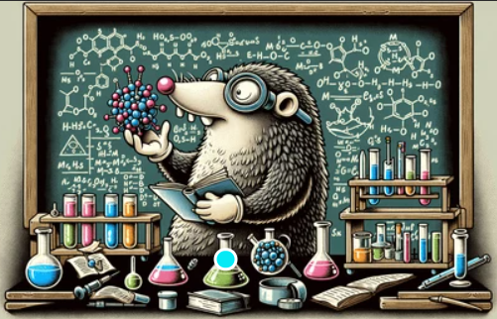
Good Morning
Please caddy your phones and get ready for our Limiting ReactantsLab.

Slide 20
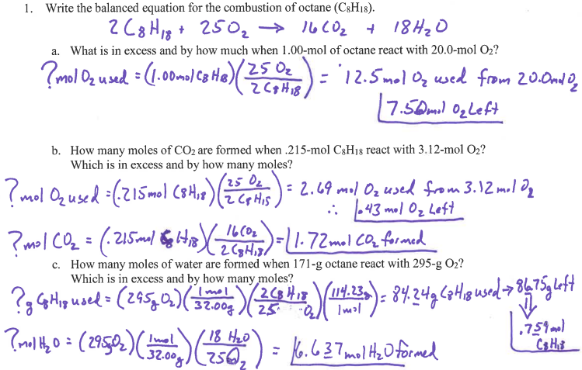
Limiting & Excess Reactants

Slide 21
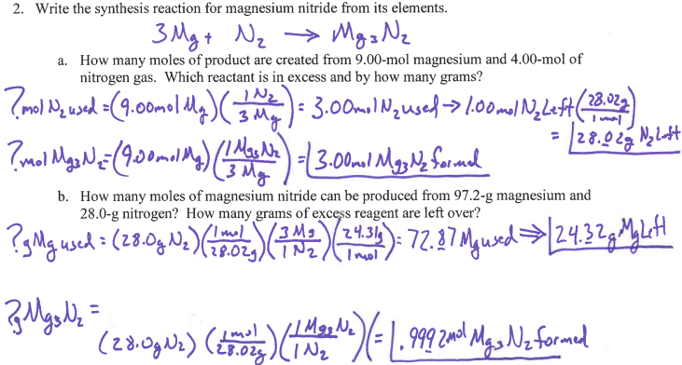
Limiting & Excess Reactants

Slide 22
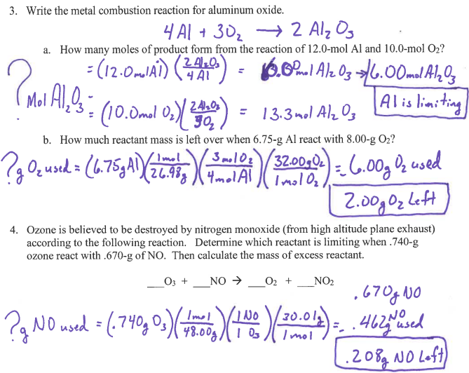
Limiting & Excess Reactants

Slide 23
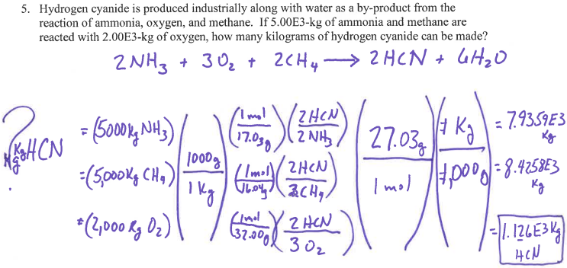
Limiting & Excess Reactants

Slide 24
Limiting & Excess Reactants
Copper(II) chloride reacts with sodium nitrate:
CuCl₂ + NaNO₃ → Cu(NO₃)₂ + NaCl
What is the theoretical yield, in grams, of sodium chloride when 15.0-g of copper (II) chloride reacts with 20.0-g of
sodium nitrate?
What is the limiting reactant?
How many grams of copper (II) nitrate could form?
How much mass of our excess reagent is left over?
2
2
13.03-g or 13.75-g
13.0-g from 15.0-g CuCl₂
20.92-g or 22.06-g
20.0-g - 18.96-g = 1.03-g excess NaNO₃

Slide 25
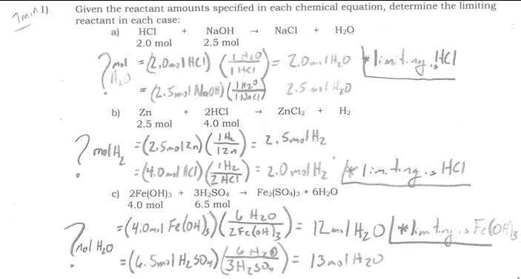
Limiting & Excess Reactants

Slide 26
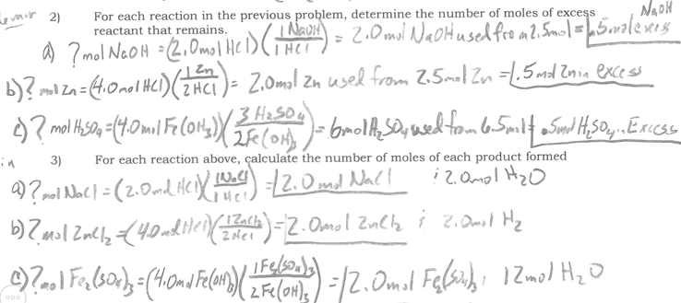
Limiting & Excess Reactants

Slide 27
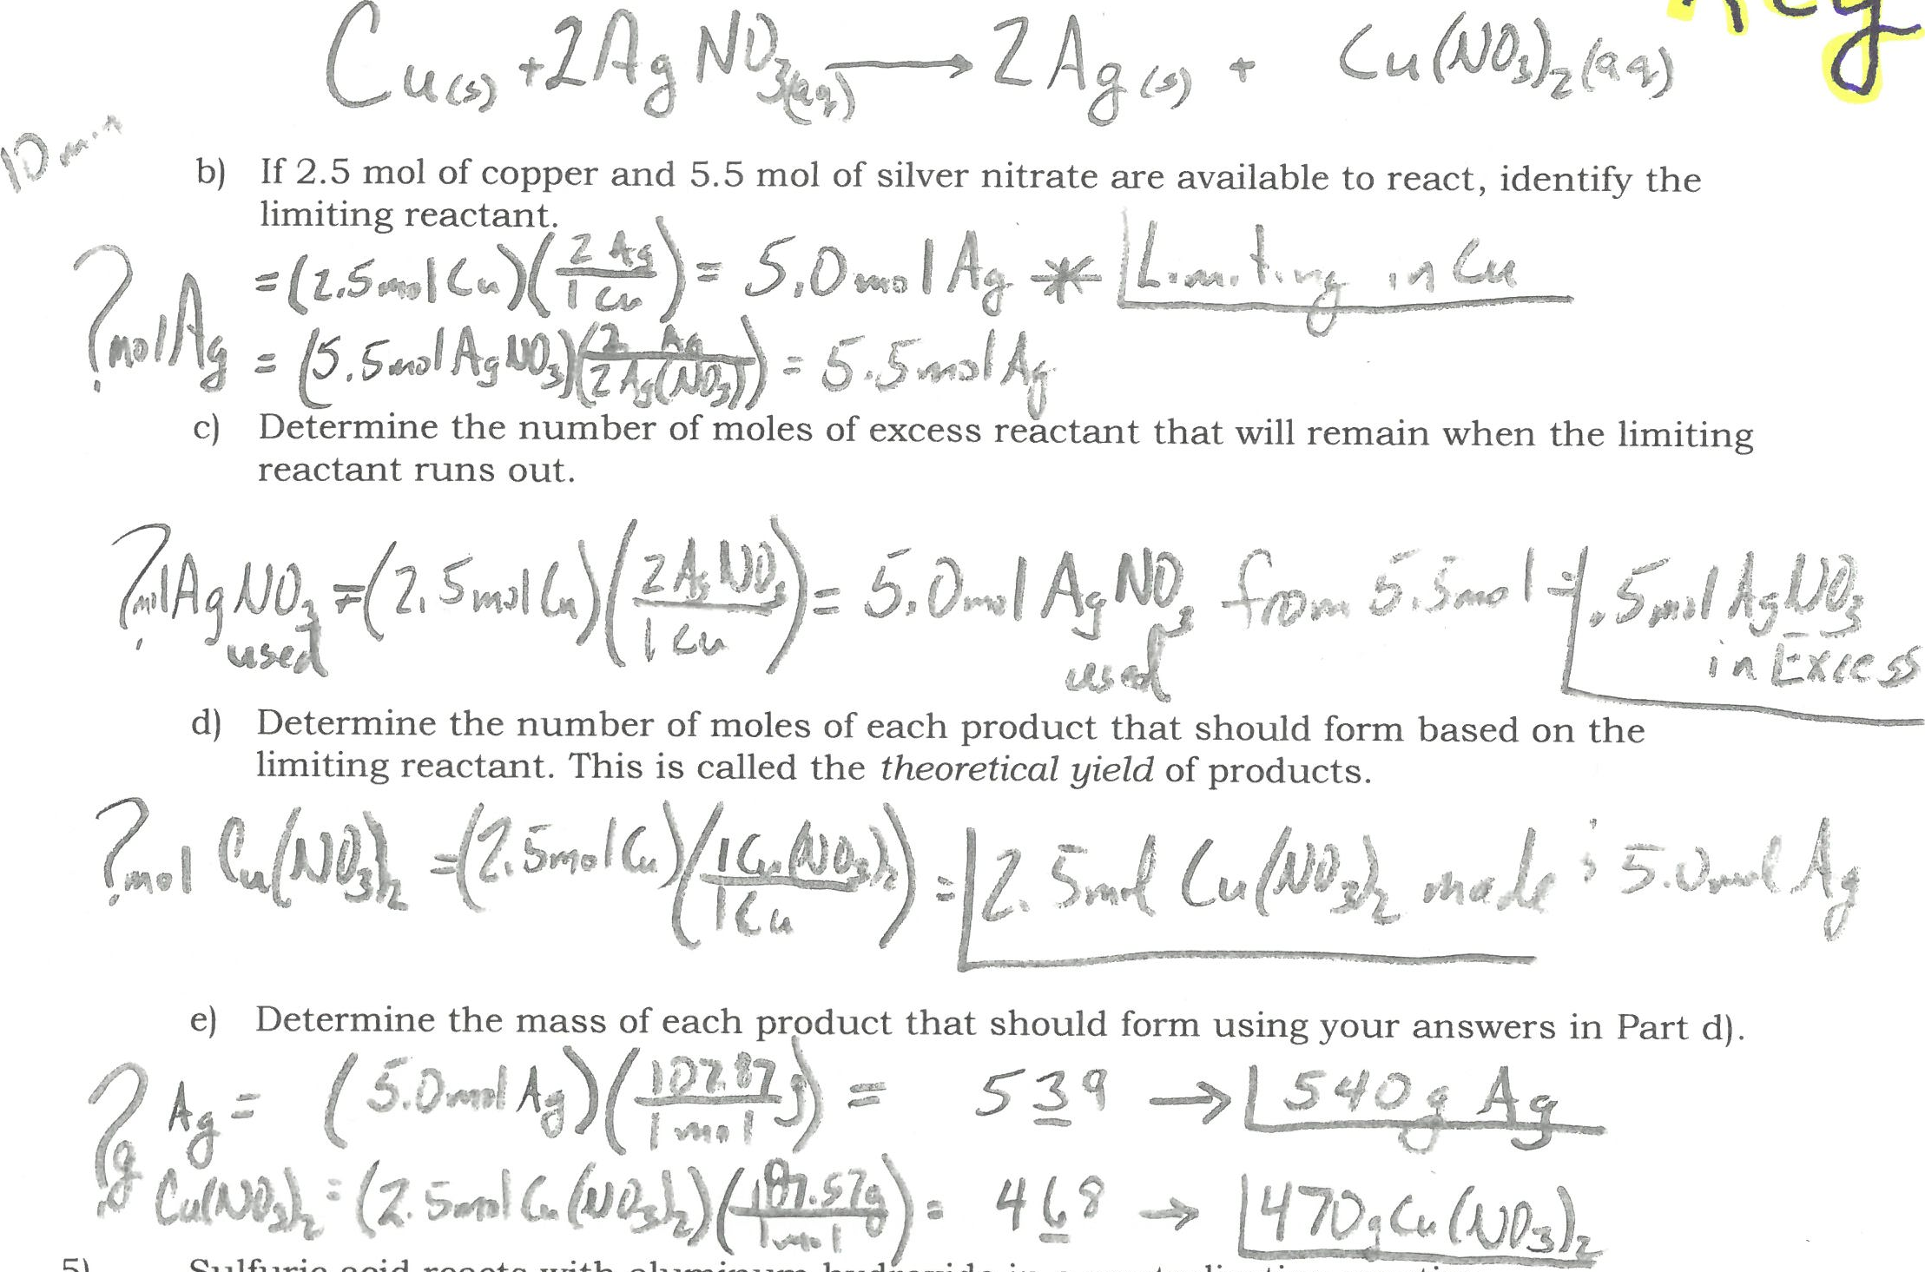
Limiting & Excess Reactants

Slide 28
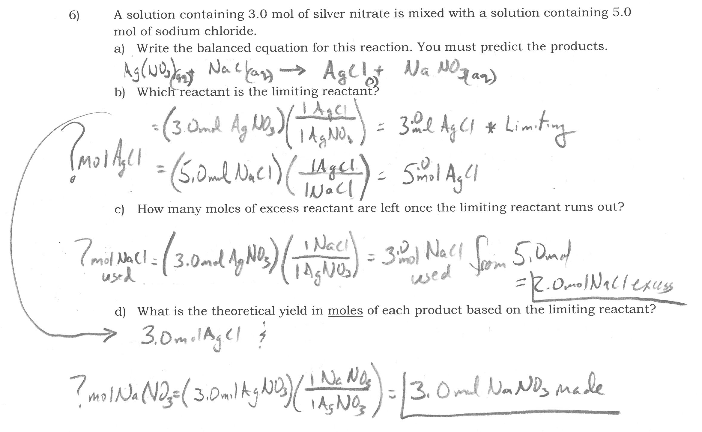
Thermochemistry

Slide 29
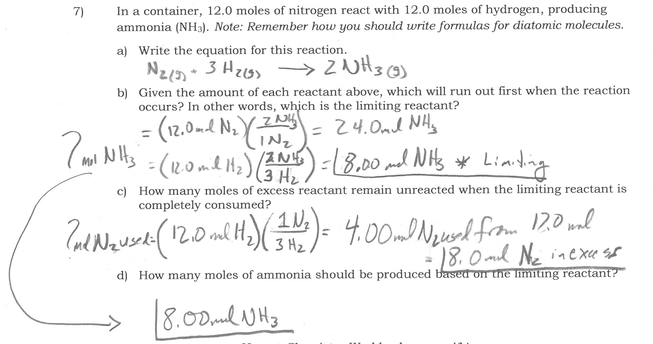
Thermochemistry

Slide 30
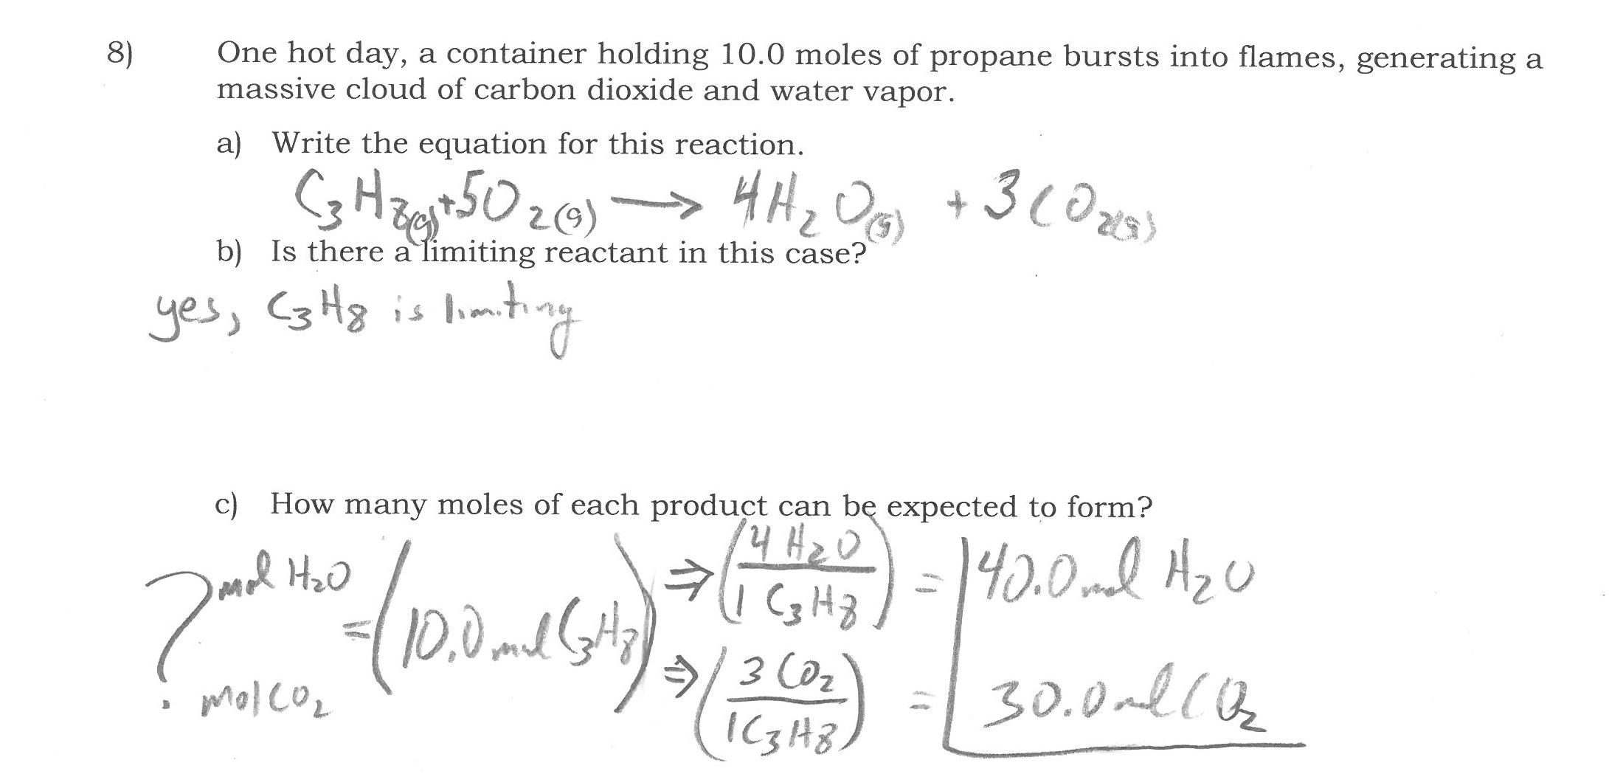
Thermochemistry

Slide 31
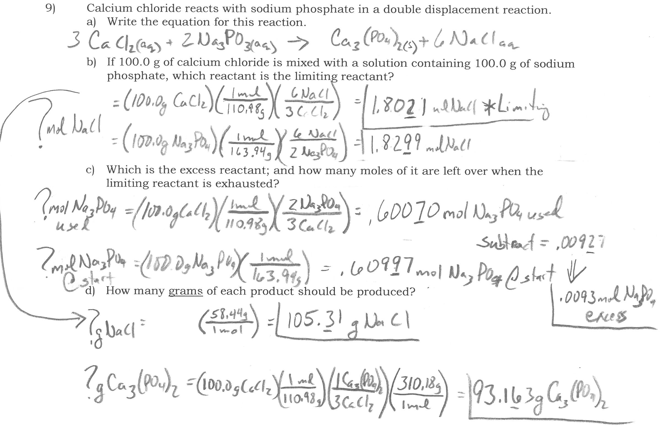
Thermochemistry

Slide 32
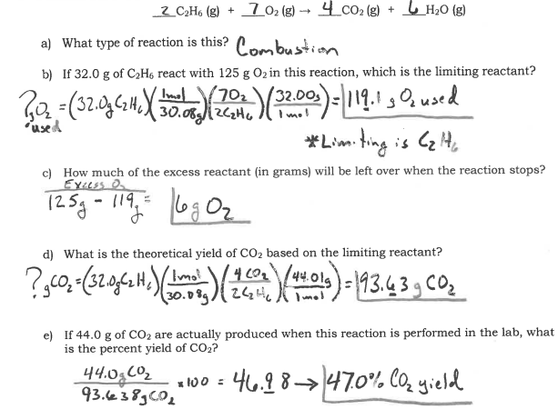

Slide 33
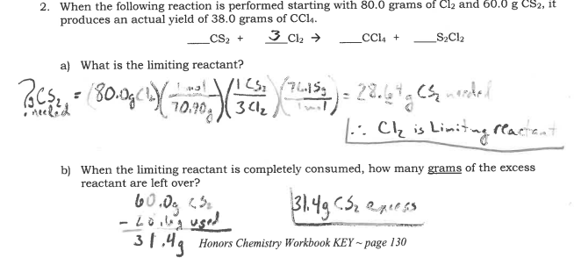
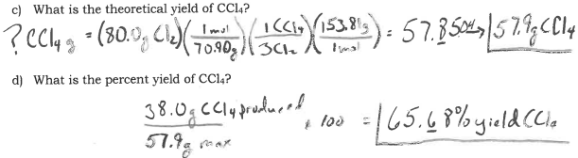

Slide 34
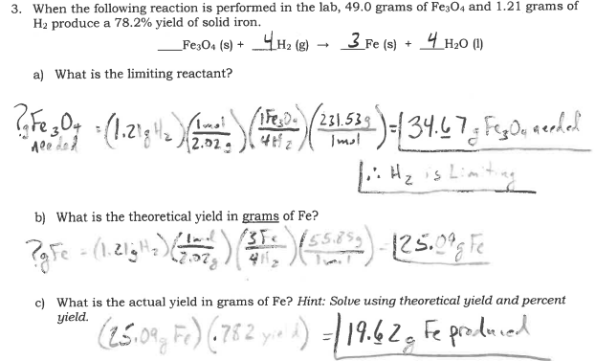

Slide 35
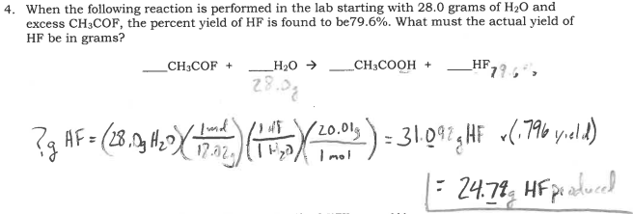

Slide 36
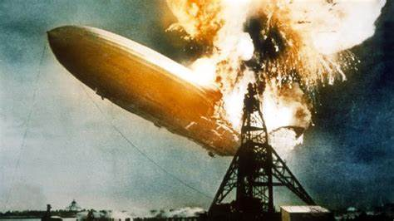
Thermochemistry
Thermochemistry is the study of heat change in chemical reactions.
2H₂ (g) + O₂ (g) → 2H₂O (g) + energy

Slide 37
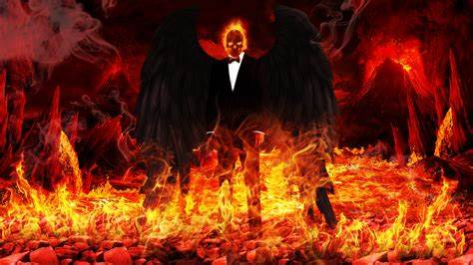
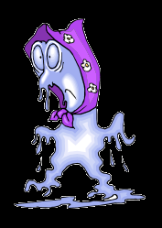
Thermochemistry
Exothermic process is any process that gives off heat – transfers thermal energy from the system to the surroundings.
2H₂ (g) + O₂ (g) → 2H₂O (g) + energy
H₂O (g) → H₂O (l) + energy
Endothermic process is any process in which heat has to be supplied to the system from the surroundings.
energy + 2HgO (s) → 2Hg (l) + O₂ (g)
energy + H₂O (s) → H₂O (l)

Slide 38

Thermochemistry
Enthalpy (H) is used to quantify the heat flow into or out of a system in a process that occurs at constant pressure.
If ΔH is positive – heat is absorbed by the system
If ΔH is negative – heat is released by the system
energy + H₂O (s) → H₂O (l)
ΔH = 6.01 kJ
H₂O (l) → energy + H₂O (s)
ΔH = -6.01 kJ

Slide 39
Thermochemistry
Gatorade has 34.0 grams of sugar (we will assume a monosacharide, C₆H₁₂O₆) in its 20 ounce drink. How much energy would you expect to get from this sports drink?
C₆H₁₂O₆ (s) + O₂ (g) → CO₂ (g) + H₂O (l)
ΔH = -2,801 kJ
?kJ =(34.0g C₆H₁₂O₆)
1Cal = 4.184KJ
6
6
6
(1mol/180.18g)
(-2,801kJ/1mol C₆H₁₂O₆)
= (-529kJ)

Slide 40
Thermochemistry
Methyhyldrazine (CH₆N₂) is a liquid fuel that burns to give off the thermal energy needed to launch a rocket.
CH₆N₂ + O₂ → CO₂ + N₂ + H₂O + 1,305kJ
How much energy could be produced if 12.5kg of CH₆N₂ are burned? ΔH = -1,305kJ
?kJ=(12.5kg CH₆N₂)
2
5
2
2
6
(1,000g/1kg)
(1mol/46.07g)
(-1,305kJ/2mol CH₆N₂)
= -177,000kJ

Slide 41
Good Morning
Please caddy your phones and take out your
Energy H.O.

Slide 42
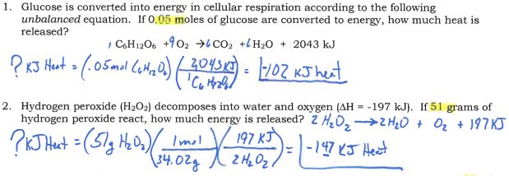
Thermochemistry

Slide 43
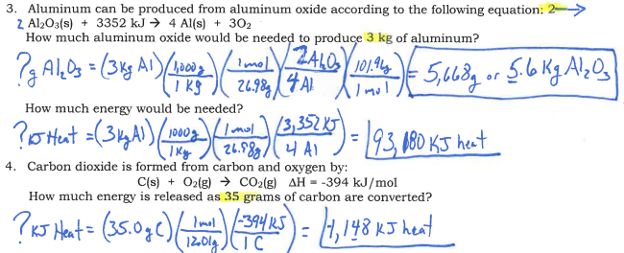
Thermochemistry

Slide 44
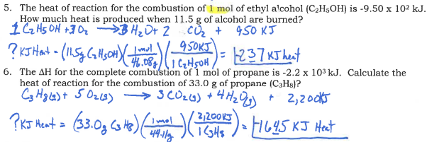
Thermochemistry

Slide 45
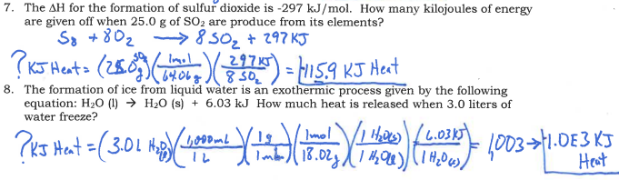
Thermochemistry

Slide 46
Thermochemistry
15.0 grams of methane can boil 4 cups of water for a box of mac-n-cheese. How much heat can be provided by this combustion?
CH₄ (g) + 2O₂ (g) → CO₂ (g) + 2H₂O (l)
? kJ=(15.0g CH₄)
Balance the combustion reaction of methane:
ΔH = -890.4 kJ
(1mol/16.05g)
(-890.4kJ/1mol CH₄)
= -832.1kJ

Slide 47
Thermochemistry
How much heat is evolved when 266 g of white phosphorus burns in air?
P_{4 (s)} + O_{2 (g)} → P₄O_{10 (s)} + 3013kJ
? kJ =(266g P₄)
5
(1mol/123.88g)
(-3013kJ/1mol P₄)
= -6,470kJ

Slide 48
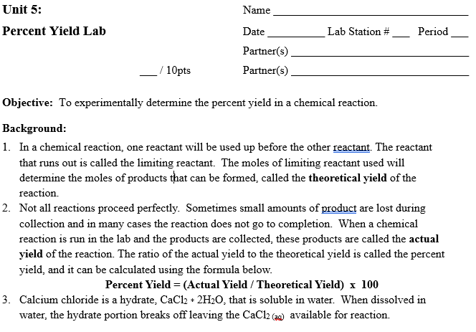

Slide 49
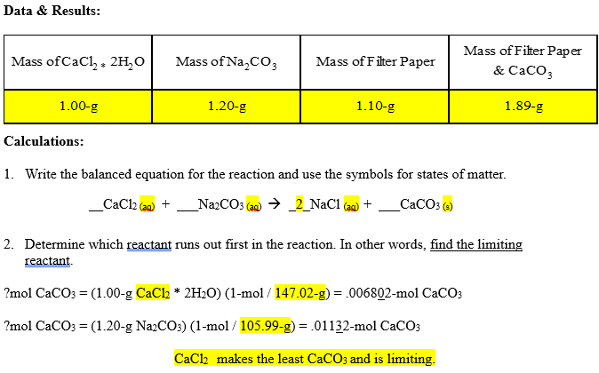

Slide 50
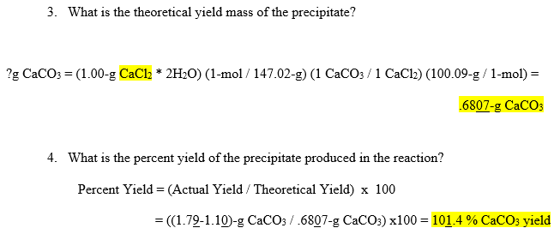

Slide 51
