Slide 1
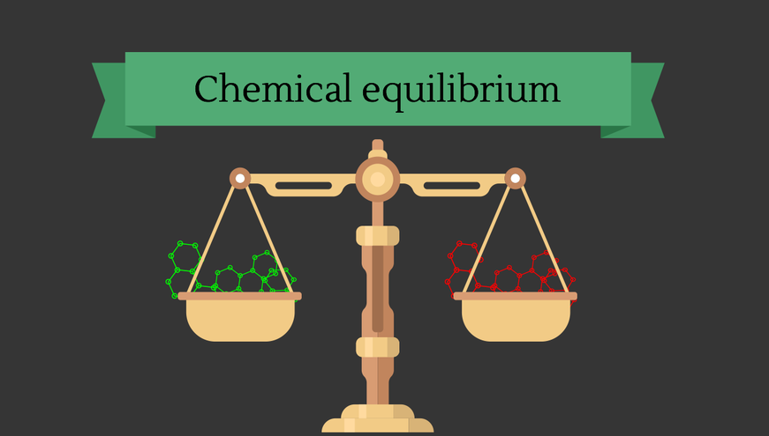
Unit 6
(Goes with Ch. 18 in textbook)

Slide 2
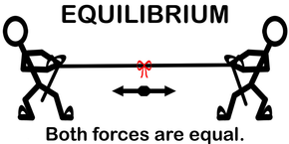
What is Equilibrium?
Equilibrium is a state of balance between opposing forces or actions.
At equilibrium there are no observable changes occurring.

Slide 3
Equilibrium
There are two types of equilibrium:
Physical Equilibrium involves a change in state. Example:
    H₂O (l) ↔ H₂O (g)
Chemical Equilibrium involves a chemical reaction. Example:
    N₂O₄ (g) ↔ 2NO₂ (g)
Notes:
3
In equilibrium, the concentration on reactants and products remains constant. Constant transfer.
Although it seems like there are no more reactions taking place, r to p and p to r formation is continuously occurring.
There are several types of equilibrium reactions that can occur and we will discuss all of them.
In this chapter we will be looking at the types of equilibrium reactions, the equilibrium constant and its relationship to the rate constant and factors that can disrupt a system at equilibrium.
Most reactions are reversible. As soon as p forms, r begins to reform. R then forms more p.

Slide 4
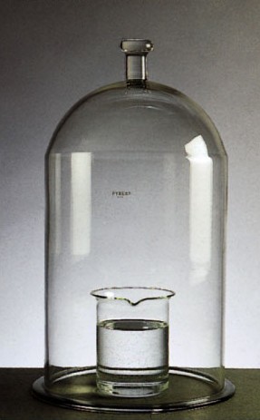
Physical Equilibrium
    Example:
    H₂0 (l) ↔ H₂0 (g)
    Liquid water exists in equilibrium with the water vapor above it in this closed system.
Notes:
4
Physical- equilibrium between two phases of the same substance. Changes that occur are physical.
Chemical- equilibrium chemists are more interested in this b/c the progress of the reaction can be easily monitored.

Slide 5
Chemical Equilibrium
Must be a REVERSIBLE reaction
In a closed system.
Rate forward = Rate reverse
[Reactants] and [Products] remain constant.
Notes:
5
a.) initially only NO₂ b.) Initially only N₂O₄ c.) Mixture of NO₂ and N₂O₄
Equilibrium always occurs at approximately the same time.

Slide 6
Chemical Equilibrium
Chemical equilibrium is also called
Dynamic Equilibrium
The forward and reverse reactions
never actually stop.
They just happen at the same rate.

Slide 7
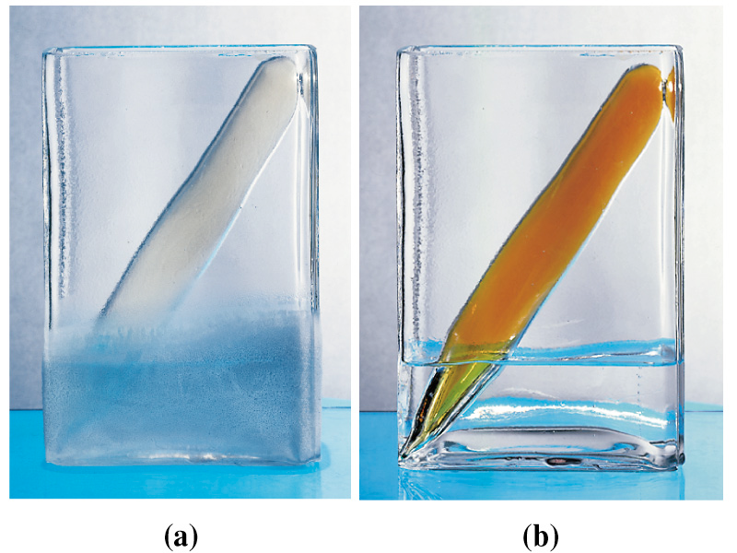
Chemical equilibrium: An example
(a) the tube holds N₂O₄ – a colorless gas.
(b) the tube has been heated,
most of the N₂O₄ was converted to NO₂ (a brown gas).
N₂O₄ (g) + heat ↔ 2NO₂ (g)

Slide 8
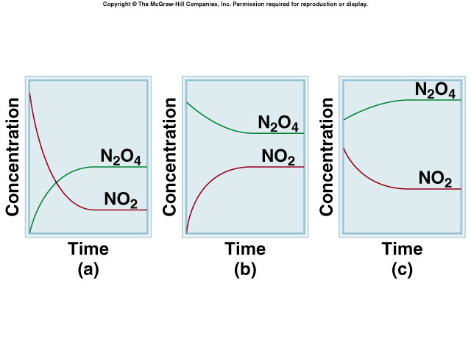
No matter how much N₂O₄ or NO₂ is put in the tube, eventually the gases will reach equilibrium because the forward and reverse reaction rates will become equal.
N₂O₄ (g) + heat ↔ 2NO₂ (g)

Slide 9
The Law of Mass Action:
When a reversible reaction is at equilibrium,
the ratio of the concentrations of products to reactants is constant.
This is called the equilibrium constant, K, for the reaction.

Slide 10
According to the
Law of Mass Action,
ONLY A CHANGE IN TEMPERATURE can change the value of the equilibrium constant.

Slide 11
Law of Mass Action and K
For the general reaction:
aA _{(aq)} + bB _{(aq)} cC _{(aq)} + dD _{(aq)}
[C]^{c}[D]^{d}
K =
[A]ª[B]^{b}
The brackets [ ] represent concentrations in moles per liter (molarity).

Slide 12
The Equilibrium Constant
The equilibrium constant is sometimes represented by K_{eq} rather than K, but they are the same thing.

Slide 13
Chemical Equilibrium
The value for K tells us whether the reactants or the products are favored at equilibrium.
If K > 10, the reaction favors the products.
If K < 0.1, the reaction favors the reactants.

Slide 14
Chemical Equilibrium
If K ≈ 1, there are significant amounts of both reactants and products at equilibrium.
Notes:
14
Liquid water in equilibrium with its vapor. The number of water molecules leaving the liquid is equivalent to those returning to the liquid.

Slide 15
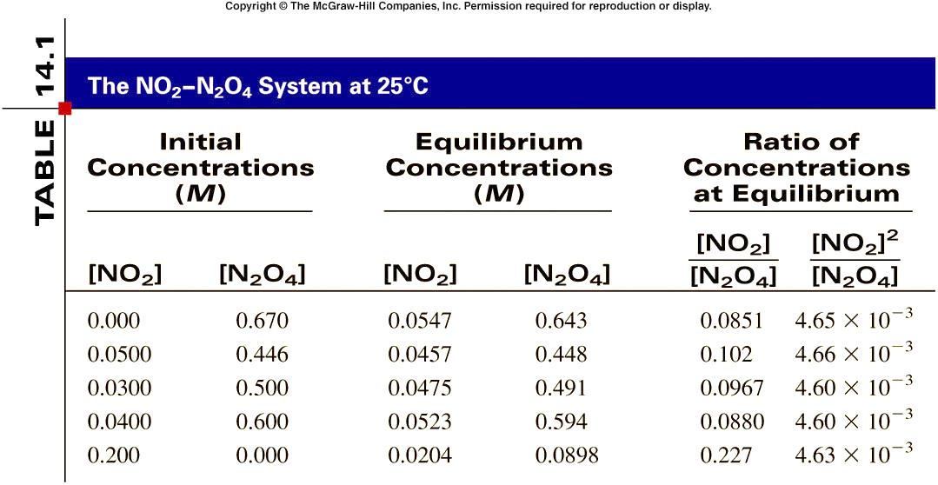
Calculating K
Consider the system
N₂O₄ (g) ↔ 2NO₂ (g) at 25ºC

Slide 16
Homogeneous Equilibrium
This term applies to reversible reactions in which all the species are in the same phase (s, l, aq, or g).
Example: N₂O₄ (g) ↔ 2NO₂ (g)
[NO₂]²
K =
[N₂O₄]
Remember that [ ] means concentration in mol/L (molarity).

Slide 17
Example Problem:r is reaction.
2SO₂ (g) + O₂ (g) ←→ 2SO₃ (g)
This system is at equilibrium at 25ºC, and the concentrations of the species are [SO₂] = 0.90 M, [O₂] = 0.35 M, and [SO₃] = 1.1 M.
Calculate K​ at this temperature.

Slide 18
2SO₂ (g) + O₂ (g) ←→ 2SO₃ (g)
Solution: For this reaction, the equilibrium constant is expressed as
K = __[SO₃]²_ = ___(1.1)²___
[SO₂]² [O₂] (0.90)²(0.35)
K_{eq} = 4.3 at 25ºC

Slide 19
Practice Problem 1
The following equilibrium has been studied at 230ºC:
2NO (g) + O₂ (g) ←→ 2NO₂ (g)
In one expt., the concentrations of the reaction species are found to be [NO] = 0.0542 M, [O₂] = 0.127 M, and [NO₂] = 15.5 M. Calculate K for the reaction at this temp.

Slide 20
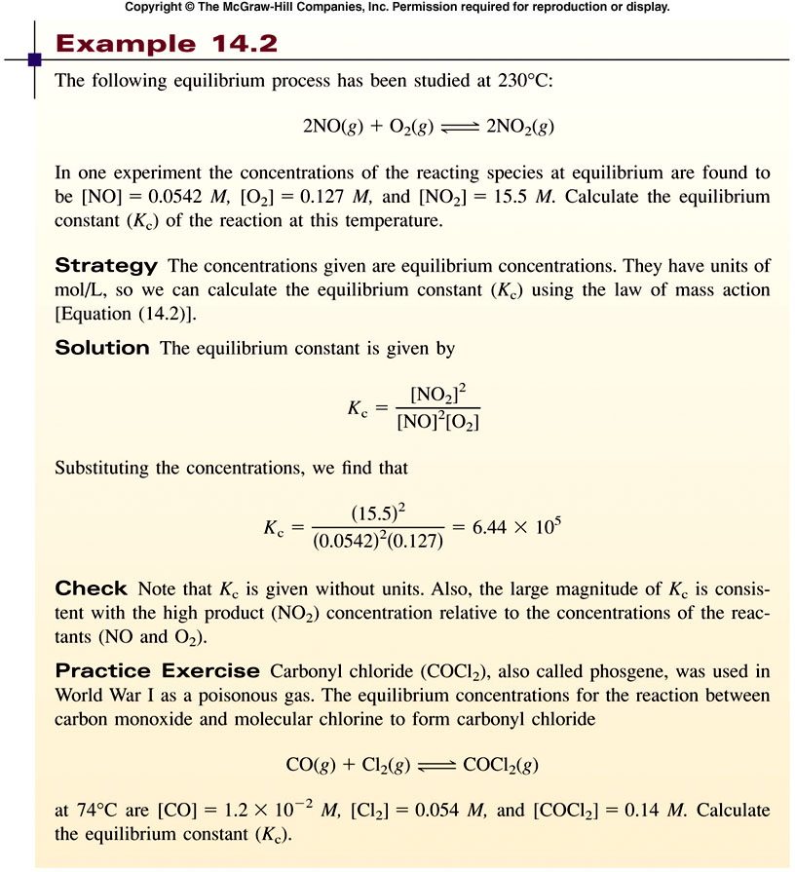
6.44 x 10⁵
This reaction STRONGLY favors the formation of the product (NO₂) at 230ºC.

Slide 21
Practice Problem 2
Carbonyl chloride, also called phosgene, is a poisonous gas that was weaponized in WWI. It is formed by the reaction
CO (g) + Cl₂ (g) ←→ COCl₂ (g)
If the equilibrium concentrations of all the species at 74ºC are [CO] = 1.2 x 10⁻² M, [Cl₂] = 0.054 M, and [COCl₂] = 0.14 M, what is the equilibrium constant at this temperature?

Slide 22
Practice Problem 2
Solution: For this reaction, the equilibrium constant is expressed as
K = [COCl₂] = (0.14) _
[CO]² [Cl₂] (1.2 x 10⁻² )(0.054)
K = 220 at 74ºC
Because K is MUCH greater than 1, the formation of product (phosgene gas) is strongly favored at this temperature.

Slide 23
Heterogeneous Equilibrium
This term describes a reversible reaction involving reactants and products in more than one phase.
Such a reaction may include liquids, gases, solids, and/or solutions as reactants or products.
Notes:
23
Reversible reaction between nitrogen dioxide and dinitrogen tetroxide forms an orange colored product. Nit. Di. Is colorless and dinit. Tet. Is brown.
Brown forms immediately, followed by the color lightnening due to reverse reaction occurring.

Slide 24
Heterogeneous Equilibrium
Concentrations of pure liquids and solids are NOT included in the expression for the equilibrium constant K because their concentrations are constant.
We use “1” to represent the concentrations of pure solids and liquids in the expression for K.

Slide 25
Why concentrations of pure solids and liquids do not change
Molarity is really just a measure of density (mass ÷ volume), because moles and grams of a substance are directly related.
Think about the density of a pure solid or liquid. When some of a pure substance is either used or produced, its density (mass/volume) stays the same. For example, if half of a piece of carbon is used in a reaction, its mass decreases by half, but so does its volume. Thus the concentration (mass/volume) never changes.

Slide 26
Finding the equilibrium constant for a heterogeneous reaction: An example
CaCO₃ (s) CaO (s) + CO₂ (g)
[CaCO₃] = constant
[CaO] = constant
K = [CO₂]
Solids and liquids have constant concentrations (meaning constant densities). They are not included in the expression for the equilibrium constant.

Slide 27
Practice Problem 3
Write the expression for the equilibrium constant of this reaction at 25ºC.
(NH₄)₂Se (s) ←→ 2NH₃ (g) + H₂Se (g)

Slide 28
(NH₄)₂Se (s) ←→ 2NH₃ (g) + H₂Se (g)
This is a heterogeneous equilibrium because the reaction includes both solid and gas phases.
Because the concentration of the solid will be constant, we will call it “1”. Therefore the expression for the equilibrium constant will not include the solid.
K_{eq} = [NH₃]² [H₂Se] at 25ºC

Slide 29
Practice Problem 4
Write the expression for the equilibrium constant K_{eq} of this reaction at 25ºC.
PCl₃ (l) + Cl₂ (g) ←→ PCl₅ (s)

Slide 30
Solution:
PCl₃ (l) + Cl₂ (g) ←→ PCl₅ (s)
K_{eq} = 1__
[Cl₂] at 25ºC
Notice that the pure substances (PCl₅, which is a solid) and (PCl₃, which is a liquid) are not included in the expression because their concentrations do not change.

Slide 31
Practice Problem 5
Write the expression for the equilibrium constant K of this reaction at 25ºC.
Fe₃O₄(s) + 4H₂(g) ←→ 3Fe(s) + 4H₂O(g)

Slide 32
Solution:
Fe₃O₄(s) + 4H₂(g) ←→ 3Fe(s) + 4H₂O(g)
K = [H₂O]⁴_
[H₂]⁴ at 25ºC

Slide 33
The Equilibrium Constant: A Summary
Concentrations of reacting species in the condensed phase are expressed in MOLARITY.
Concentrations of pure solids, liquids and solvents (like water) do not appear in the expression for an equilibrium constant.
An equilibrium constant is dimensionless (no units).
When reporting an equilibrium constant, the balanced equation and temperature must be specified.

Slide 34
What the equilibrium constant tells us
When we know K, we can…
  Predict the direction in which a reaction will proceed to reach equilibrium.
  Calculate the concentrations of reactants and products once equilibrium has been reached.
Notes:
34
Greater than 1 = any number greater than 10
Less than 1 = any number less than 0.1

Slide 35
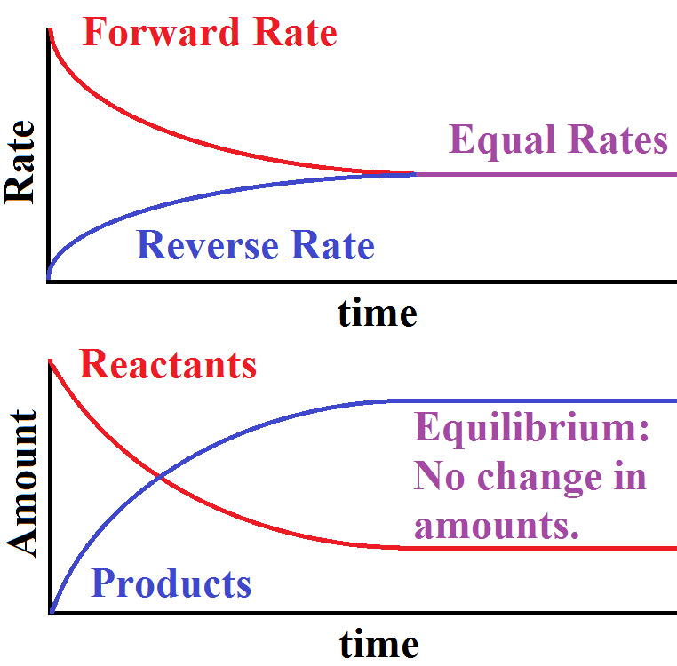
What happens to the forward and reverse reaction rates as a system approaches equilibrium, and why?

Slide 36
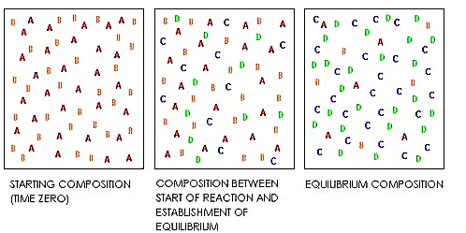
A reversible reaction system aA + bB ←→ cC + dD
Initially, the forward reaction rate is high because only reactant particles are present. Then, as product particles form, the concentrations of the reactants decrease. This means fewer collisions occur between reactant particles and the forward reaction rate slows.

Slide 37
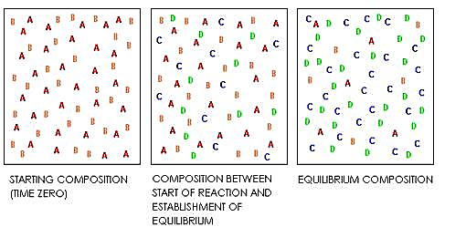
A reversible reaction system aA + bB ←→ cC + dD
Meanwhile, as the number of product particles increases, more frequent collisions occur between them. The reverse reaction rate thus increases until equilibrium is reached.

Slide 39
The Reaction Quotient
The reaction quotient (Q) is the ratio of products to reactants, each raised to the power of their coefficient, at a specific time during a reaction (not necessarily at equilibrium).

Slide 40
The Reaction Quotient
The reaction quotient (Q) is calculated by substituting the concentrations of the reactants and products at time t into the expression for the equilibrium constant.

Slide 41
The Reaction Quotient
If Q < K, the system needs to produce more products to reach equilibrium.
If Q > K, the system needs to produce more reactants to reach equilibrium
If Q = K, the system is at dynamic equilibrium.

Slide 42
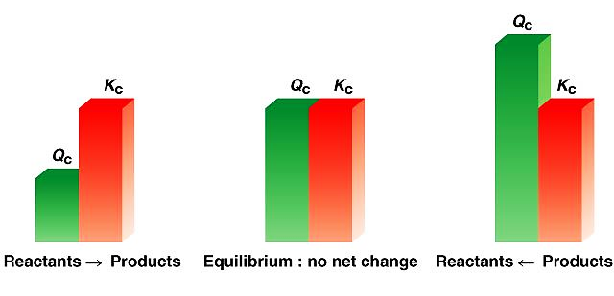
Using the reaction quotient (Q) vs. K to predict the direction that a reaction will proceed.

