Slide 1
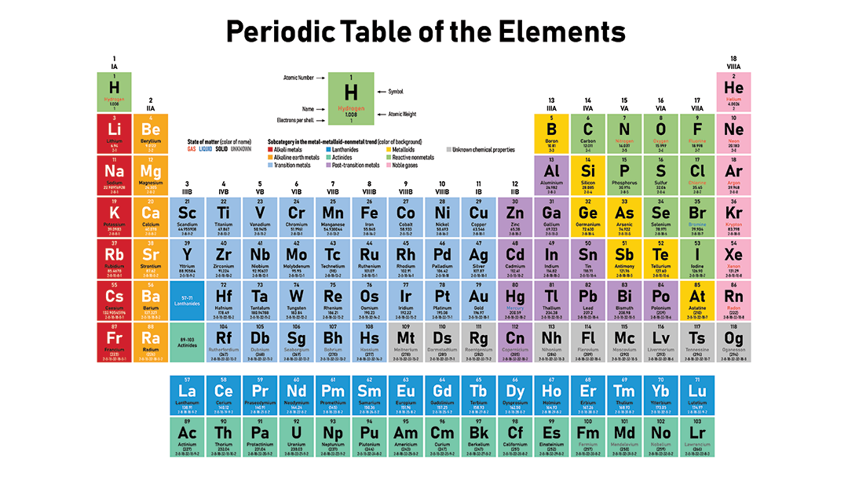

Slide 2
Periodic Trends
Unit 2
Let’s start by mentioning two scientists credited with developing the periodic table.
Dmitri Mendeleev first organized the known elements in order of increasing atomic mass such that elements with similar chemical properties were located in columns together (called GROUPS or FAMILIES).

Slide 3
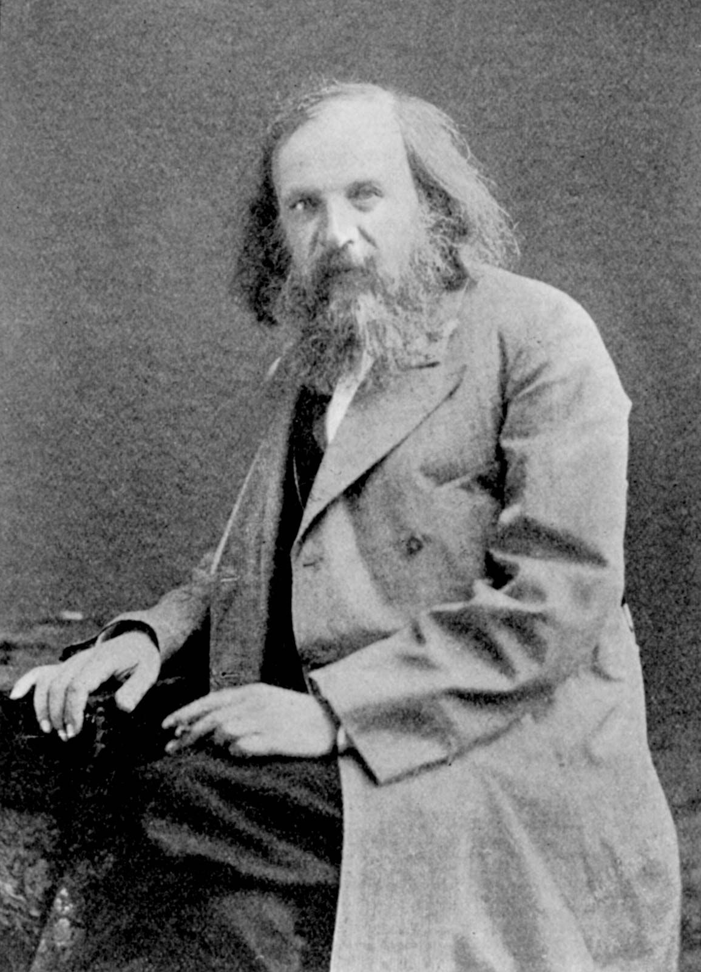
Periodic Trends
Mendeleev’s table had a problem. When placed strictly in order of atomic mass, a few elements did share similar properties with others in their group. Over 40 years later, Charles Moseley found a solution to this problem.

Slide 4
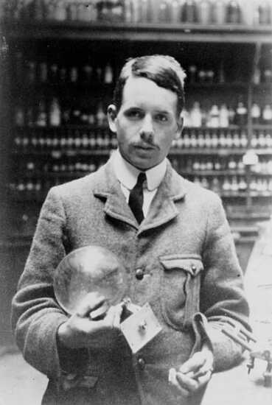
Periodic Trends
Moseley, while working with Ernest Rutherford, found that elements fit into reliable patterns when arranged by increasing nuclear charge (# of protons). This is the basis for the modern periodic table.

Slide 5
Periodic Trends
(Side Note about Charles Moseley)
Moseley left Oxford University to enlist in the Royal Engineers of the British Army when WWI broke out. He was killed during the Battle of Gallipoli in Turkey at the age of 27. Had he lived, who knows how far he might have advanced our understanding of physics and chemistry!

Slide 6
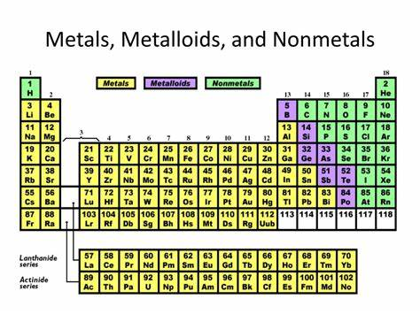
Periodic Trends
The first trend in the periodic table you need to be able to identify is where metals and nonmetals are located.

Slide 7
Periodic Trends
Elements with similar properties occur at regular intervals when all elements are arranged by increasing atomic number.
We now know the reason for this periodicity
--- elements in the same group have similar electron configurations and the same number of valence electrons.
--- Periodic Law

Slide 8
Periodic Trends
Trends are predictable patterns within the elements of the periodic table.
      in the periods (rows)
      and groups (columns)
You will learn about 4 important trends.

Slide 9
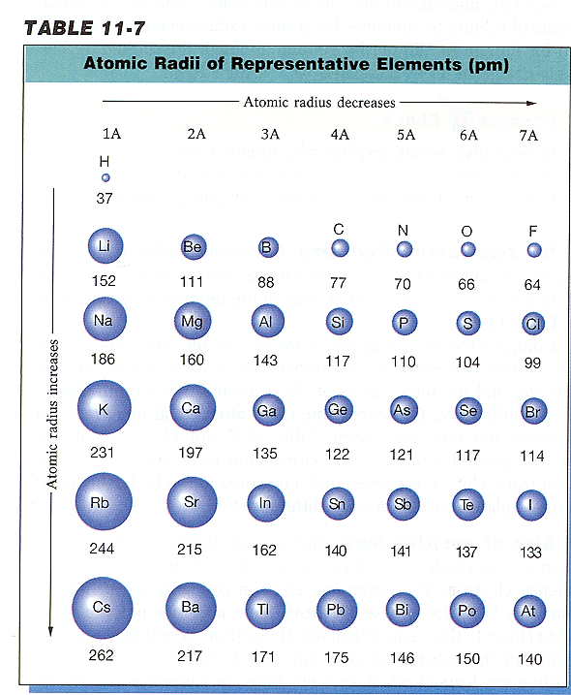
Periodic Trends
Atomic Radius is the distance from an atom’s nucleus to the outer boundary of its e⁻ cloud.

Slide 10
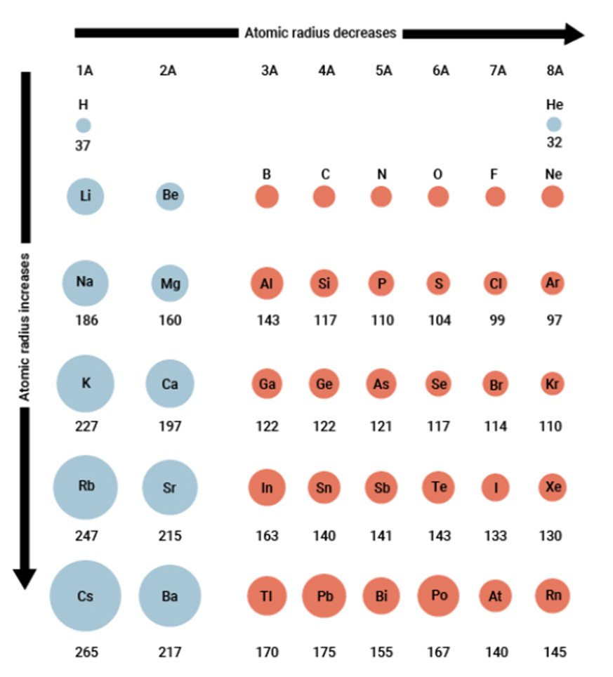
Periodic Trends
Atomic Radius
increases down a group.
Why?
Electrons keep filling orbitals that are further away from the nucleus. Nuclear attraction weakens with increased distance & e- shielding.

Slide 11
Periodic Trends
Atomic Radius
decreases from left to right across a period.
Why?
e- are all entering the same energy level, but #’s of p+ increase. Greater nuclear charge causes stronger attraction for electrons, drawing them closer.

Slide 12
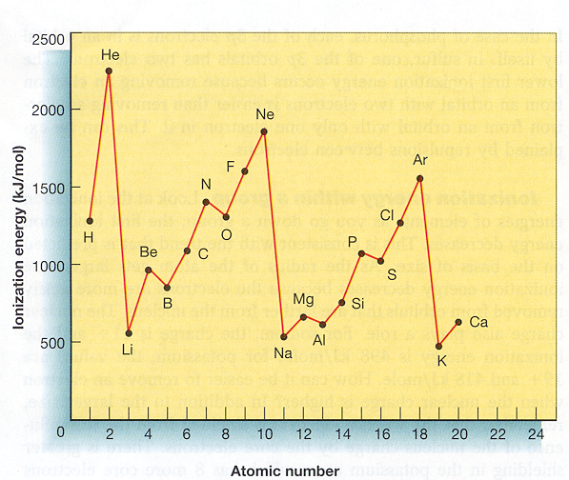
Periodic Trends
#2 Ionization Energy
The energy required to remove an outer e⁻ from an atom or ion.

Slide 13
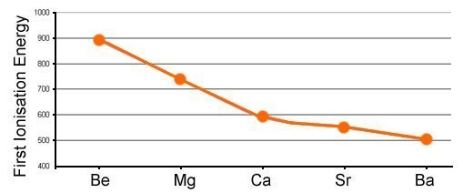
Periodic Trends
#2 Ionization Energy
Decreases down a group
Why?
Outer e- are located farther from the atom’s nucleus, and more shielding by e- in lower energy levels occurs. The nuclear attraction for outermost e- is weakened.
Allowing the e- to be removed with less energy.

Slide 14
Periodic Trends
#2 Ionization Energy
Increases from left to right across a period
Why?
As # of p+ increase, the nuclear attraction for e- grows stronger.
It becomes more difficult to remove an outer e⁻

Slide 15
Periodic Trends
#2 Ionization Energy
Why do we see exceptions to the trend across periods?
Notes:
Filled and half filled sub-levels are more stable…lower energy.

Slide 16
Periodic Trends
#2 Ionization Energy
Elements with full outer s-orbitals and no p-electrons & elements with half-filled outer p-orbitals have configurations that provide extra stability. This makes ionization energy for Group 2 and Group 15 elements slightly higher than expected.
Notes:
Filled and half filled sub-levels are more stable…lower energy.

Slide 17
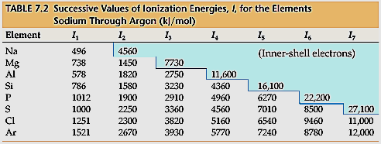
Periodic Trends
#2 Ionization Energy
Once an element has its valence e- removed, the first core e-
takes a much larger amount of energy to remove.
This shows how stable the Noble Gas e- configuration is.

Slide 18
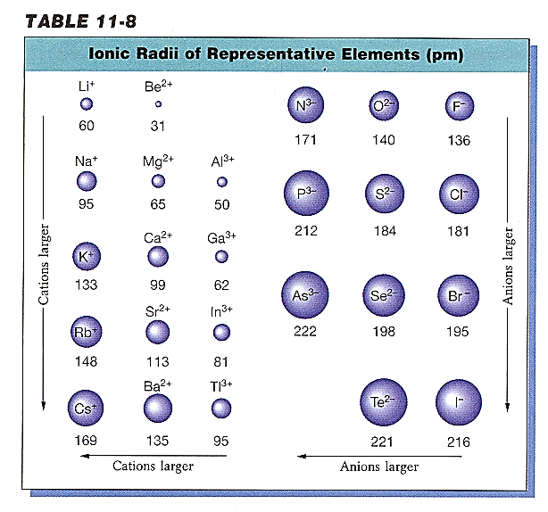
Periodic Trends
#3 Ionic Radius
This is the radius of an atom AFTER it gains or loses e⁻s to becomes an ion.
Metal ions lose e- and get smaller.
-- Cation
Non-metal ions gain e- and get bigger.
-- Anion

Slide 19
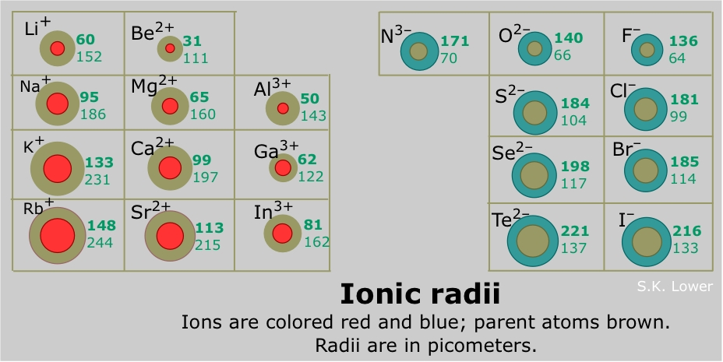
Periodic Trends
Ionic Radii vs Atomic Radii

Slide 20
Periodic Trends
#3 Ionic Radius
Increases as you go down a group.
Why?
Higher e- orbitals are being filled as we move down a group. These are farther from the nucleus, so there is increased electron shielding caused by electrons in lower orbitals.

Slide 21
Periodic Trends
#3 Ionic Radius
As you go left to right across a period, cation radius decreases & anion radius also decreases.
Why?
As you move L to R, the # of p⁺ increases, pulling the e⁻ closer to the nucleus.
The anions are larger than the cations because of more e- repulsion.

Slide 22
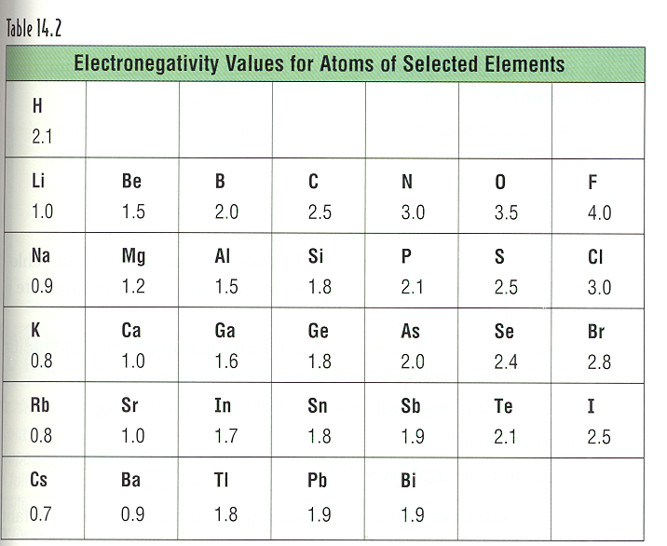
Periodic Trends
#4 Electronegativity
The ability of an atom
to attract shared
electrons in a chemical
bond.

Slide 23
Periodic Trends
#4 Electronegativity
As you go down a group, electronegativity decreases.
Why?
Atomic size is increasing, and so is electron shielding. Thus there is less attraction by the nucleus for shared e⁻s when they are farther from the nucleus.

Slide 24
Periodic Trends
#4 Electronegativity
As you go left to right across a period, electronegativity increases.
Why?
Atomic size is decreasing and nuclear charge is increasing. Thus there’s greater nuclear attraction for the shared e⁻s.

Slide 25
Periodic Trends

