Slide 1
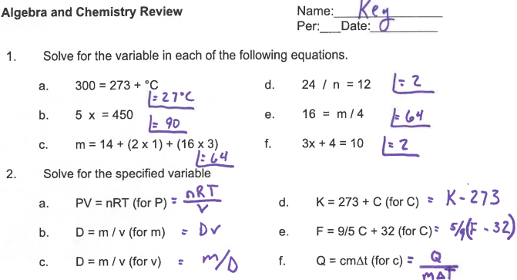

Slide 2
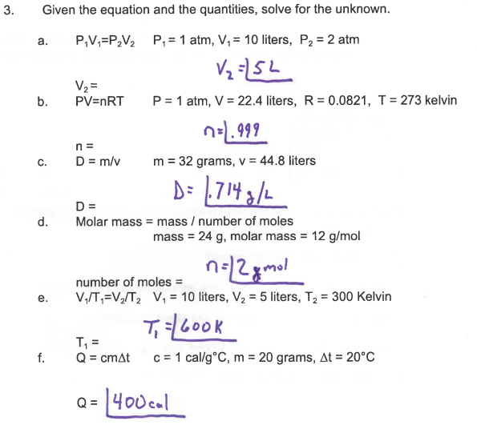

Slide 3
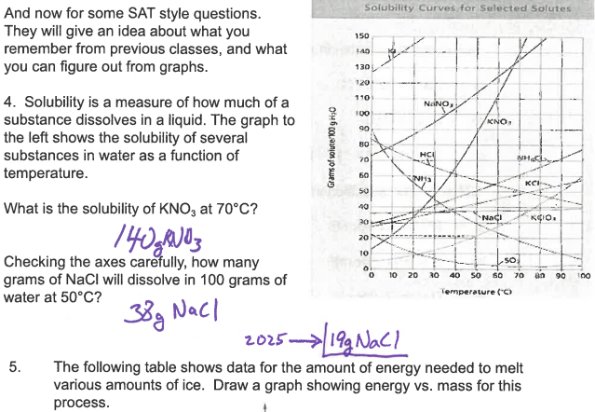

Slide 4
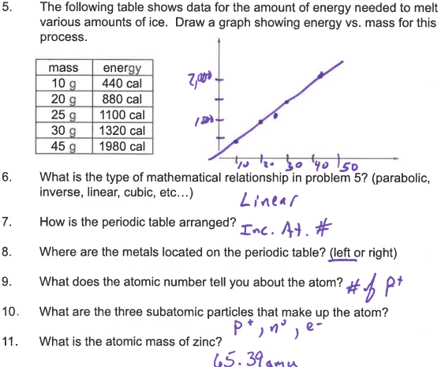

Slide 5
Working with Measured Numbers

Slide 6
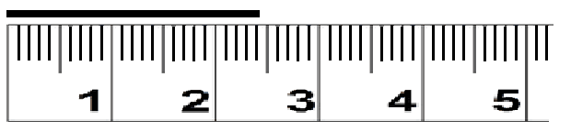
Measured Numbers
When you make a measurement in Science the value has significance.
Measure to the precision of the instrument.
2.4
Then you estimate one more number.
2.45
Don’t forget to add your units on to the number.
2.45-cm

Slide 7
Good Afternoon
Please place your phone in the blue caddy,
find your seat, and open your workbook to page 20.

Slide 8
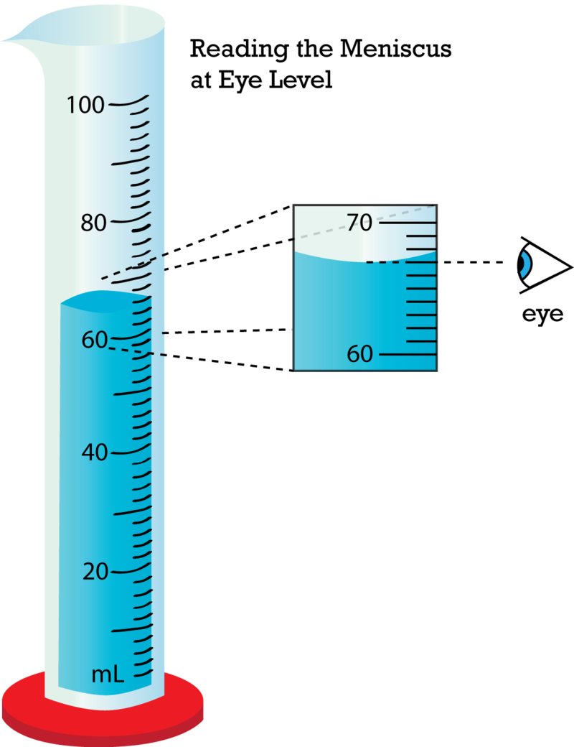
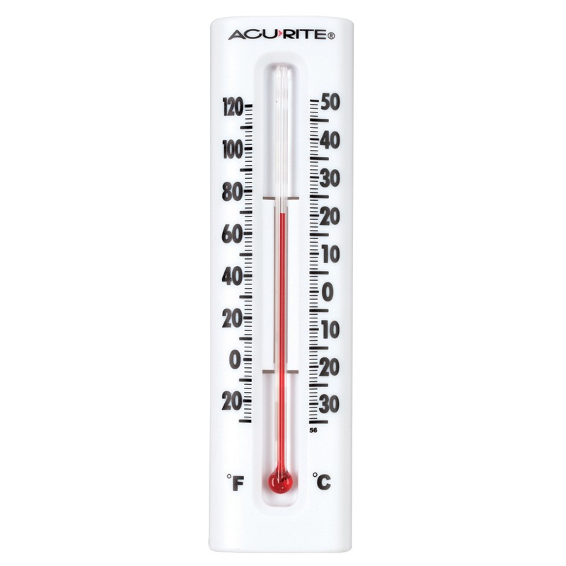
Length of Slab
_____
15.35-cm
Vol. of Test Tube
_____
35.2-mL
Temp. of Room
_____
35.2- °C

Slide 9
When working with measured numbers, it is important to keep
track of them. When doing so we call them Significant Figures.

Slide 10
Counting Sig Figs
If a decimal is present, then begin counting numbers from the left to the right. Start with the first non-zero number and count all remaining numbers including zeros.
If no decimal is present, then begin counting numbers from the left to the right. Start with the first non-zero number and count all remaining numbers, stopping when only zeros remain.
Ex/ .00010
2sf
Ex/ 003206.100
7sf
Ex/ .01290
4sf
Ex/ 510,400
Ex/ 78,000
2sf
Ex/ 004,020
4sf
3sf

Slide 11
Round the following numbers to three sig figs.
(Keep the BIG three)
Ex1/ 364,487 →
364,000
Ex2/ 2.15739 →
2.16
Ex3/ .00521058 →
.00521

Slide 12
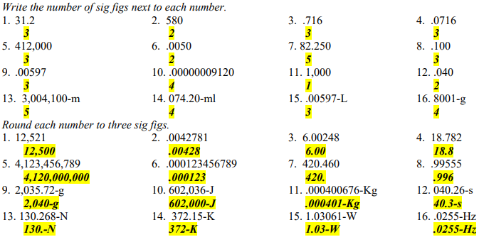

Slide 13
Scientific Notation
used when working with really big numbers or really small numbers.
Numbers are written so that they fall between 1 and 10 and they are raised to a power of 10.
  If BIG NUMBER exponent is positive.
  Ex1/ 8,200,000,000
  If small number exponent is negative.
  Ex2/ .00000000049
=8.2 x 10 ⁹
Ex3/ 3.45 x10⁷ or 3.45EE7
=34,500,000
=4.9 x 10 ⁻¹⁰
Ex4/ 7.6 x 10⁻⁴ or 7.6EE-4
=.00076

Slide 14
Multiplying & Dividing w/Sig Figs
Round your answer to the minimum number of sig figs any of the measured numbers had.
1st – Count sig figs 2nd – Round to minimum # of sig figs
Ex1/ 320 * .00521 =
Ex2/ 84,000 / 216.2 =
Ex3/ 212.4 * 522 / .087 =
1.6672 →
1.7
388.529 →
390
1,300,000 →
1274400 →
1.3EE6

Slide 15
Addition & Subtraction w / Sig Figs
Round your answer to the largest, least significant place that either measured number has.
1st – Underline least place values 2nd – ID larger place value
3rd – Round answer to that place
Ex1/ 210 + 3,100 =
Ex2/ 422,000 + 1,420 =
Ex3/ 5.040 + .40 =
Ex4/ 18,200 – 3,420 =
3,310 →
3,300
423,420 →
423,000
5.440 →
5.44
14,780 →
14,800

Slide 16
How to Work with Sig Figs
Addition and Subtraction
Multiplication and Division
Identify least place is larger.
Count sig figs in each number.
830 + 16.25
830 x 16.25
Which place is larger?
Which number is smaller?
Tens or hundredths
Place?
2 sig figs or 4 sig figs?
Round to that place.
Round to that many sig figs.
830 + 16.25
830 x 16.25
850
13,000

Slide 17
Unit Conversions
Method of solving complex problems in chemistry and physics.
Focus is on the units in the problem and the numbers go along for the ride.

Slide 18
Steps:
  Read the problem and write a question mark in front of the unit you are trying to find.
  Place an equal sign in front of measured number you are starting with.
  Use unit factors to convert your starting unit into your desired unit.
Ex/ How many seconds are there in two years?
365.25-days
24-hrs
60-min
60-s
? s
= (2-yr)
( ----------- )
( ------)
( ------ )
( ----- )=
1-yr
1-day
1-hr
1-min
= 63115200
= 63,100,000
= 6.31EE7
-s

Slide 19
Steps:
  Read the problem and write a question mark in front of the unit you are trying to find.
  Place an equal sign in front of measured number you are starting with.
  Use unit factors to convert your starting unit into your desired unit.
Ex/ How many cubic centimeters are in a 15,000-gal pool?

Slide 20
Ex/ How many cubic centimeters are in a 15,000-gal pool?
? cm³
= (15,000-gal)
4-qts
1-L
1,000-mL
1-cm³
( -----)
( ------)
( ---------)
( ----- )=
1-gal
1.06-qts
1-L
1-mL
= 56,600,000
= 5.66EE7
-cm³

