Slide 1
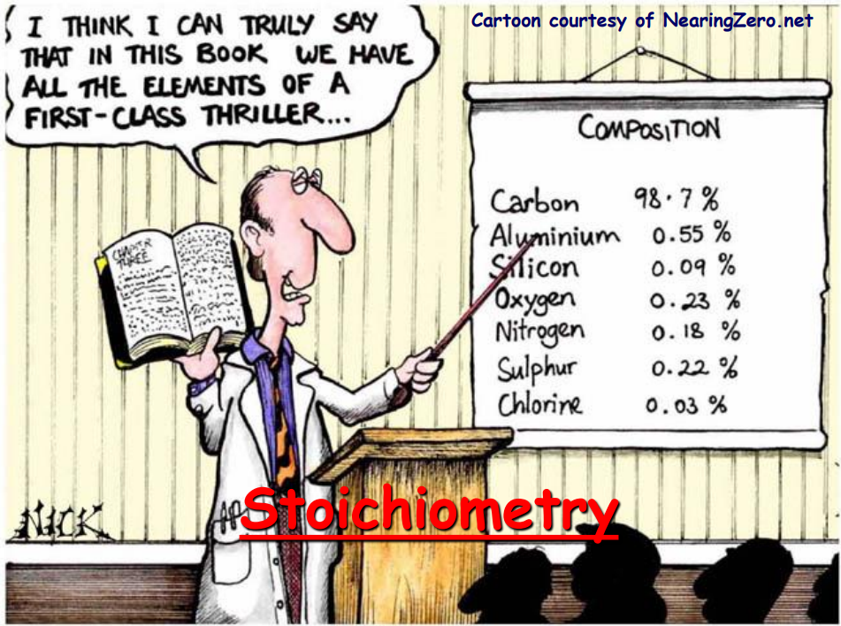
Stoichiometry

Slide 2
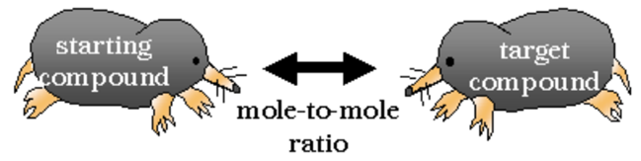
Stoichiometry
Greek for measuring the elements
Use molar mass to convert mass to moles or moles to mass
Use balanced equation coefficients to convert from one substance to another
substance ---
called a mole ratio

Slide 3
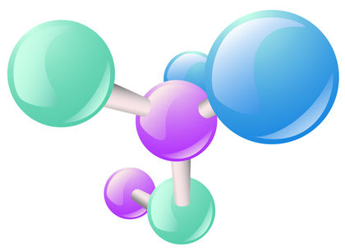
Stoichiometry
Step 1
Begin with a balanced chemical equation
Electrolysis is used to drive the non-spontaneous decomposition reaction with aluminum oxide.
Write the balanced equation for the decomposition of aluminum oxide.
2 Al₂O₃ → 4 Al + 3 O₂

Slide 4
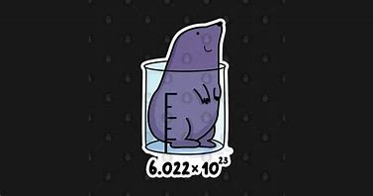
Stoichiometry
Step 2:
Mole-to-Mole conversion
Write the setup to solve the problem
Ex 1/ How many moles of aluminum oxide will be needed to make 2.50mol Al?
2 Al₂O₃ → 4 Al + 3 O₂
? mol Al₂O₃ = (2.50mol Al)
( _{4mol Al} )
2mol Al₂O₃
= 1.25mol Al₂O₃

Slide 5
Stoichiometry
Step 2:
Mass-to-Mole conversion
Write the setup to solve the problem
Ex 2/ How many moles of aluminum oxide will be needed to make 67.45g Al?
2 Al₂O₃ → 4 Al + 3 O₂
? mol Al₂O₃ = (67.45g Al)
(_{26.98g Al})
( _{4mol Al} )
1mol Al
2mol Al₂O₃
= 1.250mol Al₂O₃

Slide 6
Stoichiometry
Step 2:
Mass-to-Mass conversion
Write the setup to solve the problem
Ex 3/ How many grams of aluminum oxide will be needed to make 67.45g Al?
2 Al₂O₃ → 4 Al + 3 O₂
?g Al₂O₃=(67.45g Al)
(_{26.98g Al})
( _{4mol Al} )
( _{1mol Al2O3})
1mol Al
2mol Al₂O₃
101.96g Al₂O₃
= 127.4g Al₂O₃

Slide 7
Stoichiometry

Slide 8
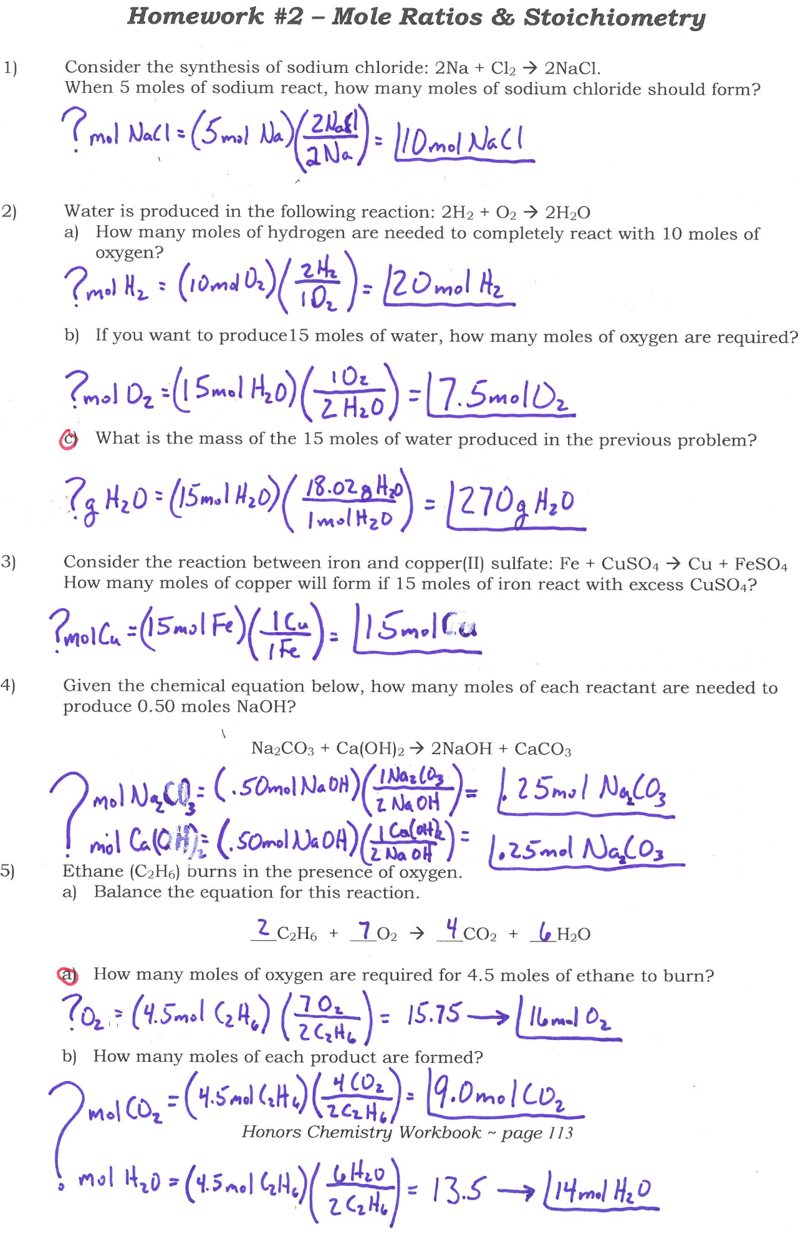
Stoichiometry

Slide 9
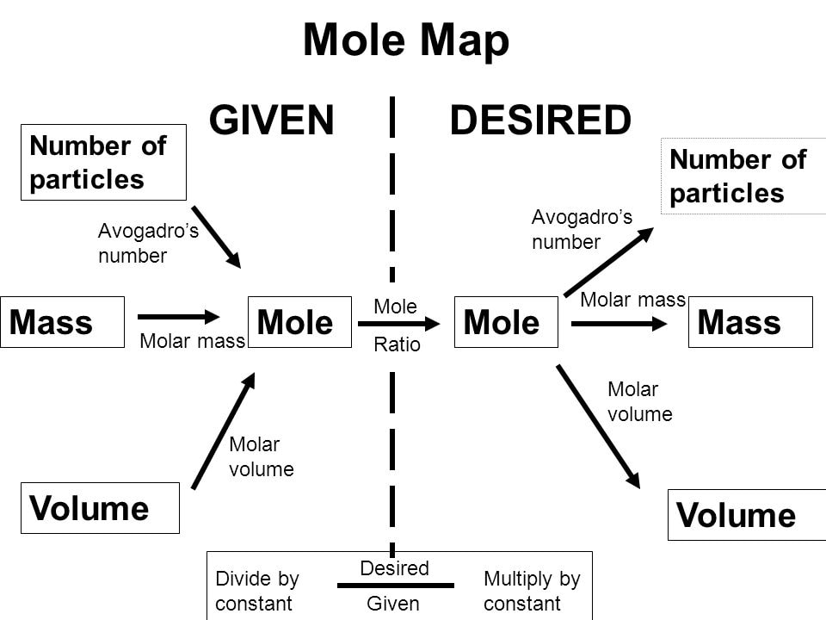
Stoichiometry

Slide 10
Stoichiometry
Ex 4/ In photosynthesis, plants use energy from the sun to produce glucose, C₆H₁₂O₆, and oxygen from the reaction of carbon dioxide and water. What mass of glucose is produced when 3.00 moles of water react?
CO₂ + H₂O → C₆H₁₂O₆ + O₂
? g C₆H₁₂O₆ = (3.00mol H₂O)
6
6
6
( _{6mol H2O} )
( _{1mol C6H12O6} )
1mol C₆H₁₂O₆
180.18g C₆H₁₂O₆
= 90.1g C₆H₁₂O₆

Slide 11
Stoichiometry
Ex 5/ In a spacecraft, carbon dioxide exhaled by astronauts can be removed by its reaction with lithium hydroxide forming lithium carbonate and water. How many molecules of carbon dioxide can be removed by 975 grams of lithium hydroxide?
CO₂ + LiOH → Li₂CO₃ + H₂O
? CO₂ = ( 975g LiOH )
2
(_{23.95g LiOH})
(_{2mol LiOH})
(_{1mol CO2})
1mol LiOH
1mol CO₂
N_{A} CO₂
= 1.23E25 CO₂

Slide 12

Stoichiometry
Review:
  Balance the chemical equation.
  Convert to moles.
  Use mole ratio to convert from starting substance into desired substance.
  Convert to requested units.

Slide 13
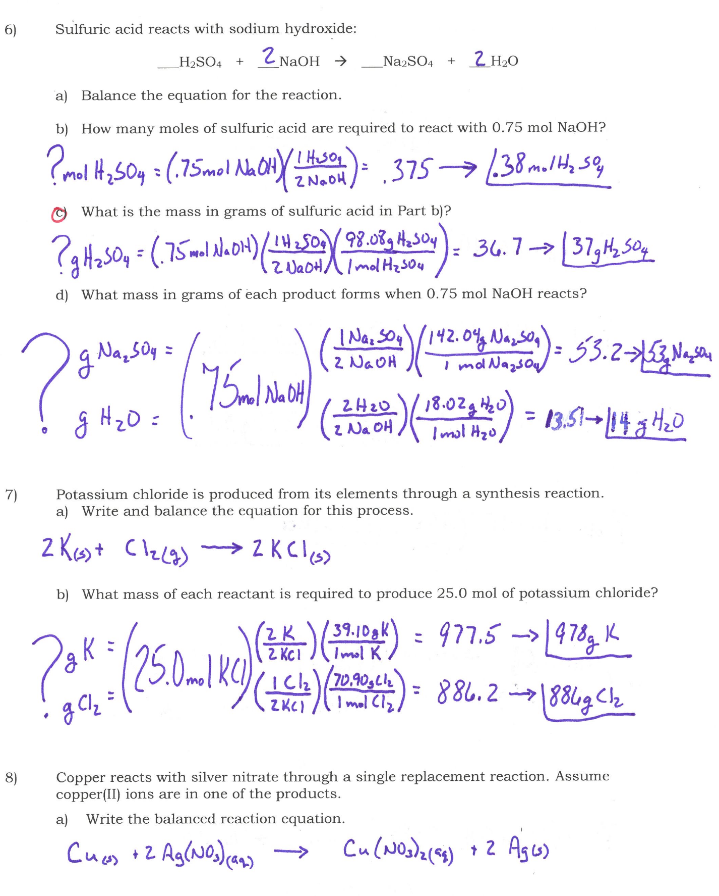
Stoichiometry

Slide 14
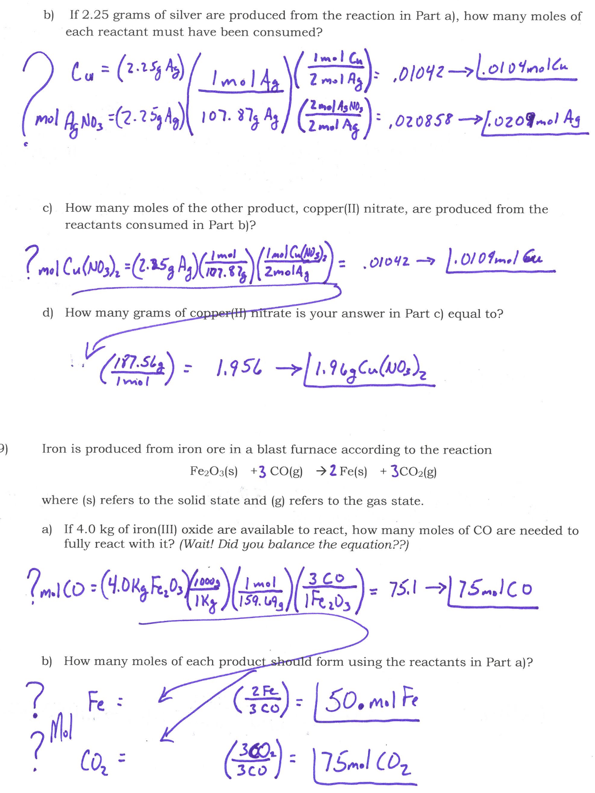
Stoichiometry

Slide 15
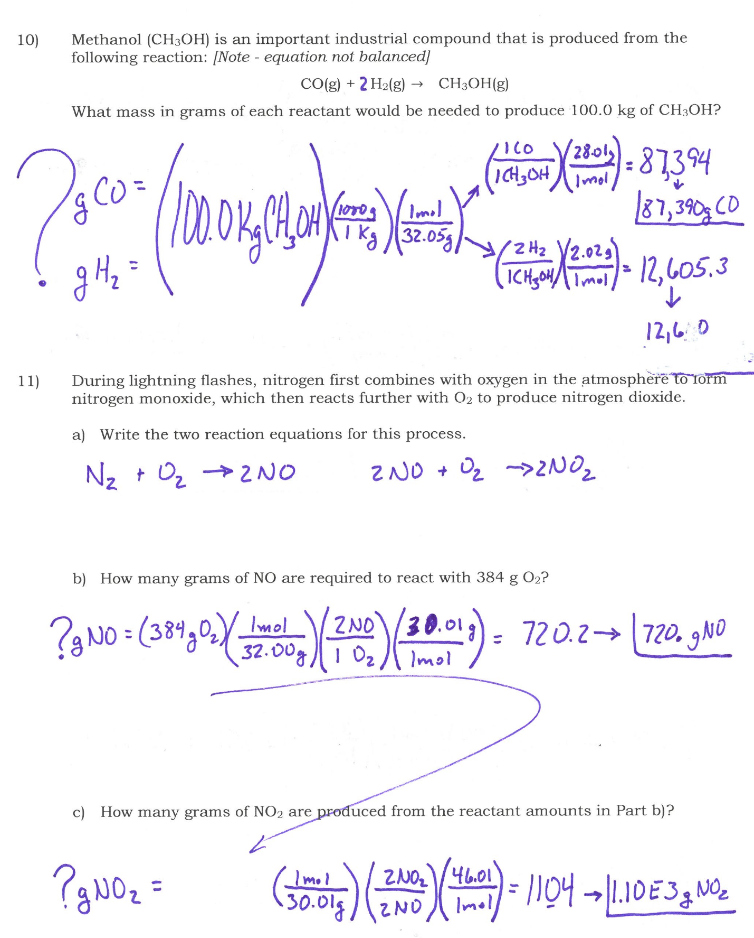
Stoichiometry

Slide 16
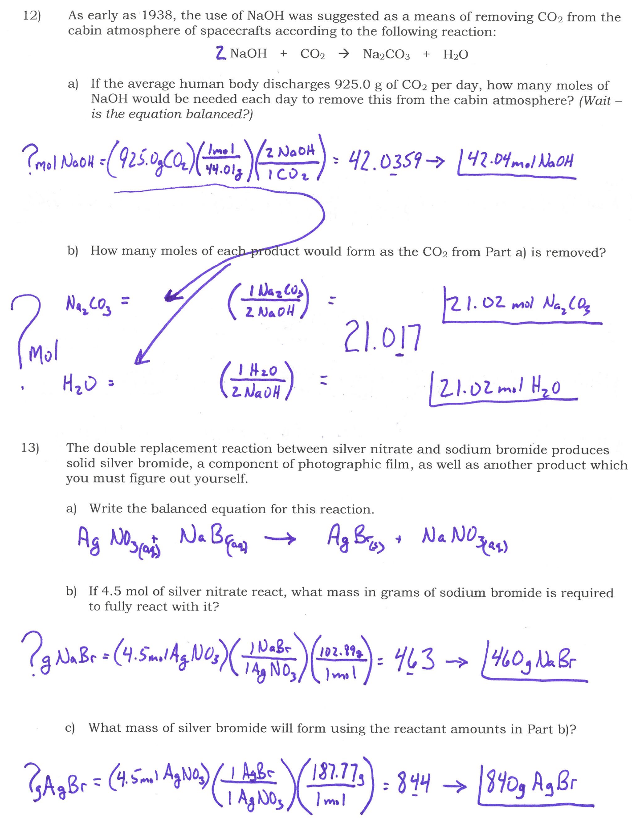
Stoichiometry

Slide 17
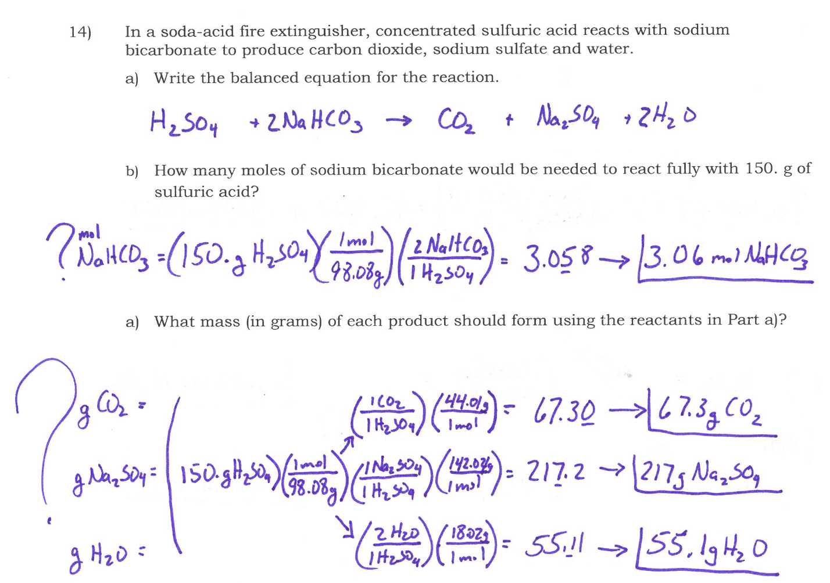
Stoichiometry

Slide 18
Stoichiometry

Slide 19
Stoichiometry

