Slide 1
Chapter 4
Arrangement of Electrons in Atom

Slide 2
Modern Atomic Theory
Quantum Mechanical Model
Electron Clound Model
Based on a mathematical Wave Equation
Erwin Schrödinger
Focus is on placement of electrons
A region in the atom where there is 90% chance of finding the electron.

Slide 3
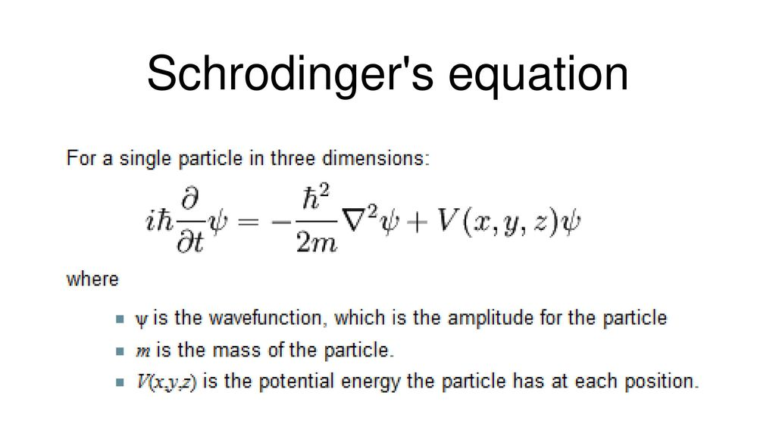
Wave Equation

Slide 4
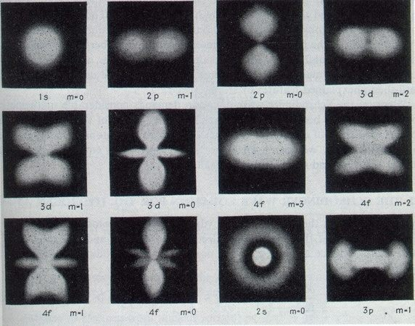
Electron probability clouds for s,p,d,& f orbitals
Electron Orbitals

Slide 5
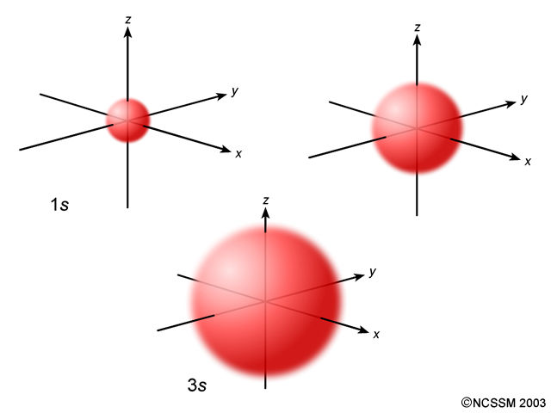
Electron Orbitals
s-orbital
There is one in each principal energy level. It can hold a maximum of 2 electrons.
2s

Slide 6
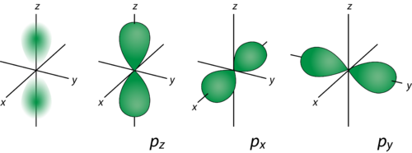
Electron Orbitals
p-orbital
There are 3 in each principal energy level beginning with n = 2.
Together they hold a maximum of 6 electrons.

Slide 7
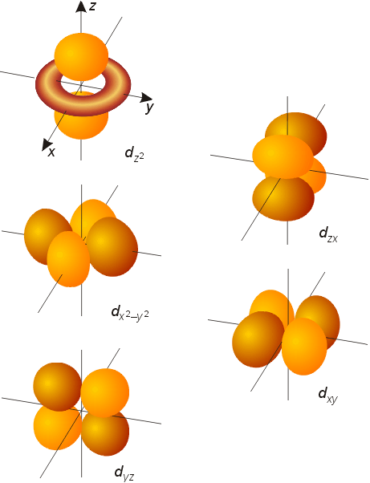
Electron Orbitals
d-orbitals
There are 5 in each principle energy level beginning with n = 3.
Together they can hold a maximum of 10 electrons.

Slide 8
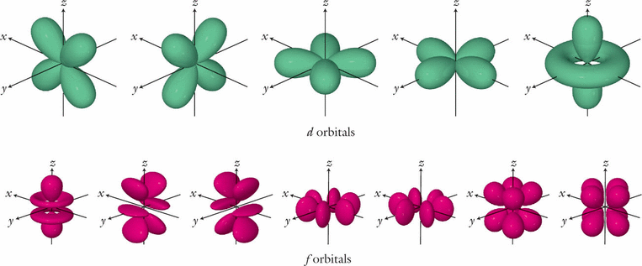
f-orbitals
There are 7 in each principal energy level beginning with n = 4
Together they hold a maximum of 14 electrons.
Electron Orbitals

Slide 9
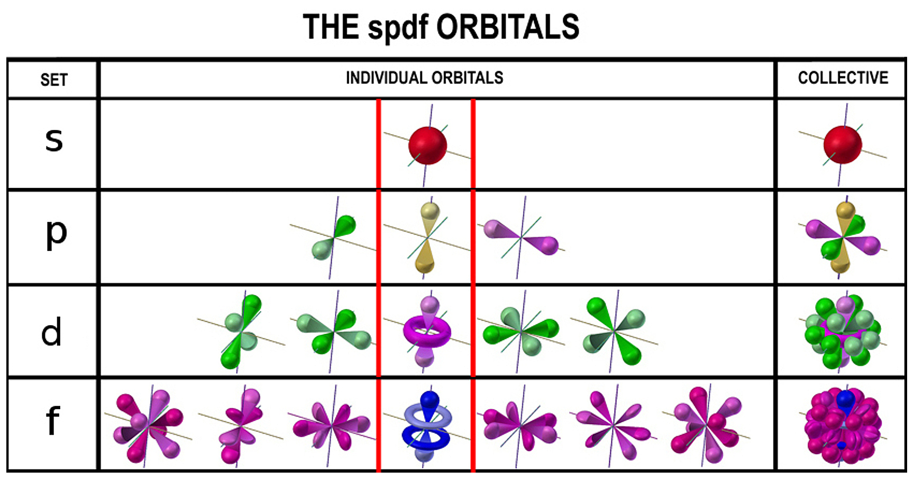
Electron Orbitals

Slide 10
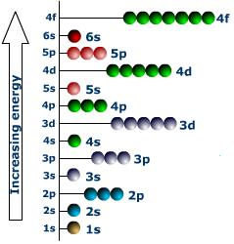
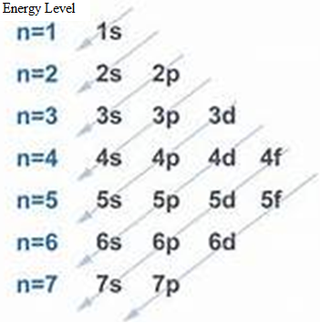
Electron Orbitals
Energy Level Diagram
Electron Placement
3d
3rd Energy level d Sub-level
Notes:
Energy Level – (n) principle Q#. Sub-level – (L) azimuthal Q#. m_{L} and m_{s}

Slide 11
Summary of Orbitals
Orbital Type | Present in each energy level beginning with | Number of suborbitals per energy level | Maximum # of electrons
s | n=1 | 1 | 2
p | n=2 | 3 | 6
d | n=3 | 5 | 10
f | n=4 | 7 | 14

Slide 12
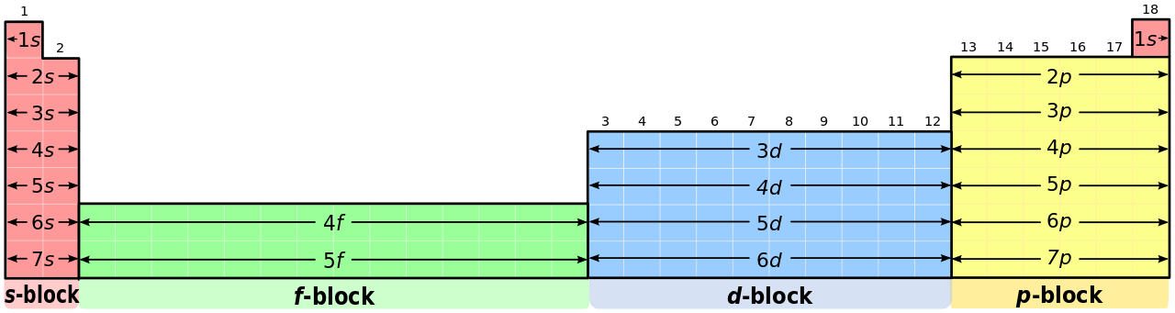
Electron Orbitals
Each row on the periodic table is labelled n=1 to n=7 These #’s are the energy levels of electrons

Slide 14
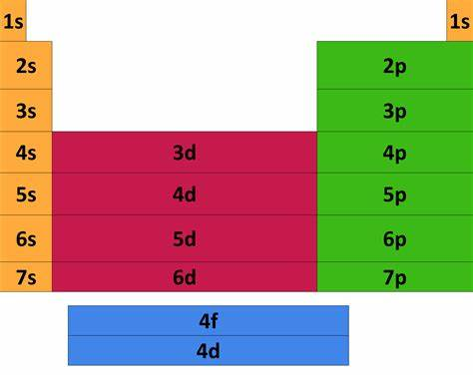

Slide 15
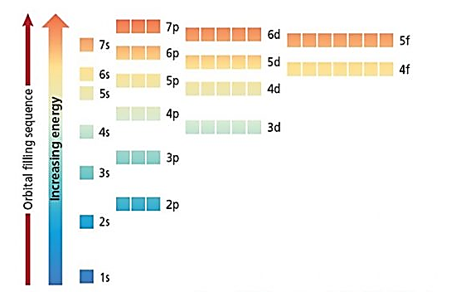

Slide 16
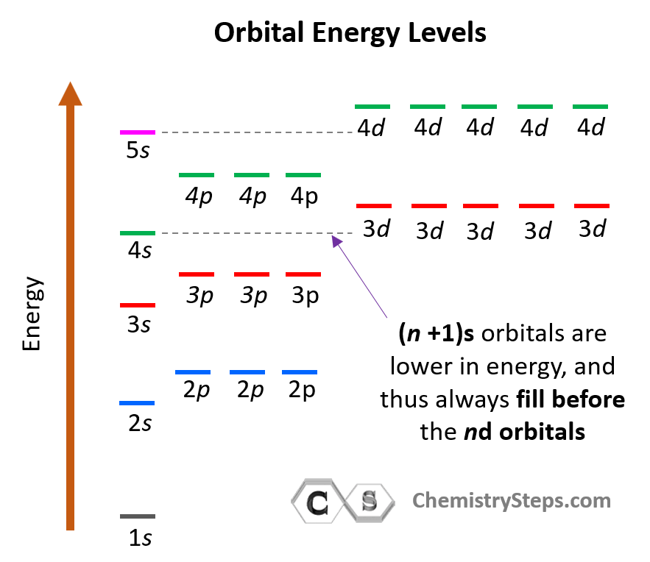

Slide 17
