Slide 1
The History of Everything!
From the dawn of time until now.
A look at where we’ve been
and where we are going.
…oh – and of course this will be on the test!

Slide 2
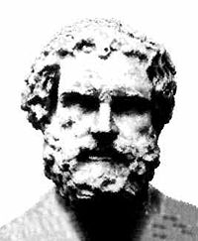
Democritus: 460 – 370 BC
Formalized the notion of the atomos – Greek for uncuttable or indivisible
Believed that all things in the world came from different combinations of atoms

Slide 3
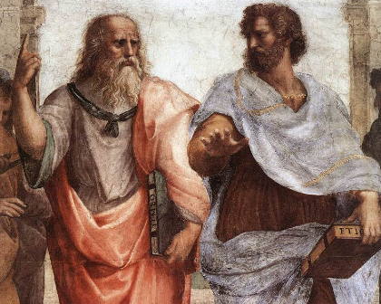
Aristotle: 384 – 322 BC
Natural philosophy is used to explain things on earth and is supported by logic
Killed Democritus’ science and chemistry dies with it!

Slide 4
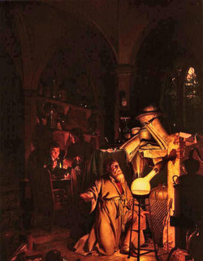
The Dark Ages…
From 300 BC to 1543 science – especially chemistry is driven underground, giving rise to the Alchemists…
Alchemy had two primary goals:
  Transmutation of metals
  The Elixir of Life

Slide 5
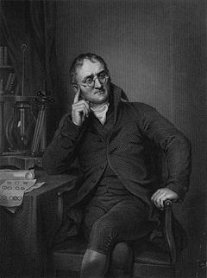
John Dalton: 1766 – 1844
Atomic Theory of Matter 1803
Everything is composed of atoms and the atom is not divisible
Matter is conserved in a chemical reaction. The reaction is a rearrangement of the atoms or molecules
Compounds always have the same number and kind of atoms
All atoms of a given element are identical

Slide 6
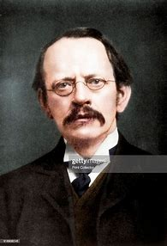
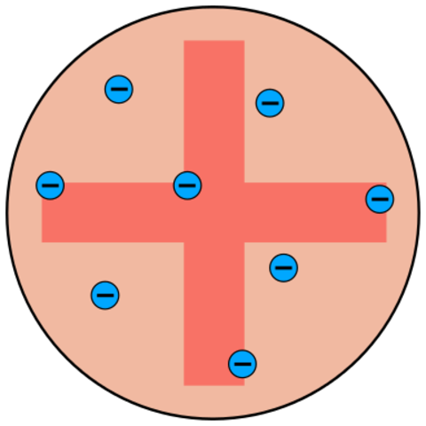
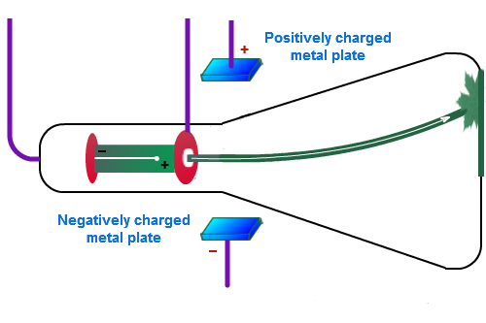
J.J. Thomson: 1856 – 1940
Discovered the electron in 1896 using
Cathode ray tubes
Noticed that the beam is deflected by
charged plates
Plumb pudding model of the atom
- the beam must be charged

Slide 7
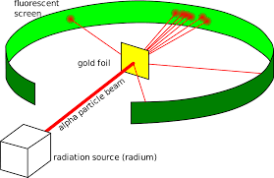
Ernest Rutherford: 1871 - 1937
IN 1909 performed the Gold foil experiment
Directed a stream of α²⁺ particles at a thin gold film
Expected a hole to be blown through the foil like a howitzer through tissue paper.
1 in 8000 bounced back!

Slide 8
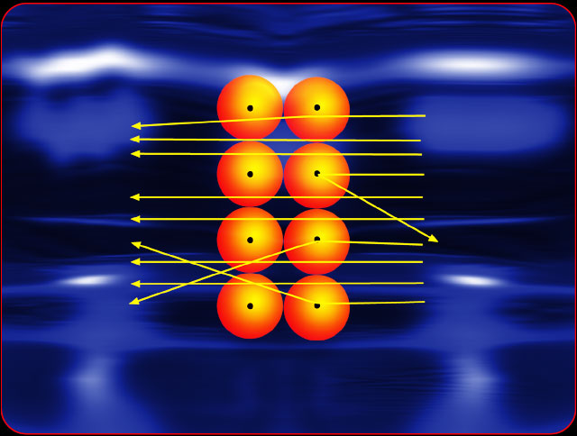
Rutherford’s conclusion:
Most a²⁺ particles went though unchanged because of the vast spaces in the atom
The deviations were caused by the nucleus
The charge of the nucleus must be positive
Reflected particles hit something massive.

Slide 9
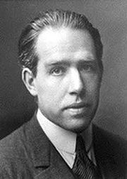
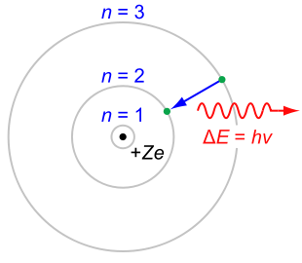
Neils Bohr: 1885 – 1962
Proposed the Planetary Model of the Atom in 1913
From observations of emission spectra of the hydrogen atom, changed our understanding of the atom
Small nucleus with a positive charge (like Rutherford)
Electrons orbit the nucleus like planets around the sun.

Slide 10
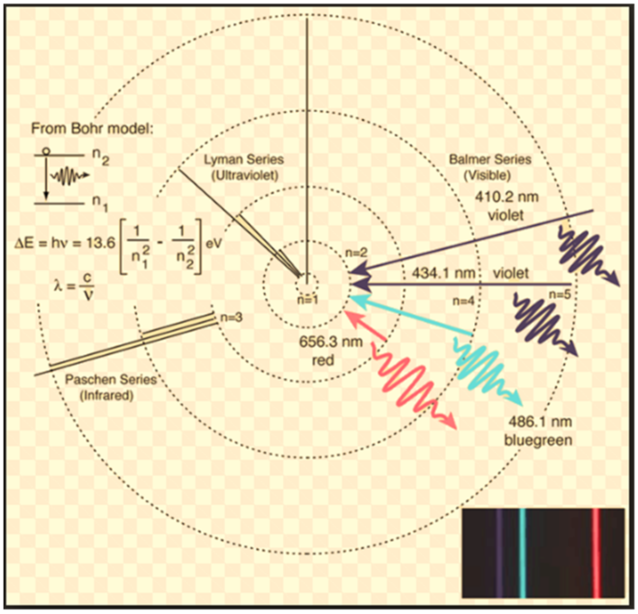
And energy levels too!

Slide 11
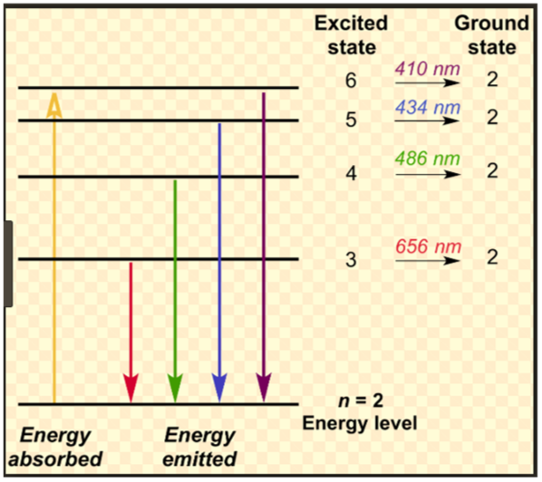
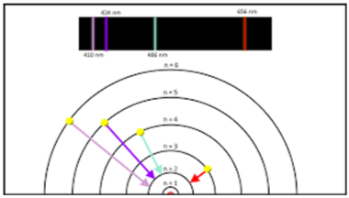
One more view…

Slide 12
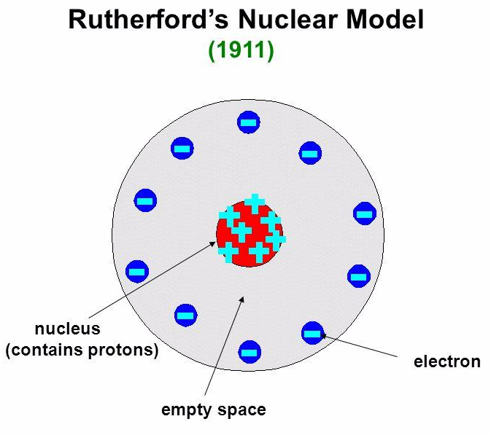
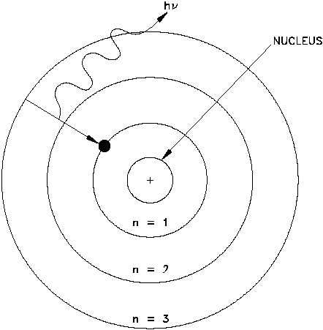
A comparison…
Rutherford Model Bohr Model

Slide 13
ChemicalChange
A new substance has formed
Observations that indicate a new substance
has formed
  Changes in color or temperature, and
production of light, a gas, or
a solid (we call a precipitate)

