Slide 1
Electrons:
Bohr’s Atomic Model and
The Quantum Model
Honors Chemistry Unit 2

Slide 2
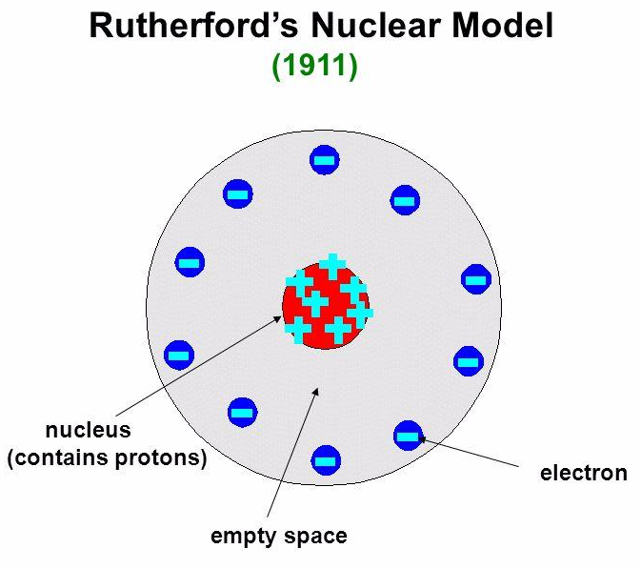
In the last unit you learned:
The nucleus is about 1 / 5,000
The size of the atom.
Notes:
about the discovery of the atomic nucleus, protons, and electrons. Ernest Rutherford’s atomic model showed atoms having a tiny, positively charged nucleus surrounded mostly by empty space.

Slide 3
Rutherford’s model did NOT explain the locations of electrons around an atom’s nucleus. His guess was that an atom looked something like the model here.

Slide 4
Part I: What is Light?
By the early 1900’s, scientists understood that light, which is a form of energy, has wave-like properties:
  Light can be described by both its frequency and wavelength. (More on next slide)
  Light travels at 3.00 x 10⁸ m/s in a vacuum. Its speed is nearly the same in air.

Slide 5
Speed of Light Equation
  c = λν
  c is speed of light
  λ is wavelength in meters
  ν is frequency; its units are waves per second or s⁻¹
  s⁻¹ is also referred to as hertz (Hz)

Slide 6
The speed of a wave depends on the medium it is traveling thru and can be calculated with
u = λν
How fast is a wave traveling whose wavelength and frequency are 17.4-cm and 87.4-Hz?

Slide 7
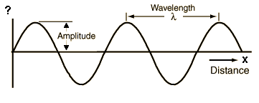
Speed, wavelength, & frequency of light
The speed of ALL light (c) = 3.00 x 10⁸ m/s

Slide 8
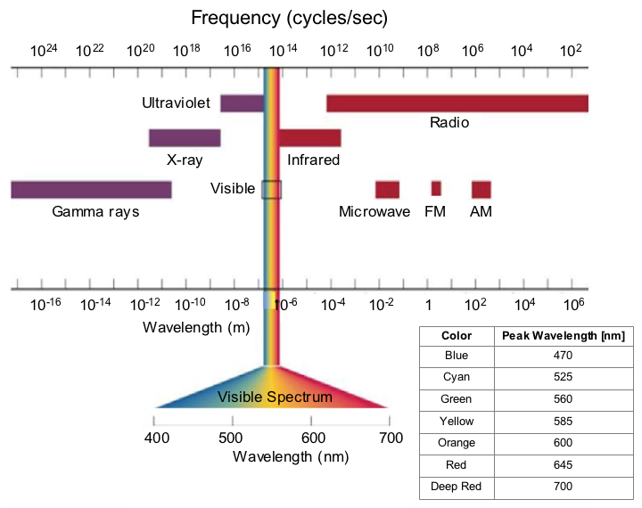
The Electromagnetic Spectrum
What color is photon with
a frequency of 4.61E14 Hz?
651-nm is Red
(6.5075EE⁻7-m)

Slide 9
Does all light have the same energy?
Scientists knew that electrons in atoms could be excited when hit by an energy source.
They assumed that all light, regardless of its frequency, carried enough energy to knock an electron off a piece of metal.
In the early 1900’s the discovery of the photoelectric effect disproved this.

Slide 10
What is the photoelectric effect?
The photoelectric effect refers to the ability of sufficiently high frequencies of light to “knock” electrons off a metal’s surface.
Electrons would not be emitted from the metal unless the frequency of the light shining on it was above a certain minimum.
View the link: (click here) the photoelectric effect explained

Slide 11
What led to the discovery of the Dual Nature of Light?
(~1900) German physicist Max Planck studied the emission of light from hot objects.
He concluded that hot objects do not emit light in continuous waves like the sun does. Instead they emit light in small, fixed amounts called quanta (plural for quantum).

Slide 12
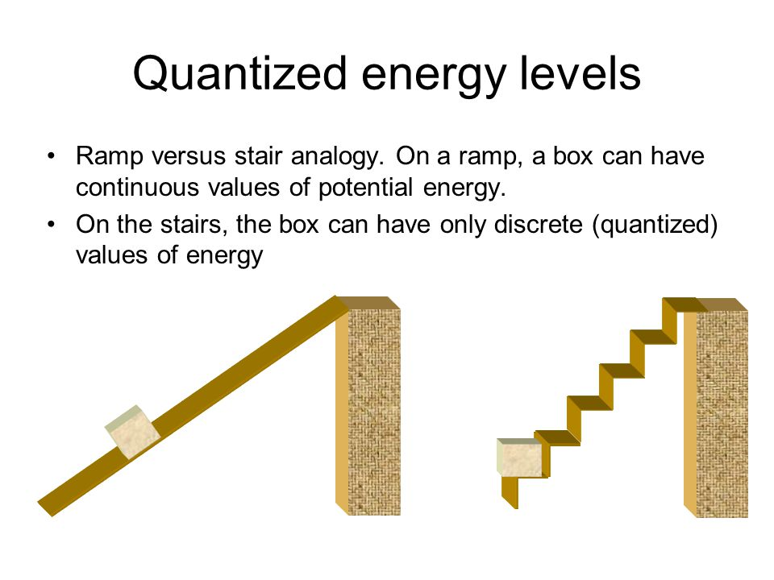
What is a Quantum?
A quantum is the minimum amount of energy that can be gained or lost by an atom’s excited electron.

Slide 13
What led to the theory of
The Dual Nature of Light?
Planck defined the relationship between a quantum of energy and the frequency of light it represents with the equation
E = hν
where
E is the energy (in joules, J) of a light photon
h is Planck’s constant, 6.626 x 10⁻³⁴ J·s
ν is frequency in hertz (1 Hz = 1/s)

Slide 14
What is the Dual Nature of Light?
In 1905, Albert Einstein expanded on Planck’s theory by proposing that light acts as both a wave and a particle; this theory is known as the DUAL NATURE OF LIGHT.
Einstein called particles of light PHOTONS (defined on next slide).

Slide 15
What is a photon?
A PHOTON is a particle of light having zero mass and carrying a quantum of energy.

Slide 16
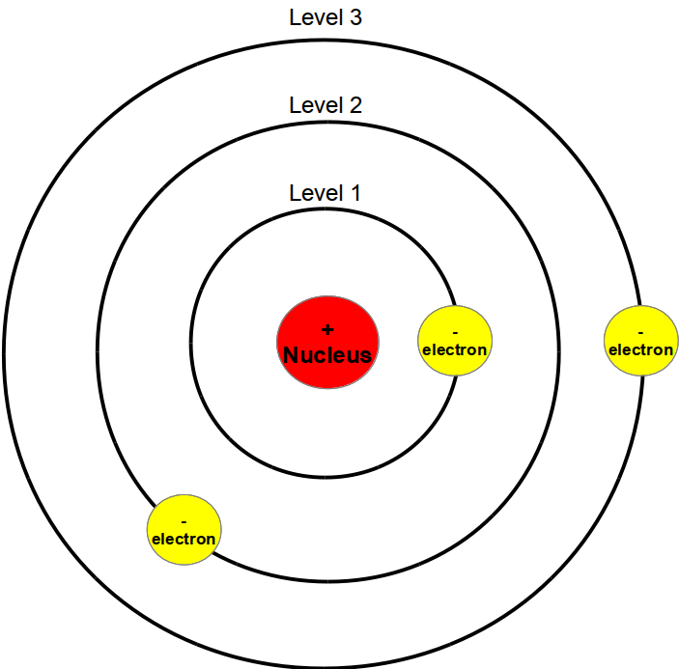
Part II: The Bohr Model of the Atom

Slide 17
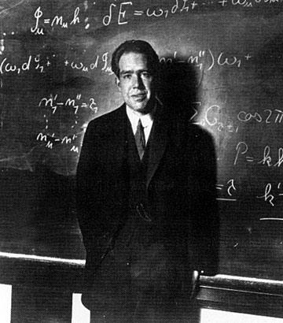
Meet Niels Bohr
(Danish physicist,1885-1962)
Bohr was a former student of Ernest Rutherford.
Bohr performed experiments with hydrogen to study electron behavior.

Slide 18
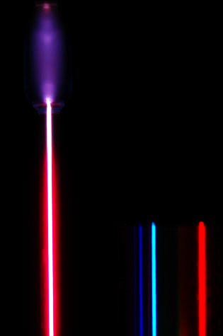
Why hydrogen? Because it has only one electron. Bohr wanted to study the electron’s location and movement in the atom.

Slide 19
Electron energy levels can be thought of as rungs of a ladder that are not equally spaced.
More energy is required at bottom than at top.

Slide 20
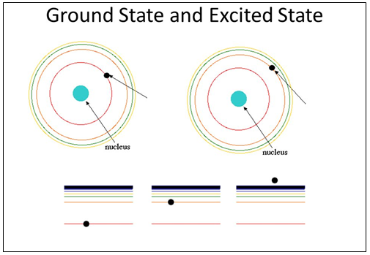
Electron Energy States
Ground state: the lowest possible energy level an electron can have.
Excited state: an energy level higher than the ground state.
Ground
State
Excited
State
Ground State
Excited State
Free Electron

Slide 21
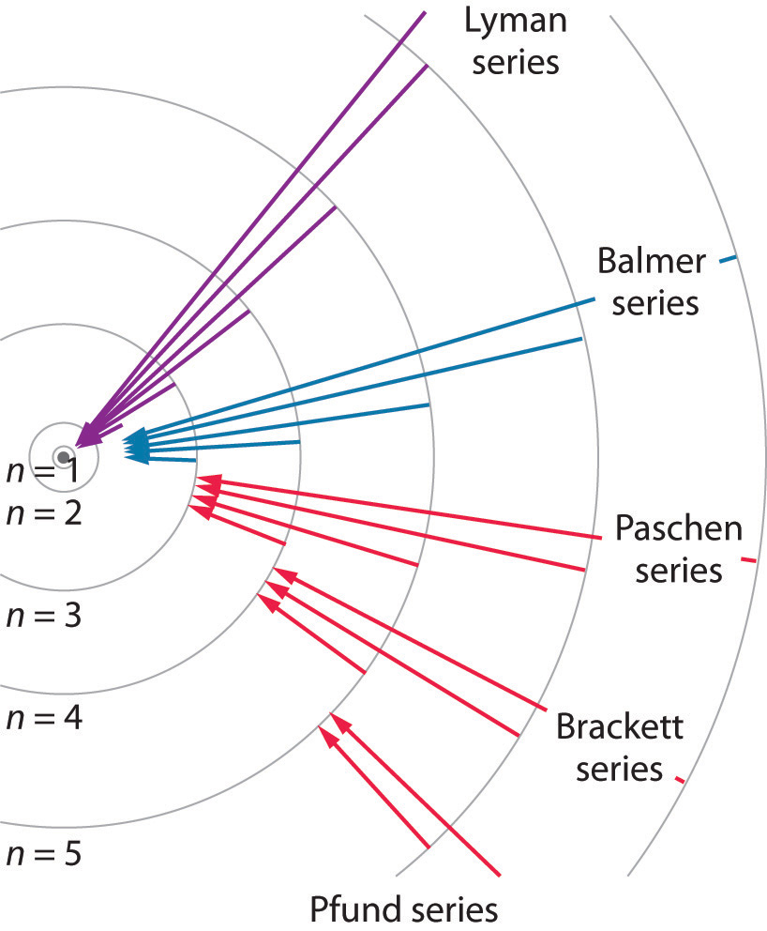
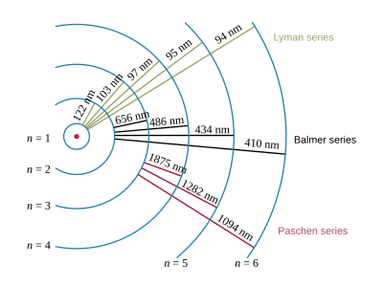
The Bohr Model Quantified

Slide 22
When Bohr ran electricity through a sample of hydrogen, he found that the excited electrons “jumped” from their ground state to an excited state further from hydrogen’s nucleus.

Slide 23
As the electrons “fell” from the excited state to their ground state, they released the absorbed energy as “particles” of light (PHOTONS), and only certain frequencies of light were emitted.

Slide 24
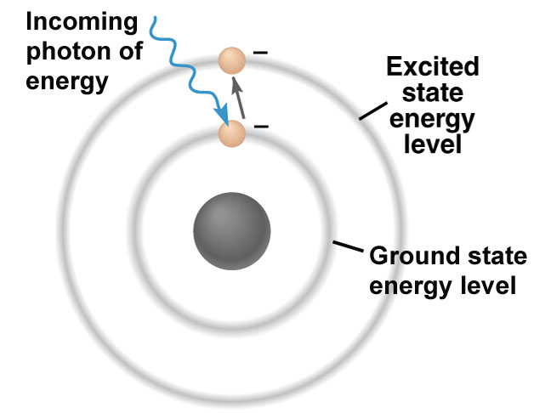
This diagram shows an electron being struck by a photon of light. If enough energy (a quantum) is absorbed, the electron will “jump” from its ground state to an excited state.

Slide 25
As electrons “fall back” from their excited state to their ground state, they release the energy they had absorbed in the form of photons of quantized energy. This energy is directly proportional to the photon’s frequency.
Ephoton = hν
E is energy in joules, h is Planck’s constant, and v is frequency.

Slide 26
Ex/ What is the frequency of a radio wave
whose energy is 1.55E-24-J/photon?
2.34E9-s⁻¹
Ex/ What is the energy associated with an e-
traveling in a wavelength of 1.3E4-nm?
1.5E-20-J

Slide 27
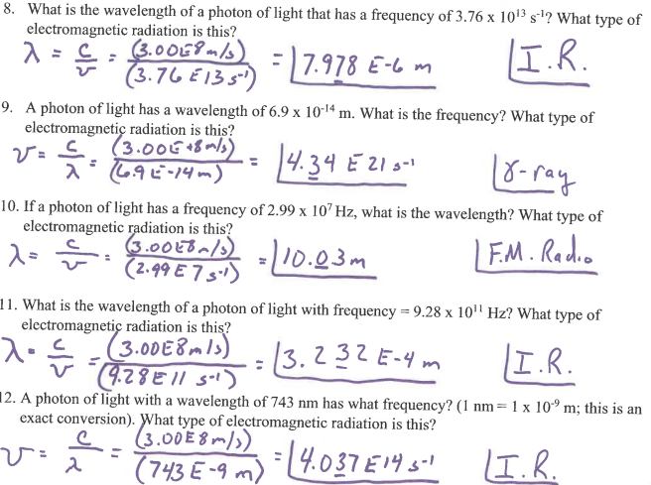

Slide 28
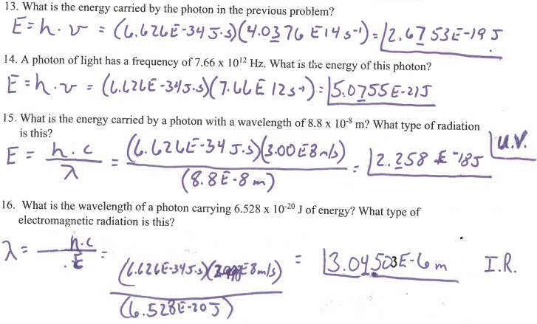

Slide 29
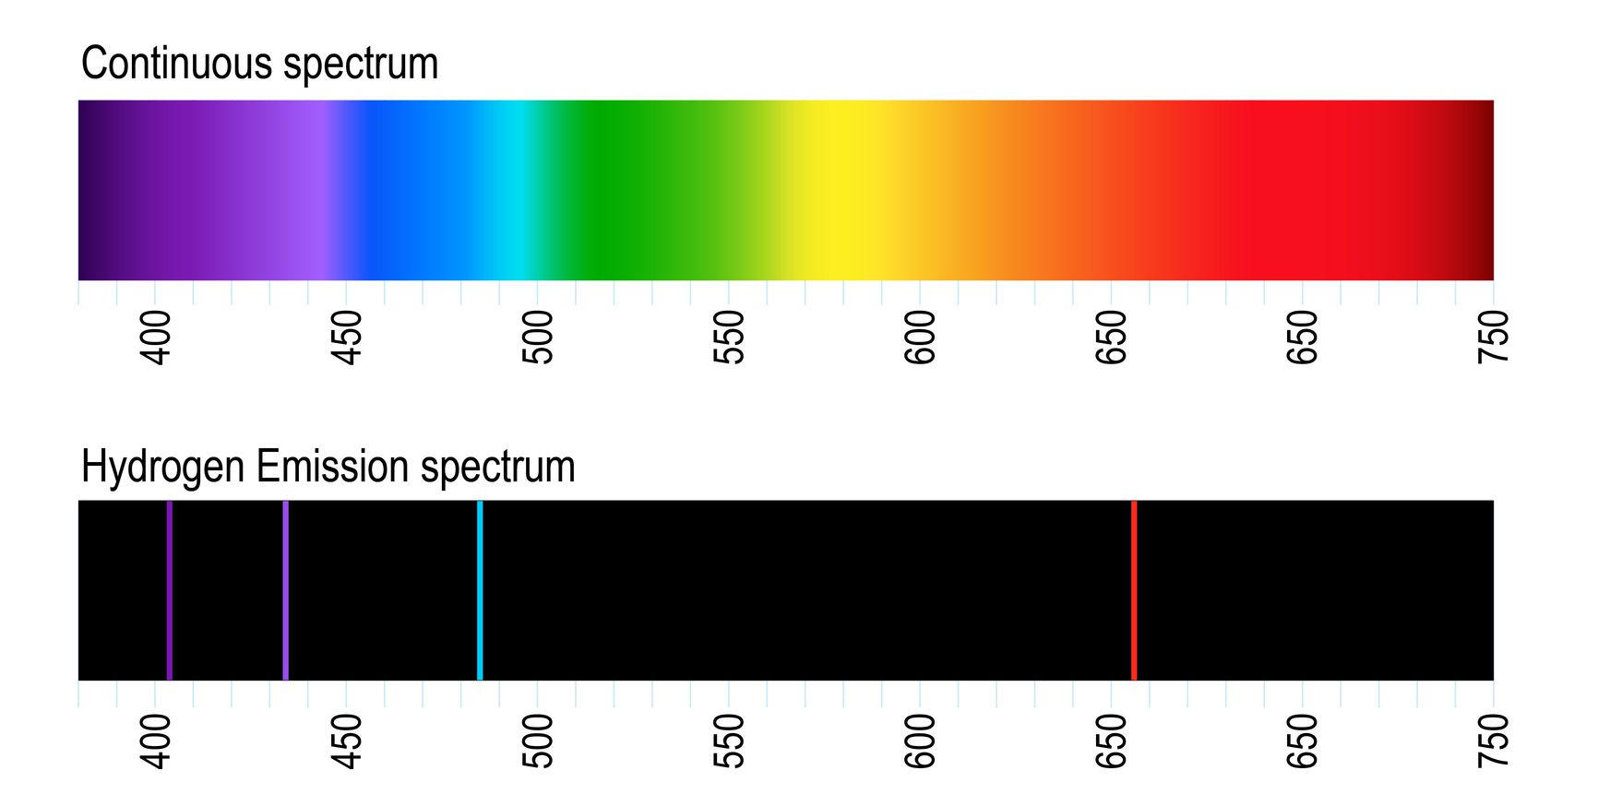
Bohr called the frequencies of light emitted by gases excited electrons the atomic emission spectrum.

Slide 30

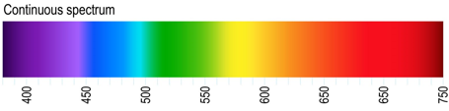
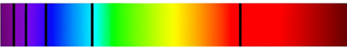

Slide 31
Bohr’s atomic model (~1913)
Video (6min)
Bohr quantized the energy of the electron in the hydrogen atom.

Slide 32
Bohr’s Contributions to Atomic Theory
He identified several important features about electrons’ distribution in an atom, including:
The energies of electrons (energy levels) in an atom are quantized and described by quantum numbers (n).
An electron’s energy increases with increasing distance from the nucleus.
The lines in the atomic emission spectrum of an element result from quantized electron energies.

Slide 33
Limitations of the Bohr model
The Bohr model explained the energy “jumps” of hydrogen’s one electron, but it did not explain the behavior of all electrons in all elements.

Slide 34
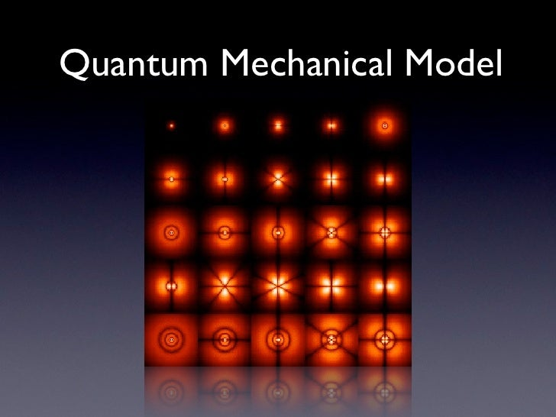
Part III: The Quantum Mechanical Model of the Atom
Developed in the 1920’s through the work of several scientists

Slide 35
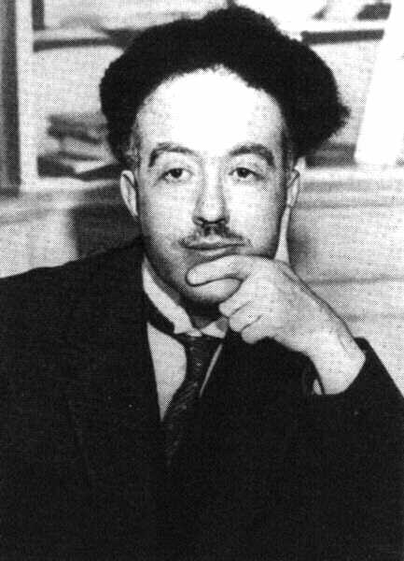
Niels Bohr proposed that electrons have fixed amounts energy that determine the radius paths around an atom’s nucleus.
Louis de Broglie disagreed, arguing that if light can behave like a particle why can’t e⁻ move like a standing wave?
Notes:
1926

Slide 36

Notice how only whole wavelengths exist.
Called a standing wave

Slide 37
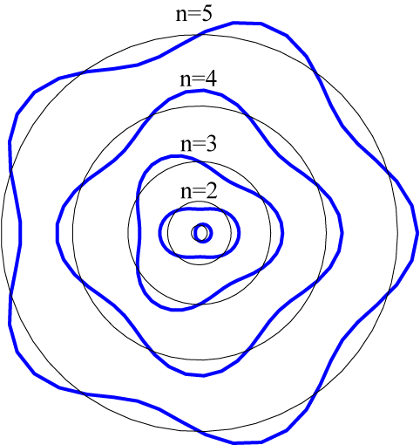
Here is De Broglie’s model of an electron’s
motion around an atom’s nucleus in principle
energy levels n=1 to n=5.
These are just standing waves connected end to end.
1 wave = 1st energy level,
2 waves = 2nd energy level,
3 waves = 3rd energy level,…

Slide 38
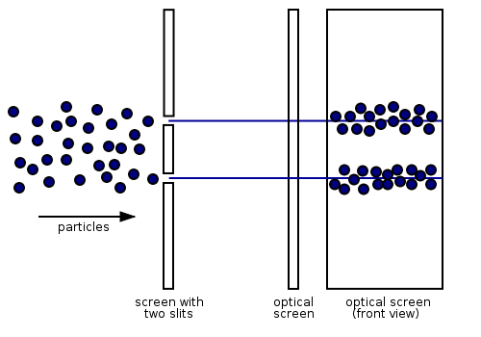
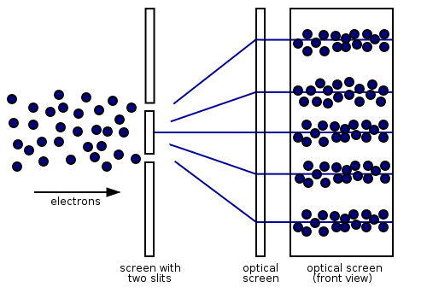
Wavelike properties of electrons have been demonstrated using the double slit experiment.
Actual pattern of electrons on screen proves that they move in a wave-like pattern.
Classical model of electrons; what their motion would look like if they behaved only as particles.

Slide 39
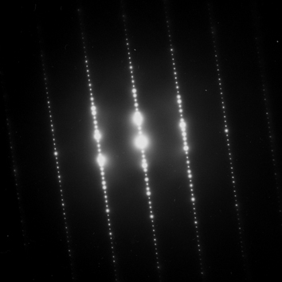
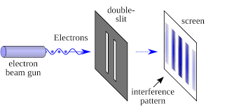
This is the pattern made by electrons striking a screen after traveling through two side-by-side slits.

Slide 40
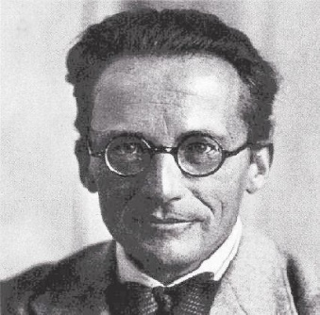
Erwin Schrödinger (Austrian Physicist, circa 1926)
Schrödinger was able to write mathematical equations that accurately describe the likelihood of finding an electron in a certain region around an atom’s nucleus. This resulted in the quantum mechanical model of the atom.
Notes:
Using Bohr’s model, de Broglie’s wave theory, and other’s work. New uantum Theory – pre 1926.

Slide 41
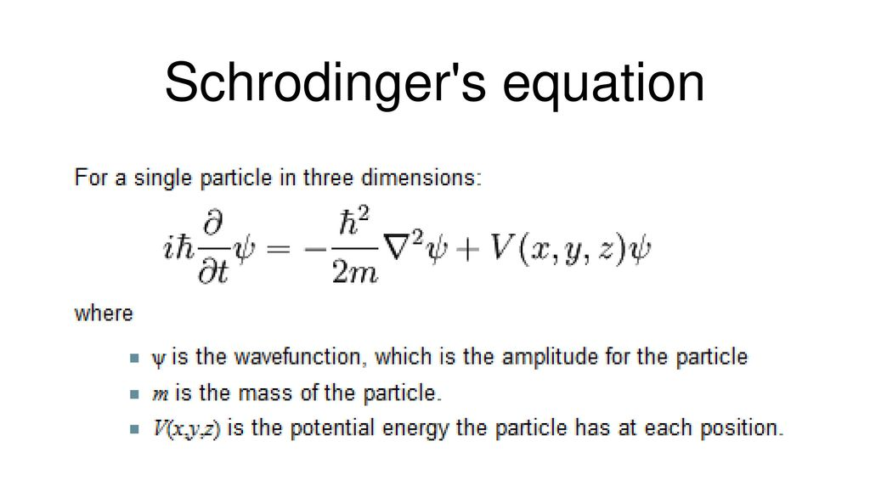
This is just for inquiring minds and is NOT required for you to learn!

Slide 42
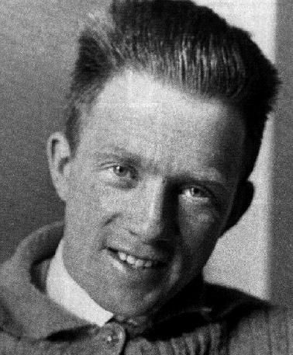
Heisenberg’s Uncertainty Principle:
One cannot describe both the position and momentum of a particle at the same time.
Momentum = mass x velocity

Slide 43
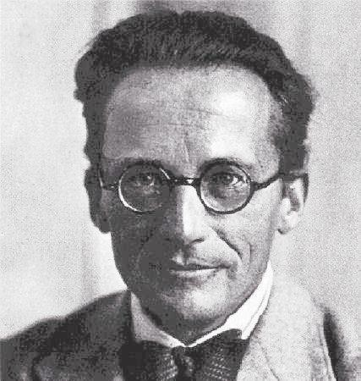
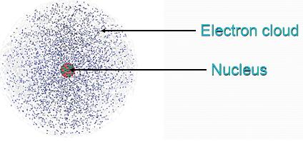
Unlike the Bohr model, the quantum mechanical model does not describe the path of an electron as a circular orbit. Instead, it uses “electron clouds” that indicate a 90% probability of finding an electron at any point in time.
The probability cloud of hydrogen’s one electron is shown at right.

Slide 44
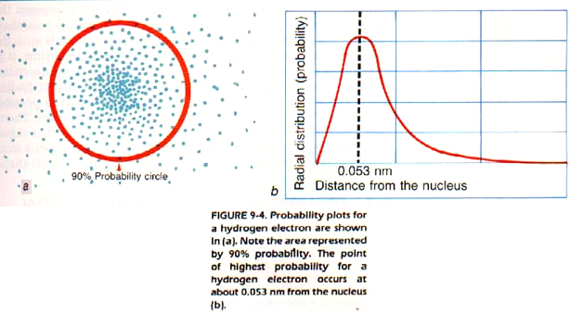
Probability of finding hydrogen’s one electron vs. distance from nucleus

Slide 45
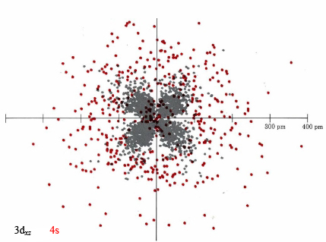
Each region in which there is a 90% probability of finding an electron is called an atomic orbital (6min). Denser regions in the electron “cloud” indicate greater probability of finding an electron.

Slide 46
Summary of the Quantum Mechanical Model
Electrons are located in orbitals within specific energy levels. Each orbital is a region in which there is a 90% probability of finding an electron.
There is no exact electron path around the atom’s nucleus. Instead, the model uses “electron clouds” to represent their most likely positions.

Slide 47
According to the quantum mechanical model, each electron has a unique set of QUANTUM NUMBER’s which describes its energy level and the shape of its orbital.

Slide 48
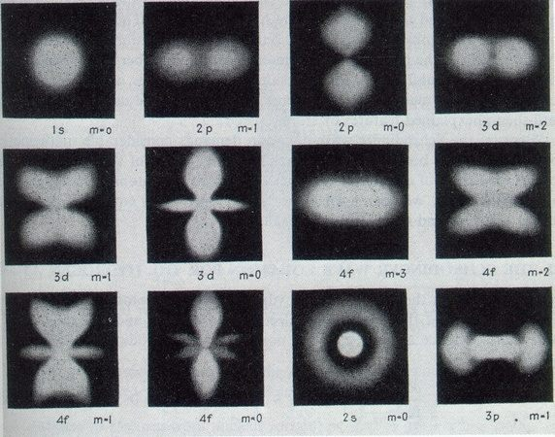
Electron probability clouds for s,p,d,& f orbitals

Slide 49
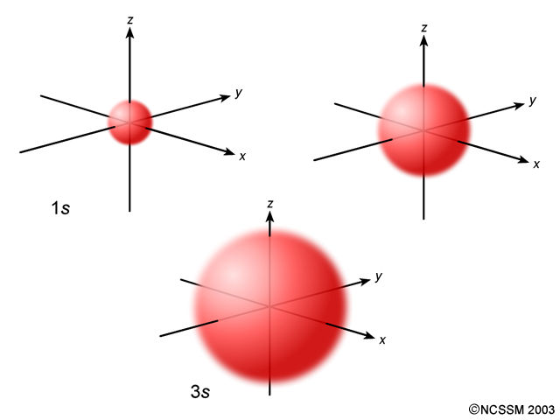
s orbital
There is one in each principal energy level. It can hold a maximum of 2 electrons.
2s

Slide 50
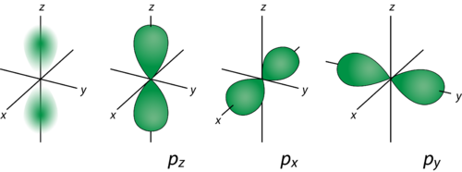
p orbitals
There are 3 in each principal energy level beginning with n = 2. Together they hold a maximum of 6 electrons.

Slide 51
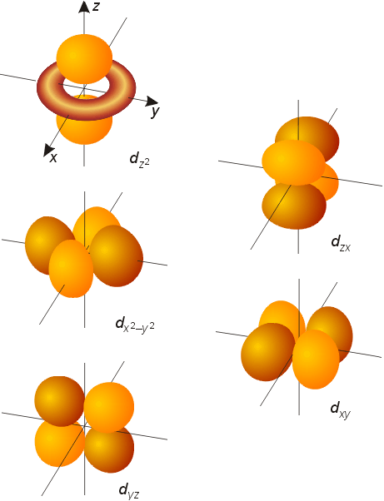
d orbitals
There are 5 in each principle energy level beginning with n = 3.
Together they can hold a maximum of 10 electrons.

Slide 52
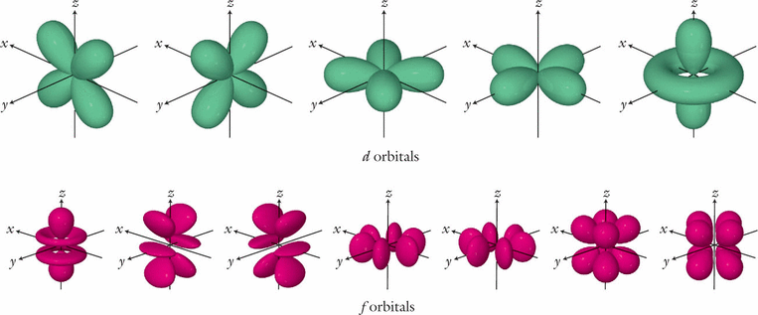
f orbitals
There are 7 in each principal energy level beginning with n = 4. Together they hold a maximum of 14 electrons.

Slide 53
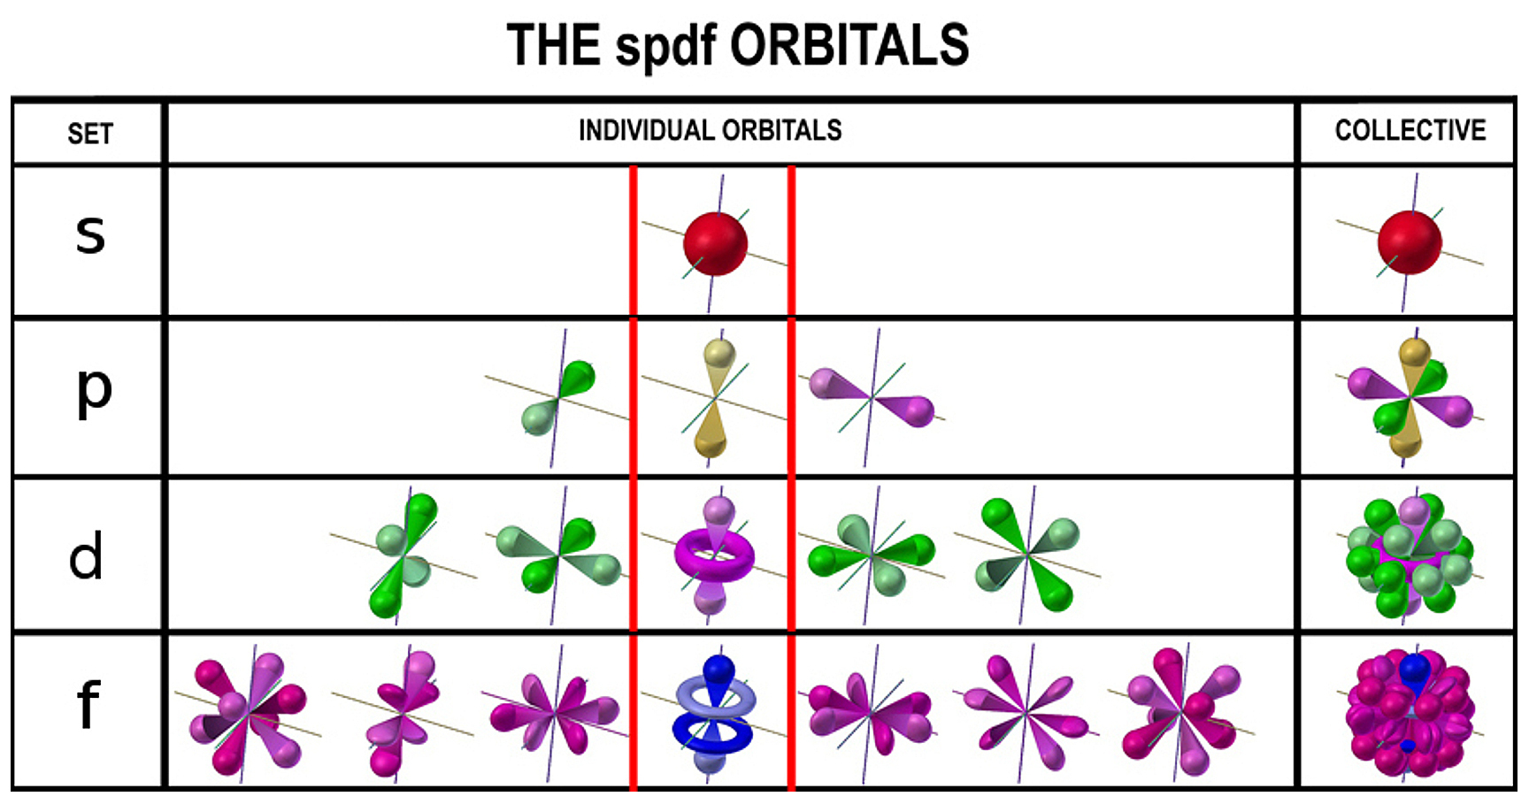

Slide 54
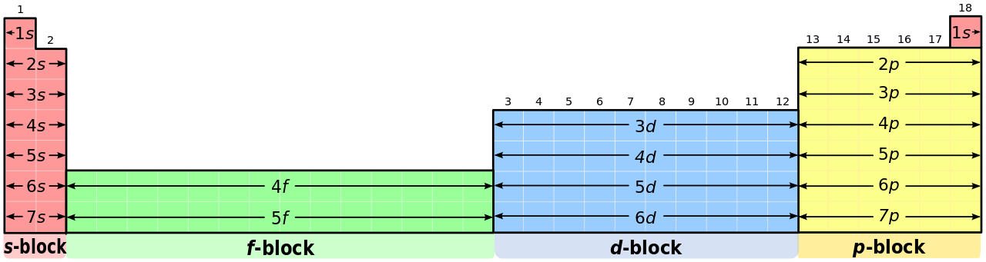
Principal Energy Levels (n) of Electrons
Each row on the periodic table is labelled n=1 to n=7. These #’s are the principal quantum numbers (energy levels) of electrons in all known elements.

Slide 55
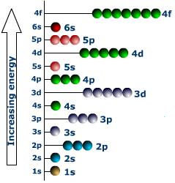
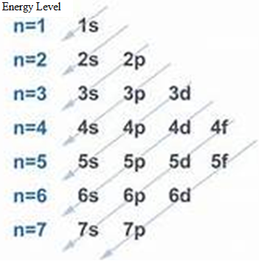
Energy Level Diagram
Electron Placement
3d
3rd Energy level d Sub-level
Notes:
Energy Level – (n) principle Q#. Sub-level – (L) azimuthal Q#. m_{L} and m_{s}

Slide 56
What are Degenerate Orbitals?
Orbitals of equal energy in each principal energy level are called degenerate orbitals.
This includes the p-orbitals, d-orbitals and f-orbitals in each principal energy level.

Slide 57
Summary of Orbitals
Orbital Type | Present in each energy level beginning with | Number of suborbitals per energy level | Maximum # of electrons
s | n=1 | 1 | 2
p | n=2 | 3 | 6
d | n=3 | 5 | 10
f | n=4 | 7 | 14

Slide 58
