Slide 2
Good Morning
Groups may be No Larger than (3)
Measurement Redo choose from stations 1-6
Evidence of Chemical Change use station 9 or 10
        Open Schoology for directions
All others sit in the Mainland

Slide 3
Chapter 3: Atoms
The history in the development of Atomic Theory from original idea to physical experimentations.

Slide 4
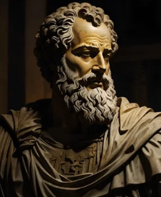
DEMOCRITUS (460-370 BC)
a Greek philosopher who proposed that everything is made of tiny indivisible particles which he named “atomos”, meaning “uncuttable”. He believed these atomos were homogeneous with no internal structure. This was the oldest reference to an atom.

Slide 5
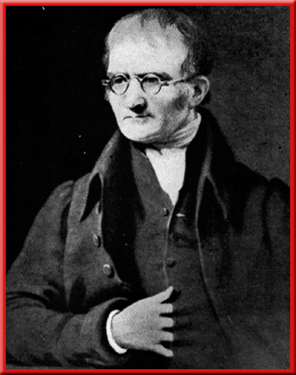
John Dalton’s (1766-1844)
Cue Ball Model
Atomic Theory
Matter is composed of tiny, indivisible particles called atoms.
Not true-we can break atoms

Slide 6
John Dalton’s (1766-1844)
Cue Ball Model
Atomic Theory
2. Atoms of the same element are exactly the same as each other.
Not true- masses of each atom can be different.
(Ca-40, Ca-43, Ca-46)

Slide 7
John Dalton’s (1766-1844)
Cue Ball Model
Atomic Theory
3. Atoms can not be changed into different atoms in chemical reactions.
True

Slide 8
John Dalton’s (1766-1844)
Cue Ball Model
Atomic Theory
4. Atoms of different elements combine in simply whole number ratios making compounds.
True

Slide 9
John Dalton’s (1766-1844)
Cue Ball Model
Atomic Theory
5. The types of atoms and their ratios are the same throughout a compound.
True

Slide 10
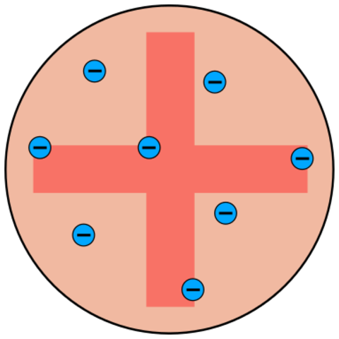
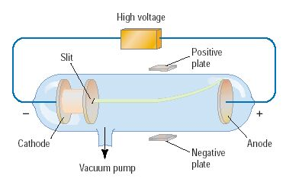
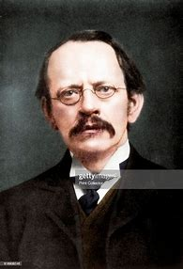
J.J. Thomson
Plumb Pudding Model
Cathode Ray Tube Experiment 1897
Noticed a ray of light created by electrifying atoms.
Could be deflected by negative charged plate.
Discovered the electron.

Slide 11
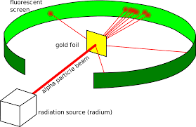
Ernest Rutherford’s
Gold Foil Experiment 1908-1913
              Took newly discovered alpha particles (α²⁺) and shot them at thin sheets of foil.
The sheet was not damaged..
            Most went straight thru.
              Some were deflected to the side.
              1 in 8,000 were reflected back.

Slide 12
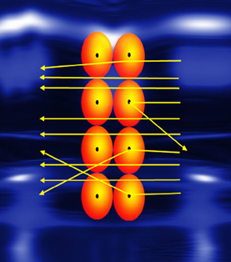
Rutherford’s conclusion:
Most α²⁺ particles went though unchanged because of the vast spaces in the atom
The deviations were caused by the nucleus
The charge of the nucleus must be positive
Reflected particles hit something massive.

Slide 13
Good Morning
After you place your phone in the caddy,
take your seat and get out your assignment.

Slide 14
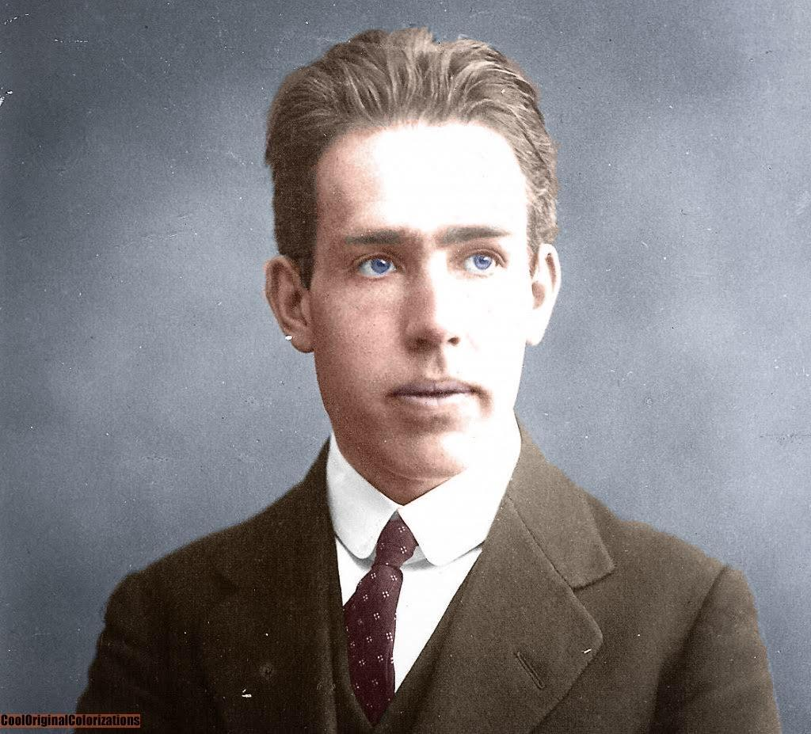
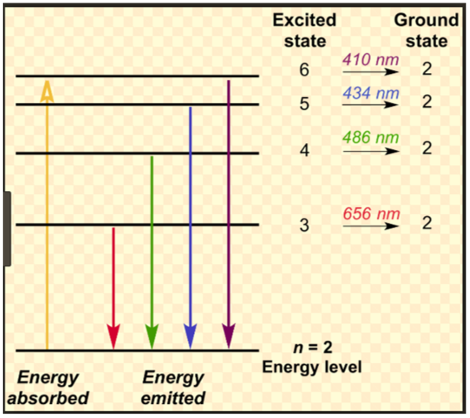
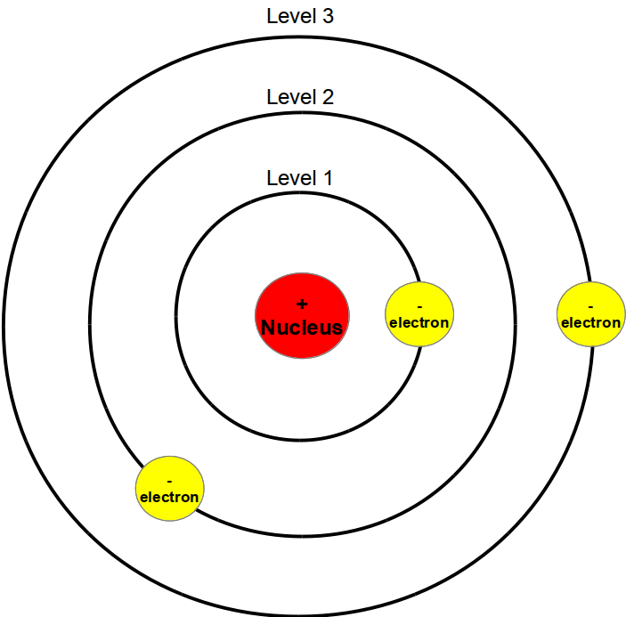

Neils Bohr: 1885 – 1962
Proposed the Orbital Model of the Atom in 1913
Electrons orbit the nucleus like planets around the sun.
Small nucleus with a positive charge (like Rutherford)
From observations of emission spectra of the hydrogen atom, changed our understanding of the atom

Slide 15
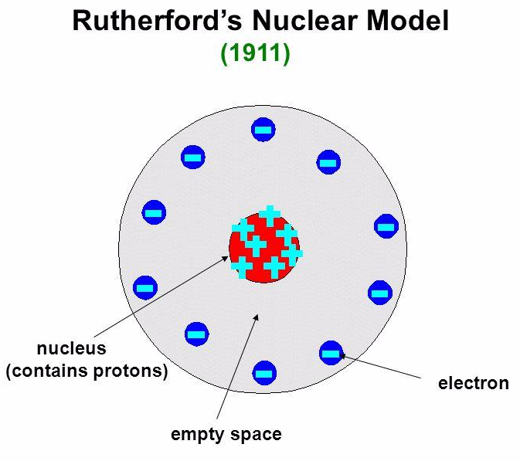
A comparison…
Rutherford Model Bohr Model

Slide 16
Atomic Structure
Atom:
Symbol:
Atomic Number:
the smallest particle of an element that
retains the properties of that element.
One or two letters representing the element.
1st letter is always capitalized
a 2nd letter is always lower case.
# of p⁺ in the atom

Slide 17
Atomic Structure
Mass Number:
# of Protons:
# of Neutrons:
# of electrons:
Ions: charged particles
# of p⁺ and # of n⁰
What is the mass # of Arsenic with 42 n⁰?
33 p⁺ + 42 n⁰ = 75
Equal to the atomic #
Mass # - # p⁺ = # of n⁰
How many n⁰ does Ni-60 have?
60 amu – 28 p⁺ =32 n⁰
# of p⁺

Slide 18
What are Isotopes?
ISOTOPES are atoms of the same element with different numbers of neutrons.
Isotopes of an element have the same atomic number but different atomic masses.

Slide 19
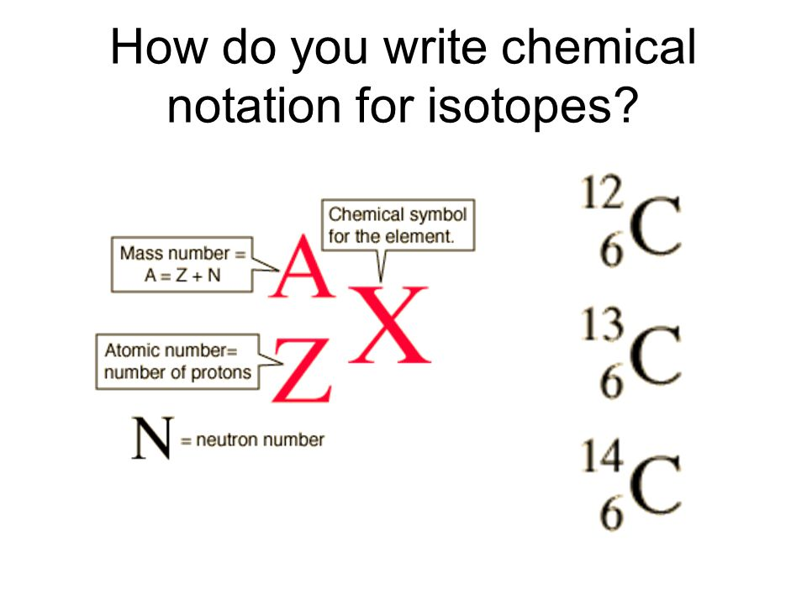
How to write isotopic symbols

Slide 20
How to write isotopic symbols
Carbon-12 or C-12
Carbon-13 or C-13
Carbon-14 or C-14

Slide 21
Use Isotopes to Find
Average Atomic Mass
Multiply each isotope's mass by its decimal abundance (82% would be 0.82).
Add the products of each isotope.

Slide 22
Use Isotopes to Find
Average Atomic Mass
The equation looks like this:
(mass of isotope 1)(its decimal abundance) +
(mass of isotope 2)(its decimal abundance) +
(mass of each additional isotope)(its decimal abundance)
What is the average atomic mass of vanadium?
Given it has two isotopes:
V-50 (mass = 49.9472 amu, 0.250%)
V-51 (mass = 50.9440 amu, 99.750%)

Slide 23
Use Isotopes to Find Average Atomic Mass
Average atomic mass =
(49.9472 amu)( 0.00250)
+ (50.9440 amu)(0.99750)
50.941508 amu

