Slide 1
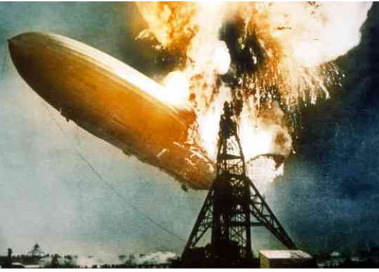
Gibbs Free Energy
and Spontaneity

Slide 2
Comparing Entropy Values between Substances in the Same State
Entropy increases as freedom of motion within a substance increases.
For two substances in the same state, the larger molecule has a greater # of possible rotations of its atoms, so it has a higher entropy value.

Slide 3
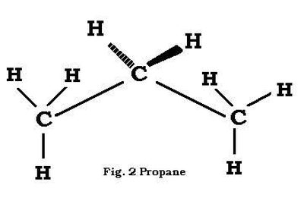

Comparing Entropy Values between Substances in the Same State
Example: Which has more entropy?
Cl₂ (g) and, propane (C₃H₈ _{(g)})has more atoms and thus more positional entropy.

Slide 4
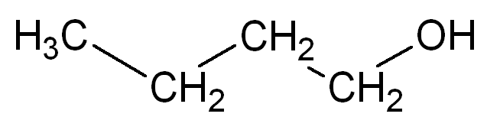
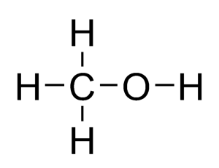
Which liquid has greater entropy, butanol (l) or methanol (l)?
Which liquid has greater entropy, butanol or methanol?
Butanol has more atoms, thus greater entropy.

Slide 5
A spontaneous process is a change that occurs with no outside help.
If ΔS for both a system AND its surroundings is positive (ΔS_{universe} > 0), the reaction will ALWAYS be spontaneous.
For example, combustion reactions have positive ΔS values for both the system and surroundings.
If ΔS_{sys} and ΔS_{surr} are NOT both positive, factors like ΔH and temperature will also affect spontaneity of a reaction.

Slide 6
Predicting Spontaneity
 | -ΔH_{sys} | +ΔH_{sys}
+ΔS_{sys} | always spontaneous | spontaneous at HIGH temps
-ΔS_{sys} | spontaneous at LOW temps | never spontaneous

Slide 7
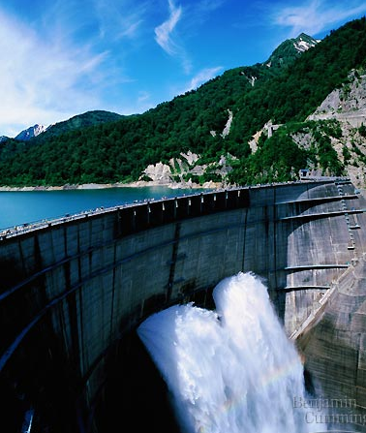
Energy and the States of Energy
Energy is the ability to do work or produce heat.
Potential energy =
Stored energy
Kinetic energy =
Energy of motion
Notes:
Types of Energy
Mechanical Energy- Energy of objects moving or restrained movement; for example stretching a rubber band has potential mechanical energy.
Nuclear Energy- Energy contained in the nucleus of an atom and is released during an atomic reaction like detonating a hydrogen bomb.
Chemical Energy- Energy stored in chemical bonds or released during chemical reactions.
Electromagnetic Energy- Energy found in electromagnetic waves such as radiant energy or energy from a microwaves or energy from radio waves.
Electric Energy- Energy released as electrons move from point A to point B, usually through a wire.
Heat Energy- Energy involved in the movement of molecules.

Slide 8
Free Energy
Gibbs free energy (symbol G) is energy that is available to do work.
The amount of free energy in a system is always lower than the total energy of the system.
Notes:
In a closed system (one in which energy does not leave or enter), there is a decrease in the system’s usable energy, or free energy, and an increase in the system’s unusable energy as energy transformations occur.
The universe is a closed system but the Earth is not because energy in the form of light energy is constantly reaching the Earth.
Technically, free energy is called Gibb’s free energy after Josiah W. Gibbs, the 19th century chemist who quantified free energy as this lesson details.

Slide 9
Exergonic and Endergonic Reactions
Changes in free energy can be found using
ΔG = ΔH – TΔS
When ΔG is -, the reaction is spontaneous.
When ΔG is +, the reaction is nonspontaneous. Its reverse reaction is spontaneous instead.
When ΔG = 0, the reaction is at equilibrium (not spontaneous in either direction)
Notes:
In general, exothermic reactions are exergonic and endothermic reactions are endergonic.
Alka Seltzer is a endothermic reaction
C₆H₈O₇(aq)+3NaHCO₃(aq)→3H₂O(l)+3CO₂(g)+Na₃C₆H₅O₇(aq)
citric acid+sodium bicarbonate→water+carbon dioxide+sodium citrate

Slide 10
Exergonic and Endergonic Reactions
You may see the free energy equation expressed as
ΔGº = ΔHº – TΔSº
What does the symbol º indicate?
The symbol º indicates that the system is in its STANDARD STATE, 25ºC (298 K) and 1 atmosphere of pressure.
Notes:
In general, exothermic reactions are exergonic and endothermic reactions are endergonic.
Alka Seltzer is a endothermic reaction
C₆H₈O₇(aq)+3NaHCO₃(aq)→3H₂O(l)+3CO₂(g)+Na₃C₆H₅O₇(aq)
citric acid+sodium bicarbonate→water+carbon dioxide+sodium citrate

Slide 11
Exergonic and Endergonic Reactions
ΔG = ΔH – TΔS
An exergonic reaction (-ΔG) is one that releases free energy to the surroundings.
An endergonic reaction (+ΔG) is one that absorbs free energy from its surroundings.
Notes:
In general, exothermic reactions are exergonic and endothermic reactions are endergonic.
Alka Seltzer is a endothermic reaction
C₆H₈O₇(aq)+3NaHCO₃(aq)→3H₂O(l)+3CO₂(g)+Na₃C₆H₅O₇(aq)
citric acid+sodium bicarbonate→water+carbon dioxide+sodium citrate

Slide 12
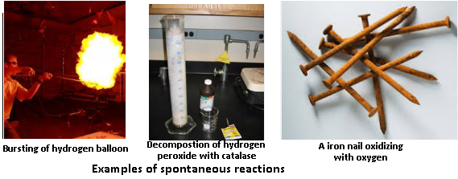
Spontaneous Reactions
Spontaneous reactions are energetically favorable and occur without outside energy.
Systems generally move from a higher to a lower energy state, so exothermic reactions are generally spontaneous …but not always.
Notes:
The illustrations demonstrate that the speed of spontaneous reactions can differ. Mention that spontaneous reactions are the not same as instantaneous reactions.

Slide 13
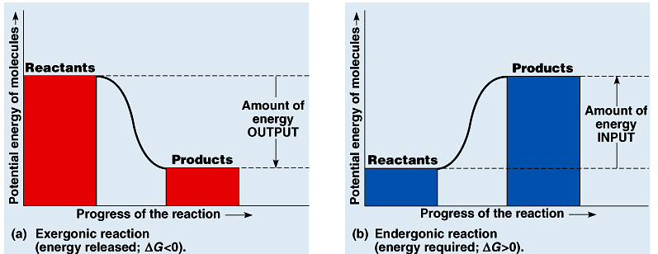
Spontaneous process: ΔG < 0 (negative)
Notes:
In the first example the initial state has more energy than the final state so that the change in free energy is a negative value.
If τηε χηανγε ιν φρεε ενεργψ is negative, then the reaction is exergonic (releases energy). The difference in the free energy of the products and the reactants represents the amount of energy that is released, or energy output.
In the second example the initial state has less energy than the final state so that the change in free energy is a positive value.
If τηε χηανγε ιν φρεε ενεργψ is positive, then the reaction is endergonic (absorbs energy from the surrounding). The difference in the free energy of the products and the reactants represents the amount of energy that is absorbed, or energy input.

Slide 14
Nonspontaneous process: ΔG > 0 (positive)
Notes:
In the first example the initial state has more energy than the final state so that the change in free energy is a negative value.
If τηε χηανγε ιν φρεε ενεργψ is negative, then the reaction is exergonic (releases energy). The difference in the free energy of the products and the reactants represents the amount of energy that is released, or energy output.
In the second example the initial state has less energy than the final state so that the change in free energy is a positive value.
If τηε χηανγε ιν φρεε ενεργψ is positive, then the reaction is endergonic (absorbs energy from the surrounding). The difference in the free energy of the products and the reactants represents the amount of energy that is absorbed, or energy input.

Slide 15
Effects of Changes in Entropy and Its Effect Examples of spontaneous reactions
CaCl_{2(S)} → Ca²⁺_{(aq)} + 2Cl⁻_{(aq)}
This is exergonic and exothermic.
(ΔG is negative, ΔH is negative, ΔS is positive)
NH₄Cl_{(s)} → NH₄⁺_{(aq)} + Cl⁻_{(aq)}
This is exergonic but endothermic. (ΔG is negative, ΔH is positive, ΔS is positive)
Notes:
Relate this back to the video of dissolving calcium chloride versus ammonium chloride.

Slide 16
Finding the temperature at which a reaction is spontaneous when ΔH > 0 and ΔS > 0:
When ΔG = 0, a reaction is at equilibrium.
To find the temperature at which an endothermic reaction becomes spontaneous, set ΔG = 0.
This gives ΔH = TΔS
Solve for T. This is the “tipping point” for the reaction. Any temperature above this will make the reaction spontaneous. Below this temperature, the reaction is nonspontaneous.
Notes:
Relate this back to the video of dissolving calcium chloride versus ammonium chloride.

Slide 17
Determine ΔG for the formation of water vapor.
ΔGº = ΔHº – TΔSº
Write a balanced equation.
Look up ΔH values for each chemical.
ΔH_{Rxn} = ΔH_{Products} - ΔH_{Reactants}
ΔH_{Products} = 2mol (-241.8-kJ/mol) = -483.6-kJ
Given ΔSº_{Rxn} = -89.0J/K
ΔGº = -457.078kJ
Is this reaction spontaneous?

