Slide 1
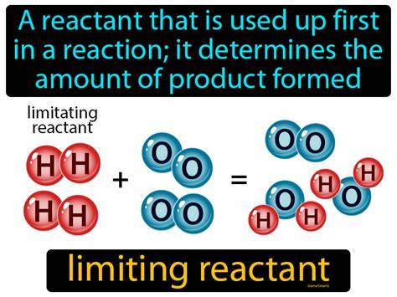
Limiting & Excess Reactants
When you have a chemical reaction of 2 or more reactants, you will have one all used up and the others with some left over.
              The one used up is called the Limiting Reactant.
              The ones left over are called Excess Reactants.

Slide 2
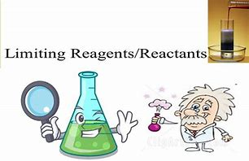
Limiting & Excess Reactants
To determine limiting reactant you will need to calculate the amount of product each quantity of reactant can make.
The one that makes the least is the limiting reactant.
The rest are in excess.
To calculate the excess, find the amount used by the limiting reactant and subtract it from the starting amount.

Slide 3
Limiting & Excess Reactants
Ex 1/ How many sandwiches can you make with 20 Br, 40 Hm, and 15 Ch if you use the following equation to make a sandwich?
          2Br + 3Hm + 1 Ch → 1 Br₂Hm₃Ch
  ?Br₂Hm₃Ch=(20 Br) ( 1 Br₂Hm₃Ch / 2 Br ) =10 Br₂Hm₃Ch
  ?Br₂Hm₃Ch=(40 Hm)(1 Br₂Hm₃Ch / 3 Hm)=13.3 Br₂Hm₃Ch
  ? Br₂Hm₃Ch=(15 Ch )( 1 Br₂Hm₃Ch / 1 Ch )= 15 Br₂Hm₃Ch
Br makes the fewest sandwiches and is the Limiting Reactant.

Slide 4
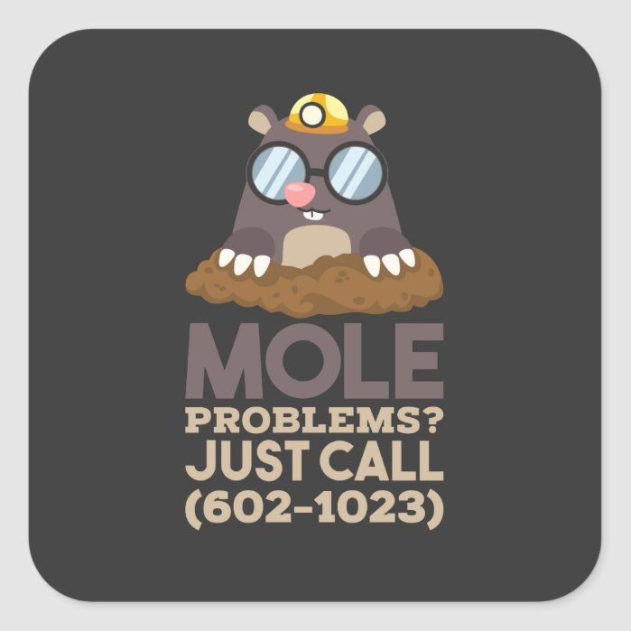
Limiting & Excess Reactants
How much of the other reactants are left over?
? Hm used = ( 20 Br ) ( 3 Hm / 2 Br ) = 30 Hm used
40 Hm to start – 30 Hm used = 10 Hm left over
? Ch used = ( 20Br ) ( 1 Ch / 2 Br ) = 10 Ch used
15 Ch to start – 10 Ch used = 5 Ch left over

Slide 5
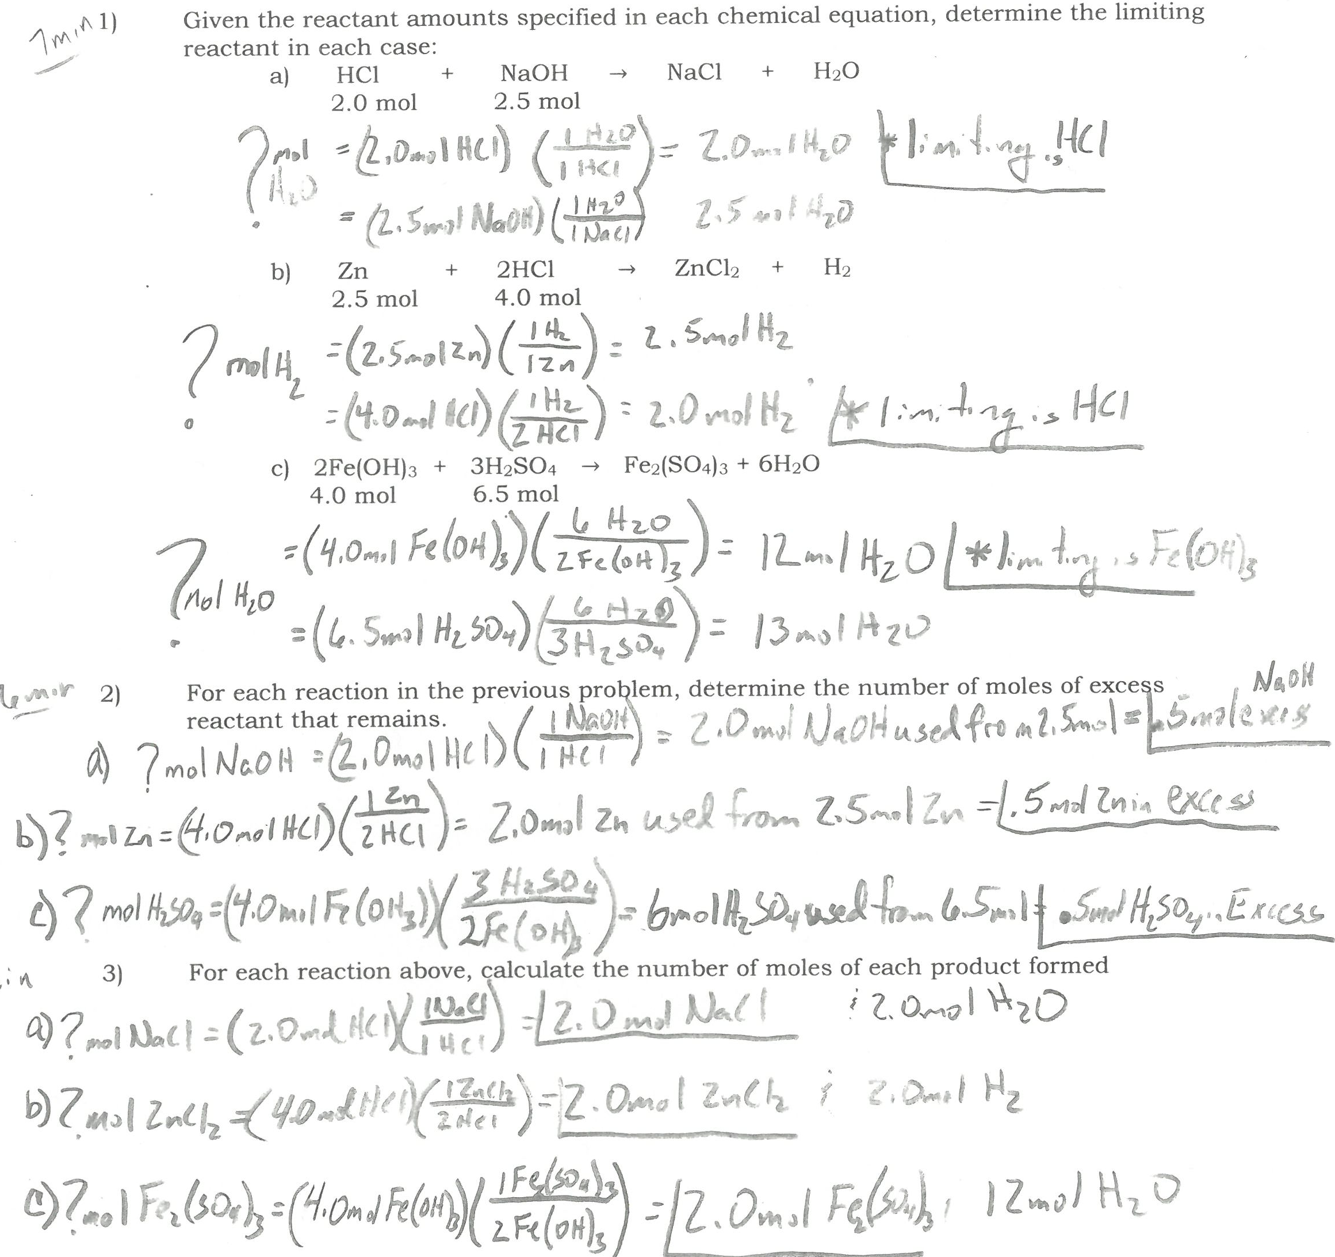
Limiting & Excess Reactants

Slide 6
Limiting & Excess Reactants
Ex2/ Sand (silicon dioxide) is usually quite unreactive but reacts readily with hydrogen fluoride in a double replacement reaction.
SiO_{2 (s)} + HF _{(g)} → SiF_{4 (g)} + H₂0 _{(l)}
If 5.0 moles of HF are exposed to 2.0 moles of SiO₂, which is limiting?
? SiF₄ = ( 5.0mol HF ) (1 SiF₄ / 4 HF ) = 1.25mol SiF₄
? SiF₄ = ( 2.0mol SiO₂ ) ( 1 SiF₄ / 1 SiO₂ ) = 2.0mol SiF₄
1
4
1
2

Slide 7
Limiting & Excess Reactants
HF is the Limiting Reactant b/c it made the least amount of product.
How much excess SiO₂ is there?
? SiO₂ used =(5.0mol HF)(1SiO₂/4 HF) = 1.25mol SiO₂ used
2.0mol SiO₂ to start–1.25mol SiO₂ used = .75mol SiO₂ excess

Slide 8
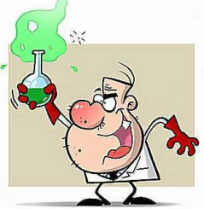
Limiting & Excess Reactants
Ex 3/ Sulfuric acid reacts with lithium hydroxide in a double replacement reaction.
H₂SO_{4 (aq)} + LiOH _{(aq)} → HOH _{(l)} + Li₂SO₄ _{(aq)}
If 30.0g of H₂SO₄ react with 25.0g LiOH, what is the limiting reactant?
2
2

Slide 9
Limiting & Excess Reactants
2
2
H₂SO_{4 (aq)} + LiOH _{(aq)} → HOH _{(l)} + Li₂SO₄ _{(aq)}
If 30.0g of H₂SO₄ react with 25.0g LiOH, what is the limiting reactant?
?mol HOH=(30.0g H₂SO₄)(1mol/98.08g)(2 HOH/1 H₂SO₄)
= .612mol HOH
?mol HOH=(25.0g LiOH)(1mol/23.95g)(2HOH/2 LiOH)
or… = 1.04mol HOH

Slide 10
Limiting & Excess Reactants
2
2
H₂SO_{4 (aq)} + LiOH _{(aq)} → HOH _{(l)} + Li₂SO₄ _{(aq)}
If 30.0g of H₂SO₄ react with 25.0g LiOH, what is the limiting reactant?
What is the mass of the excess reactant remaining?
? LiOH used=(30.0g H₂SO₄)(1mol/98.08g)(2LiOH/1 H₂SO₄)(23.95g/1mol)
= 14.66 LiOH used from 25.0g at the start…
10.3g LiOH in excess

Slide 11
Limiting & Excess Reactants
Ex 4/ Copper(II) chloride reacts with sodium nitrate:
CuCl₂ + NaNO₃ → Cu(NO₃)₂ + NaCl
What mass of sodium chloride could form when
15.0g of copper (II) chloride reacts with 20.0g of
sodium nitrate?
What is the limiting reactant?
How many grams of copper (II) nitrate could form?
How much mass of our excess reagent is left over?
2
2

