Slide 1
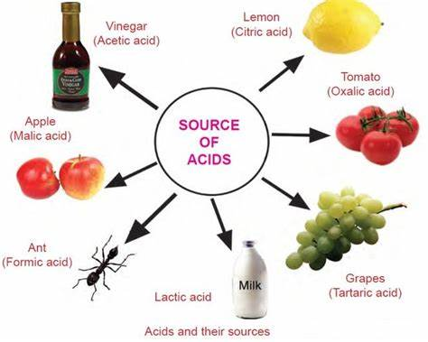
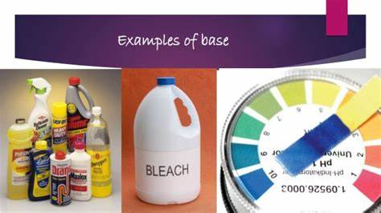
Acids and Bases
(Unit 10 / Chapter 15)

Slide 2
Properties of Acids
Taste -- sour. (lemon juice,sour kraut,belch)
React w/ certain dyes to change their color.
React w/ CO₃⁻² to give off CO₂, H₂O, & Salt.
MgCO₃ +2HNO₃ ----> CO₂ + H₂O +Mg(NO₃)₂
Neutralized by bases to give off H₂O,& Salt.
HCl + NaOH ----> H₂O + NaCl

Slide 3
Properties of Acids
React w/ metals to give off H₂ & Salt.
Mg + 2HCl ----> H₂ + MgCl₂
Conduct electricity in Solution.
HCl ----> H⁺_{(aq)}+ Cl⁻_{(aq)} (ions conduct)
Usually contain H⁺. Always written 1st.
general form of an acid -- HA
HCl, H₂SO₄, HNO₃.
CH₄?
NH₃?

Slide 4
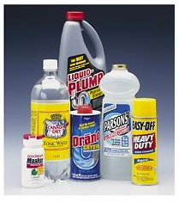
Properties of Bases
Taste -- bitter
Feels slippery -- soaps
React w/ certain dyes to change their color
Neutralized by acids
Conduct electricity
NaOH ----> Na⁺_{(aq)} + OH⁻_{(aq)} (ions conduct)

Slide 5
Water: Both an Acid and Base
Water is AMPHOTERIC
it can act as an acid or a base.
It contains both the hydrogen ion (H⁺) and the hydroxide ion (OH⁻).

Slide 6
Water: Both an Acid and Base
If water combines with an acid, it will act as a base. If it combines with a base, it will act as an acid.

Slide 7
Acid Nomenclature
Does not contain oxygen
Contains oxygen
A way to remember which goes with which…“You ATE a bug – ICk”

Slide 8
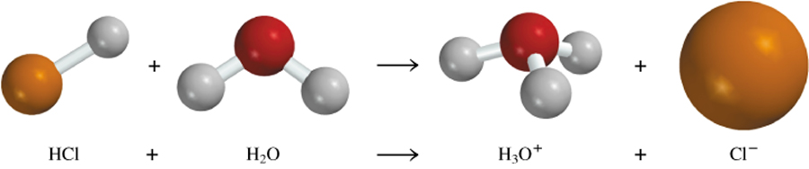
Arrhenius’ Definitions of Acids and Bases
Arrhenius acid: a substance that produces H⁺ ions (H₃O⁺) in water
4.3

Slide 9
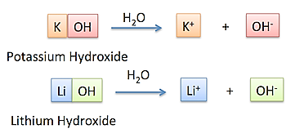
Arrhenius’ Definitions of an Acid and Base
Arrhenius base: a substance that produces OH⁻ ions in water
4.3

Slide 10
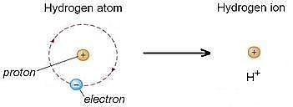
Brønsted-Lowry’s Definition of Acids and Bases
  Acid = proton (H+) donor
  Base = proton (H+) acceptor
  (A proton is just a hydrogen atom that has lost its electron, so its symbol is H⁺)

Slide 11
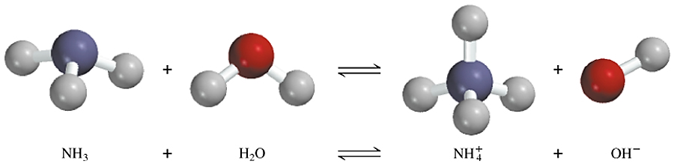
In the reaction below, water is acting as a proton donor while ammonia is acting as a proton acceptor.
base
acid
conjugate acid
conjugate base

Slide 12

Comparing Theories
Brønsted-Lowry’s definition does not restrict bases to just substances with an -OH group. NH₃ is a proton acceptor, so it is a BASE.
Arrhenius’ definition excludes bases that don’t contain -OH.
That does not mean, however,
that Arrhenius was erroneous.

Slide 13
Conjugate acid/base pairs: What are they?
When an acid gives up a proton (H+), the remaining ion is called its conjugate base.
When a base accepts a proton (H+), the conjugate acid of that base forms.

Slide 14
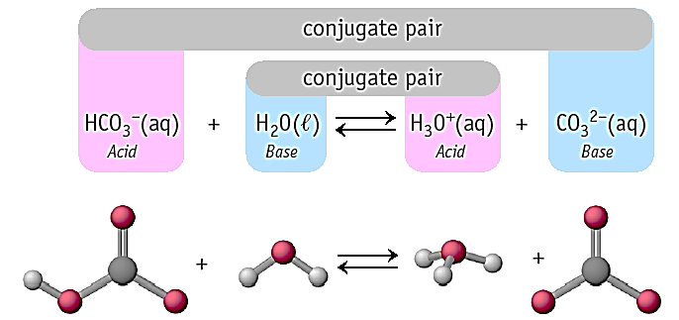
Conjugate Acid/Base Pairs: Example

Slide 15
Check for understanding
Label the acid, base, conjugate acid, and conjugate base in each reaction:
HCl + OH⁻ → Cl⁻ + H₂O
Acid
Base
Conj.Base
Conj.Acid
H₂O + H₂SO₄ → HSO₄⁻ + H₃O⁺
Base
Acid
Conj.Base
Conj.Acid

Slide 16
Check for understanding
NH₃ + H₂O ----> NH₄+ + OH-
Label the acid, base, conjugate acid, and conjugate base in each reaction:
HI + H₂O ----> +
I⁻
H₃O⁺
Base
Conj.Base
Conj.Acid
Acid
OH⁻
NH₃ + H₂O ----> +
NH₄⁺
Base
Acid
Conj.Base
Conj.Acid

Slide 17
Neutralization Reactions
H⁺_{(aq)} + OH⁻_{(aq)} ⇄ H-OH_{(l)}
And a salt will also be produced.
Hydrochloric acid reacting with potassium hydroxide
A reaction producing potassium nitrate

Slide 18
Autoionization of water
water will natural form some H⁺ & OH⁻ ions
this is referred to as autoionization
H₂O_{(l)} + H₂O_{(l)} <----> H₃O⁺_{(aq)} + OH⁻_{(aq)}
K_{w} = [H₃O⁺][OH⁻] = 1E-14 (at 25ºC)
[H₃O⁺] = [OH⁻] =
since K_{w} is constant, what must happen if the [H₃O⁺] increases?
1E-7
1E-7

Slide 19
pH -- a Measure of Acidity
since the concentrations of H⁺ and OH⁻ ions
are very small numbers and hard to work
with, we use a more practical unit--
pH = -log [H⁺]
[H⁺] pH
3.2E-4
1.0E-4
4.82
10.46
pH
3.49
4.00
1.5E-5
3.5E-11

Slide 20
Other useful relationships
pOH = -log [OH⁻] pH + pOH = 14
pH pOH [H+] [OH-]
10.46n
6.4E-3
12.68
3.54
3.5E-11
2.9E-4
11.81
2.19
1.5E-12
1.32
4.8E-2
2.1E-13

Slide 21
Given Find
[H+]= 2.0E-5 pH=
pH = 3.70 [H+]=
4.70
2.0E-4
[H⁺], pH, and pOH

Slide 22
Strengths of Acids and Bases
acid/base strength is measured by the ability of each to ionize in water
Strong acids and bases
-- HClO₄, HClO₃, HCl, HI,
HBr, HNO₃, H₂SO₄
-- LiOH, NaOH, KOH, RbOH, Ca(OH)₂, Sr(OH)₂, Ba(OH)₂
-- completely ionize in water
(100% of the time)
[H⁺], pH, and pOH

Slide 23
Ex1/ If 2.00-L of solution was made with 24.33-g of Sr(OH)₂, calculate the [H⁺],[OH⁻], pH, pOH:
Sr(OH)₂ ----> _____+ _____
Sr⁺²
2OH⁻
.100-M
.200M
[H⁺], pH, and pOH
pH = 13.301
pOH = .699
[H⁺] = 5.00E-14
Is [H₃O⁺] more in .1M HCl or .1M HC₂H₃O₂ ?

Slide 24
[H⁺], pH, and pOH

