Slide 1
Titrations
Honors Chemistry Unit 10

Slide 2
Titration - the measured addition of one known concentration solution (called a titrant) to the known volume of another solution of unknown concentration until the reaction reaches neutralization.

Slide 3
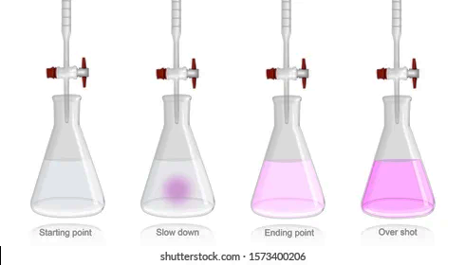
pH indicator: A weak acid that changes color when the end point is reached in a titration.

Slide 4
The example uses NaOH as the titrant (standard solution) and HCl as the acid of unknown concentration.
The pH indicator you will use is called phenolphthalein.

Slide 5
STOP adding titrant when the equivalence point is reached ~
When equal concentrations of H⁺ and OH⁻ are in solution.
End Point: The point at which your pH indicator changes color. This occurs when the equivalence point is reached.

Slide 6
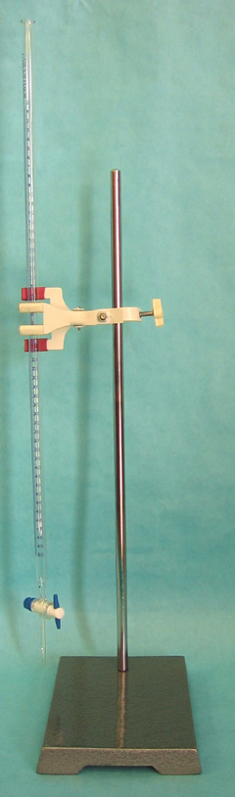
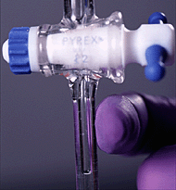
Buret
Turn the stopcock to control the flow of titrant
Buret clamp and ringstand

Slide 7
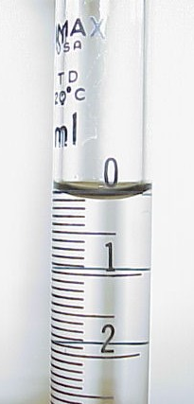
Record starting volume to nearest 0.01 or 0.02 mL.
Perform titration; then record final volume to nearest 0.01 or 0.02 mL.
Subtract starting volume from final volume.

Slide 8
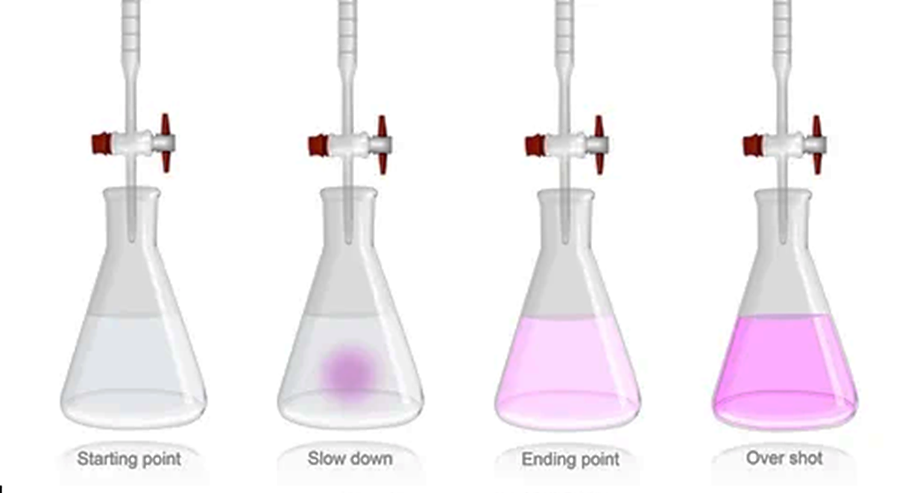
Color Change During Titration
Acid solution with phenolphthalein indicator
Endpoint is reached (neutralization)
Too much base added

Slide 9
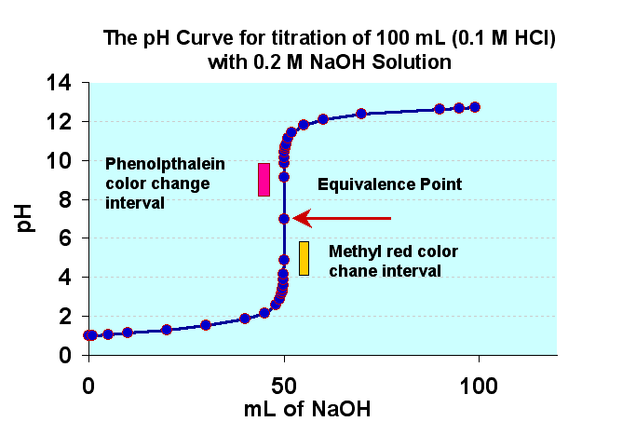

Slide 10
pH Indicators
Different indicators change color at different pH values. Phenolphthalein changes color at pH = 8.2
At the end point, the solution will be:
  Neutral for strong acid + strong base
  Basic for strong base + weak acid
  Acidic for strong acid + weak base

Slide 11
Solving Titration Problems:
1.) You can use the formula
M_{a}V_{a}= M_{b}V_{b}
where M_{a} = molarity of acid
V_{a} = volume of acid
M_{b} = molarity of base
V_{b} = volume of base

Slide 12
Ex. 1
Ex 1/ What is the concentration of an HCl solution if 30.0 mL of 0.100 M NaOH neutralizes 50.0 mL of the HCl?
HCl + NaOH → H₂O + NaCl
(30.0 mL)(0.100 M) = (50.0 mL)·M_{a}
M_{a} = 0.0600 M

Slide 13
Ex 2/ A 20.0 mL solution of Sr(OH)₂ is neutralized after 25.0 mL of standard 0.0500 M HCl is added. What is the concentration of Sr(OH)₂?
2 HCl + Sr(OH)₂ → 2 H₂O + SrCl₂
(0.0500 M )(25.0 mL) = (20.0 mL · 2 )·M_{B}
It provides twice the OH⁻ for every Sr(OH)₂
M_{B} = 0.03125 M Sr(OH)₂

Slide 14
Ex 3/ How many mL of 0.200 M H₂SO₄ are needed to neutralize 55.0 mL of a 0.100 M solution of NaOH?
H₂SO₄ + 2NaOH → 2H₂O + Na₂SO₄
It provides twice the H⁺ for every H₂SO₄
(55.0 mL)(0.100 M) = (0.200 M · 2)·V_{A}
V_{A} = 13.75 mL

