Slide 1
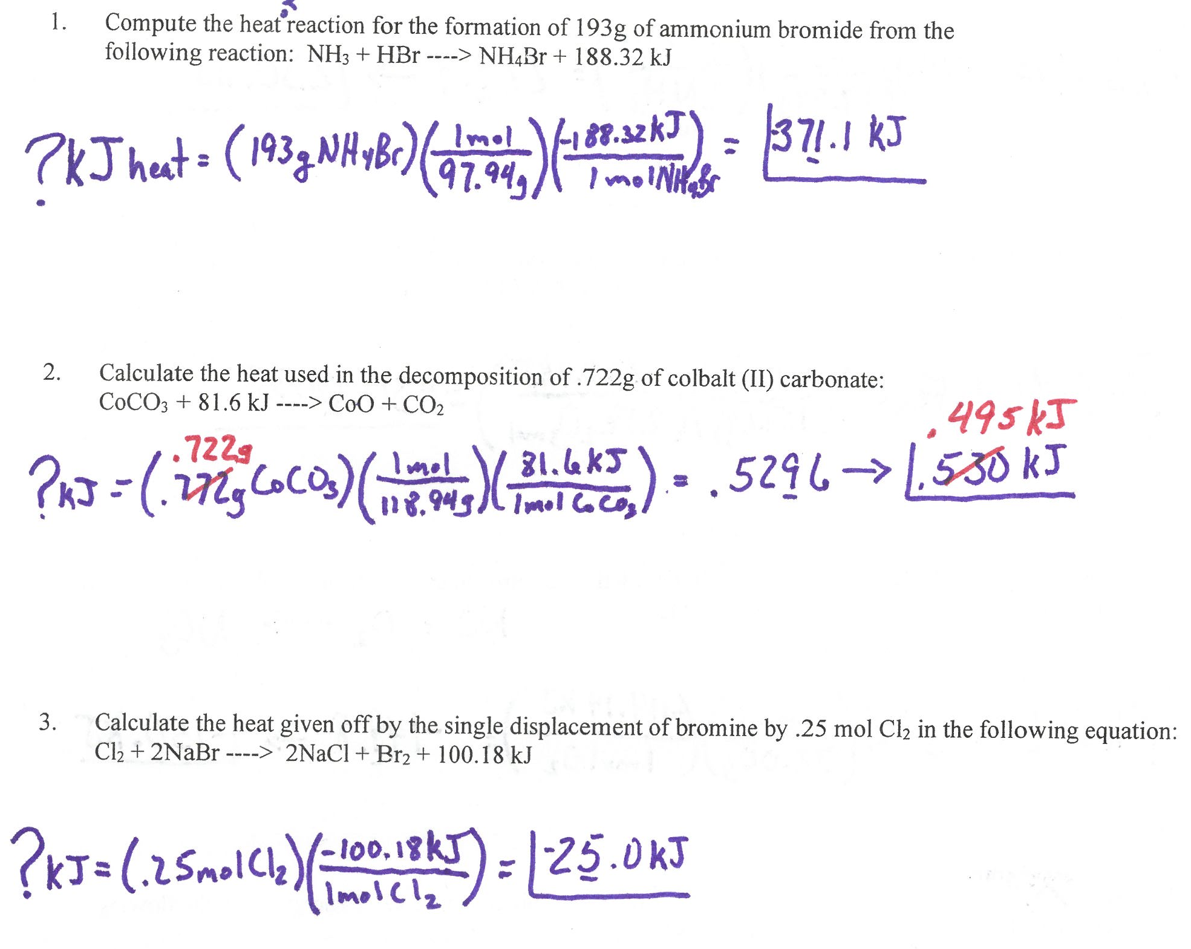

Slide 2
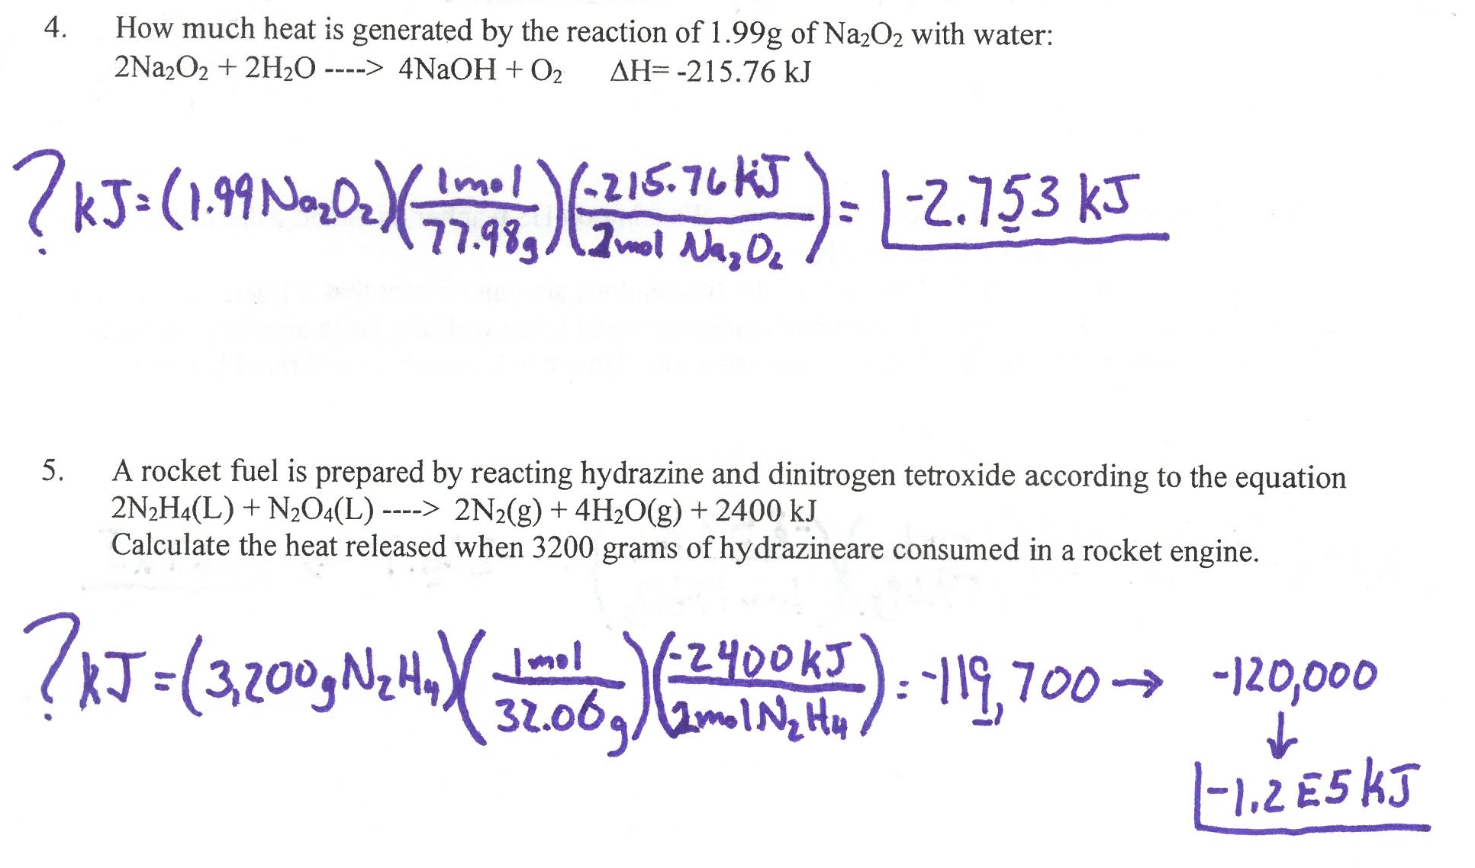

Slide 3
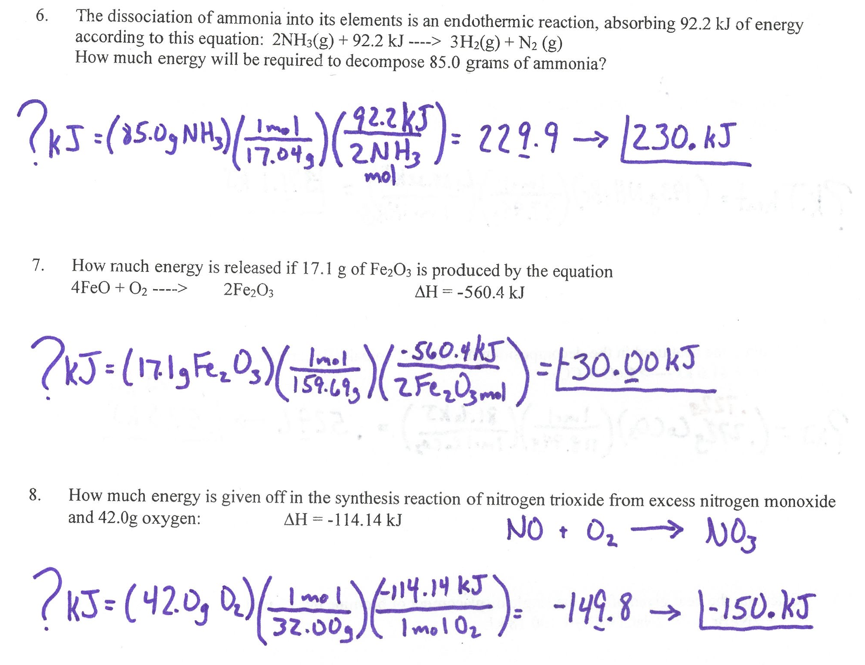

Slide 4
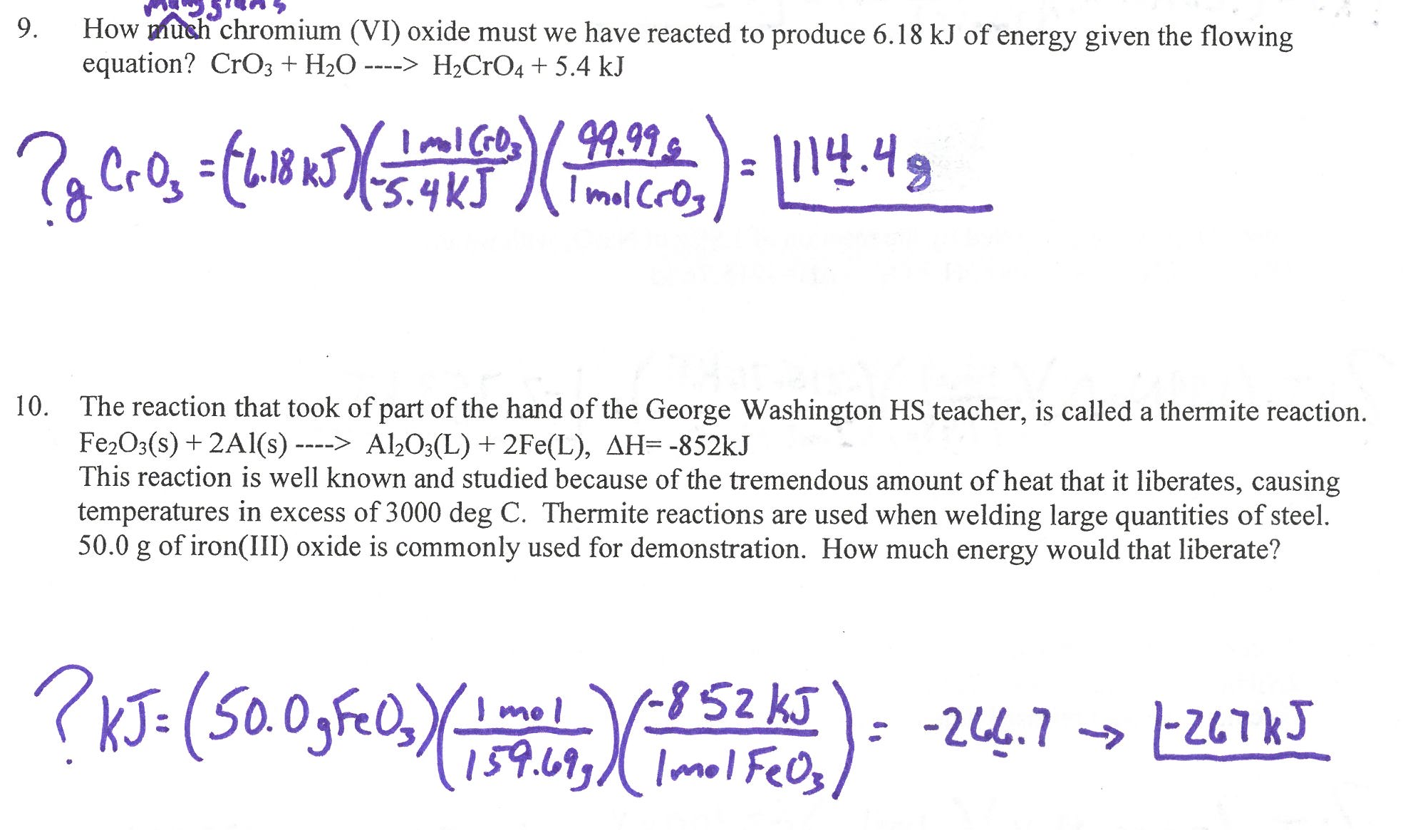

Slide 5
Warmup:
A. Write the chemical formulas for these compounds:
Potassium sulfate
Tin(II) oxalate
Silver oxide
Iron(III) nitrate
Dinitrogen pentoxide
B. Write the balanced equation for the synthesis of chromium(III) oxide from its elements.

Slide 6
Theoretical Yield,
Actual Yield,
& Percent Yield
Unit 5: Stoichiometry

Slide 7
What is theoretical yield?
Theoretical yield is the amount of a product that SHOULD form based on the amount of limiting reactant used in a reaction.
You’ve already been doing this!

Slide 8
What is actual yield?
Actual yield is the amount of product we get when we ACTUALLY perform our reaction in the lab.
This is typically reported in grams because we measure the mass of product using a balance.

Slide 9
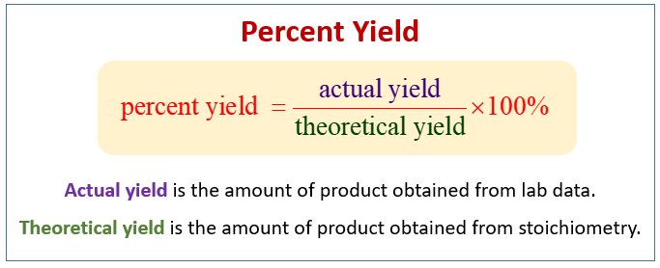
What is percent yield?
Percent yield of a product is the ratio of actual yield to theoretical yield, multiplied by 100%:

Slide 10
What is theoretical yield?
Write the balanced equation for the reaction of 275g acetic acid reacting with 125g aluminum hydroxide.
What is excess and by how many grams?
What is in the percent yield, if you obtained 292g aluminum acetate?

