Slide 1
Good Moring
After you caddy your phones,
take your seats, and open
your workbook to p.44

Slide 2
Rules that guide electron placement in atomic orbitals
Honors Chemistry Unit 2

Slide 3
Representing placement of electrons in an atom
An electron configuration shows which principle energy levels and sublevels occupied by electrons as well as how many are in each.
For instance, oxygen’s electron configuration is
1s² 2s² 2p⁴
*Notice that the sum of all superscripts
equals the total # of electrons in the atom.

Slide 4
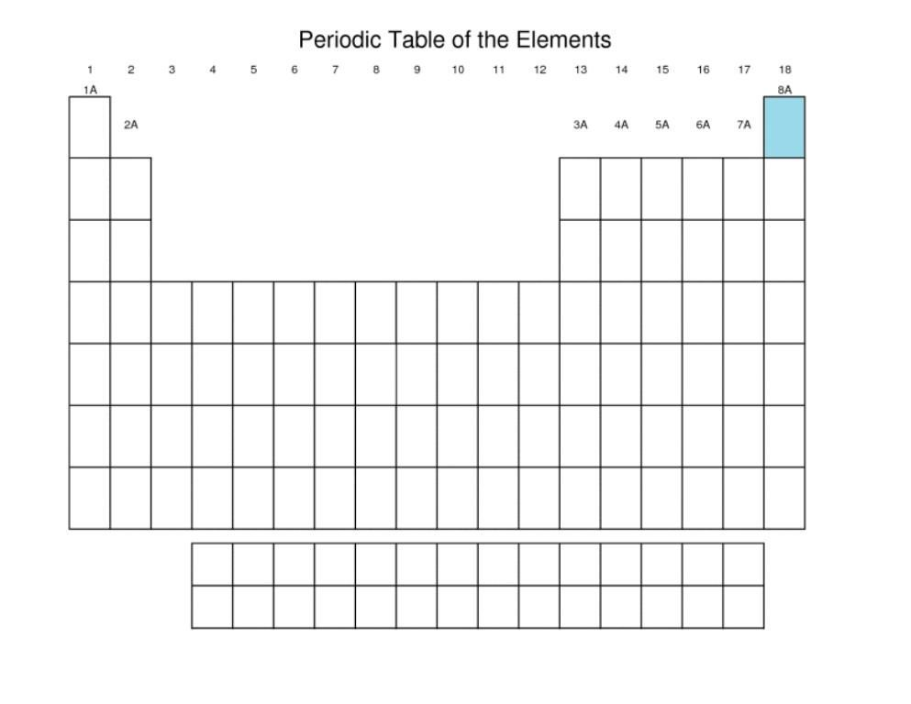

Slide 5
There are 3 rules that electrons must follow when filling atomic orbitals
And you need to learn them.

Slide 6

Rule 1:
The Pauli Exclusion Principle
An orbital can contain only 2 electrons, and they must have opposite spins.
Reasoning: The opposing spins reduce repulsion between the electrons in the orbital.

Slide 7
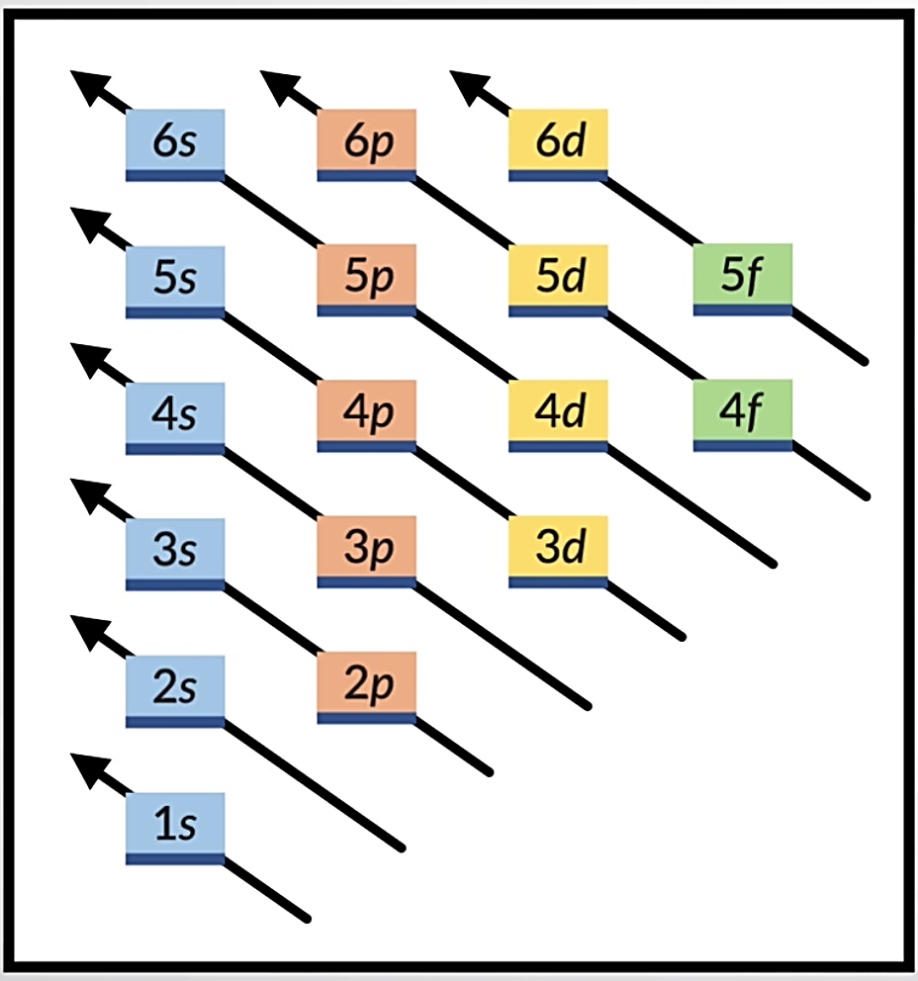
Rule 2:
The Aufbau Principle
e⁻ fill orbitals starting closest to the nucleus 1st
These are the lowest energy e⁻
“Aufbau” is German for “building up.”

Slide 8
Rule 2:
The Aufbau Principle
Reasoning: Each electron wants to be in the lowest energy state possible, which means being as close to the nucleus as possible. Electrons that are further from the nucleus have higher energies than the closer ones.

Slide 9
Exceptions to
The Aufbau Principle
For atoms that would otherwise have an electron configuration ending in d⁴, d⁹, f⁶, or f¹³, an electron that would normally fill the highest s orbital will instead be placed in the highest d or f orbital to produce a half-filled or filled set of degenerate orbitals.

Slide 10
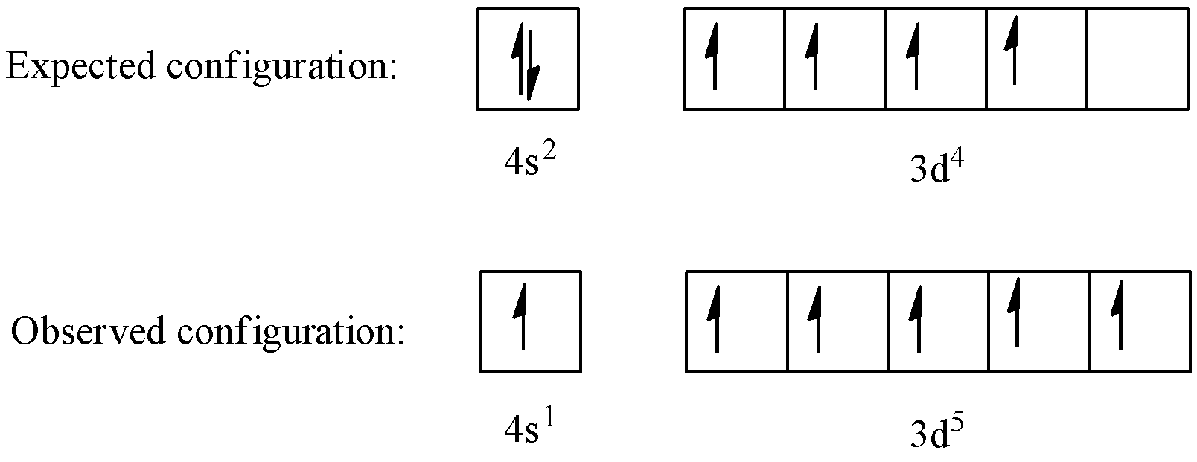
Reasoning:
The half-filled or filled set of d or f orbitals creates a more stable configuration.
An example is the element chromium (Cr).

Slide 11
Exceptions to
The Aufbau Principle
Elements whose highest d orbital are predicted to take an electron from the nearby s orbital:
Group 6 Group 11
Cr Cu
Mo Ag
W Au

Slide 12
Rule 3:
Hund’s Rule
When filling a set of degenerate orbitals (such as the 2p orbitals), each orbital receives its first electron before any receives a second.
Reasoning: Electrons stay as far from each other as possible due to repulsion.

Slide 13
Noble Gas Notation: a Shortcut
We can bracket [ ] the symbol of the noble gas at the end of the row above the element of interest
Then write the remaining e⁻ configuration starting at the highest principal energy level.

Slide 14
Noble Gas notation
Examples:
Chlorine
Yttrium
Radon
[Ne] 3s² 3p⁵
[Kr] 5s² 4d¹
[Xe] 6s² 4f¹⁴ 5d¹⁰ 6p⁶

