Slide 1
Part I:
Polar and Nonpolar molecules

Slide 2

intermolecular forces
There are two types of covalent bonds:
  Polar and Nonpolar

Slide 3

Polar Covalent Bonds
Polar covalent bonds are formed by unequal sharing of e-
Caused by differences in electronegativity

Slide 4
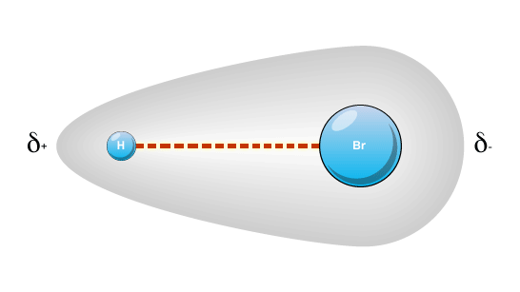
Polar Covalent Bonds
The higher EN atom has a greater e- density
Gives a partial negative charge
The other atom has a partial positive charge

Slide 5
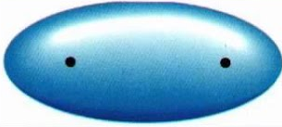
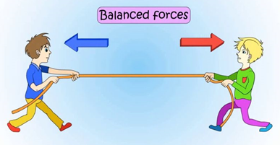
Nonpolar Covalent Bonds
A nonpolar covalent bond is formed by equal (or almost equal) sharing of e-

Slide 6
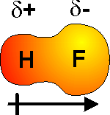
Dipole-Dipole IMF
A dipole arrow points toward the more negative end.

Slide 7
Classifying chemical bonds
Differences in EN values determine type of bond
Type of Bond | Electronegativity Difference
Nonpolar Covalent | 0 to 0.4
Polar Covalent | 0.5 to 1.9
Ionic | 2.0 and above

Slide 8
Practice
What type of bond is in HCl? (H = 2.1, Cl = 3.1)
E.N. difference = 3.1 – 2.1 = 1.0
The bond is polar.
Practice: Identify each type of bond
N (3.0) and H (2.1)
C (2.5) and H (2.1)
Si (1.8) and Cl(3.0)
C (2.5) and Cl (3.0)
O (3.5) and C (2.5)
Si (1.8) and O (3.5)

Slide 9
Practice Drawing Dipoles
Consider this P – Br bond:
E.N. for P = 2.1
E.N. for Br = 2.8
P – Br
^{δ+ δ-}
Practice
H (2.1) – S (2.5)
F (4.0) – C (2.5)
C (2.5) – Si (1.8)
N (3.0) – O (3.5)

Slide 10
Part II: intermolecular forces
Notes:
4 types, we are focusing on 3 of them

Slide 11
Intermolecular Forces
Kinetic molecular theory states that the attractive forces between molecules in a gas are negligible—gases have neither a definite shape or volume.
Liquids and solids have definite volumes, which means that there are attractive forces holding the particles together.
These temporary attractive forces are known as intermolecular forces (they can apply to atoms and ions as well as molecules).
While these intermolecular forces are based on electrostatic attractions, they are much weaker than covalent or ionic bonds.

Slide 12
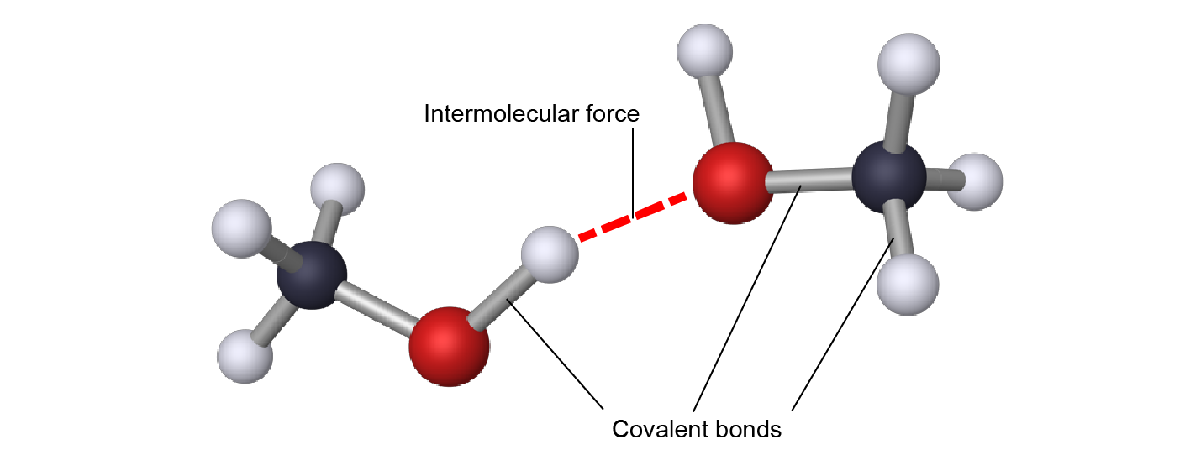
Covalent, Intramolecular Bonds versus Intermolecular Forces
Image: MacMillan Interactive General Chemistry 1st Edition ©2021

Slide 13
Intermolecular Forces
Liquids and solids have definite volumes, which means that there are attractive forces holding the particles together.
These temporary attractive forces are known as intermolecular forces (they can apply to atoms, ions, and molecules).
They are based on electrostatic attractions, but are much weaker than covalent or ionic bonds.

Slide 14
Types of Intermolecular Forces
Ion–dipole attractions form between ions and polar molecules.
Dipole–dipole attractions form between two polar molecules.
Hydrogen bonding is a particularly strong type of dipole–dipole attraction.
Dispersion forces occur between all particles, and are based on the # of e-.
The strength of intermolecular forces can explain trends in MP, BP, and solubilities and can explain many of the unique properties of water.

Slide 15
Covalent, Intramolecular Bonds versus Intermolecular Forces
Image: MacMillan Interactive General Chemistry 1st Edition ©2021

Slide 16
Ion–Dipole Attractions
Polar molecules, such as H₂O, have separate locations of partial positive and partial negative charges; they are dipoles.
Ionic compounds dissolve in water to form hydrated ions.
Hydrated ions form by way of ion–dipole attractions.
Ion–dipole attractions are the strongest of the temporary attractions between particles.

Slide 17
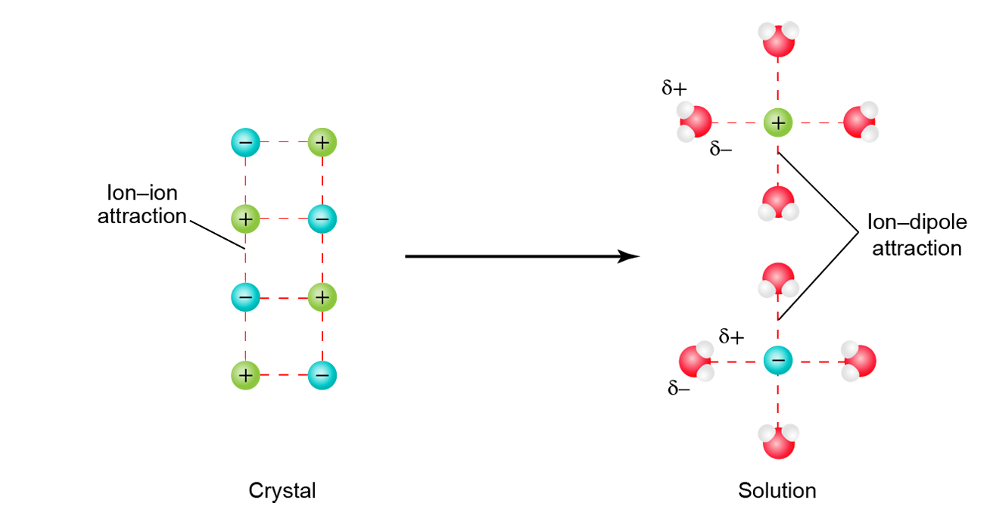
Ions Form Ion–Dipole Attractions upon Dissolution
Image: MacMillan Interactive General Chemistry 1st Edition ©2021

Slide 18
Example
Predict whether any of the following pairs of compounds can form ion–dipole attractions.
H₂O and CO₂
NaCl and H₂O
NaCl and CO₂

Slide 19
Dipole-Dipole IMF
An unequal sharing of e- causes a
dipole moment

Slide 20
Classifying chemical bonds
Differences in EN values determine type of bond
Type of Bond | Electronegativity Difference
Nonpolar Covalent | 0 to 0.4
Polar Covalent | 0.5 to 2.0
Ionic | 2.0 and above

Slide 21
Dipole–Dipole Attractions
Polar molecules interact with other polar molecules.
The negative pole of one polar molecule is attracted to the positive pole of another polar molecule.
These attractions are a type of intermolecular force known as dipole–dipole attractions.

Slide 22
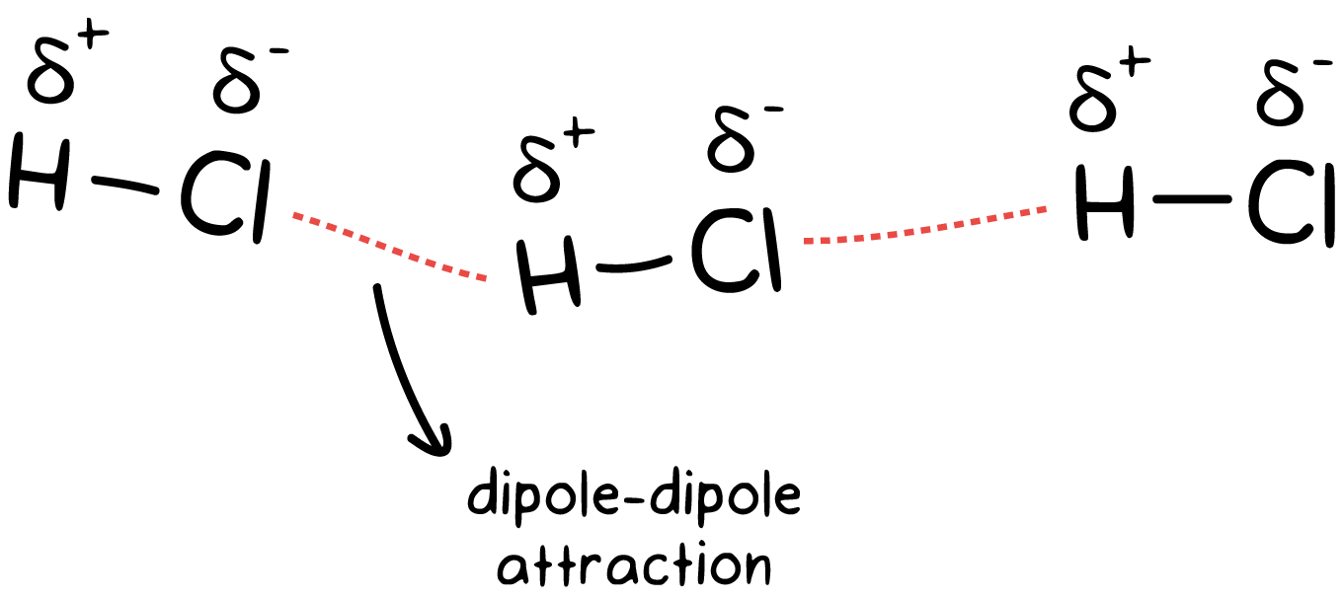
Dipole-Dipole Forces
Molecules with dipoles are attracted to each other because of their partially charged ends.

Slide 23
Dipole-Dipole Forces
The partially positive end of one molecule is attracted to the partially negative end of an adjacent molecule.

Slide 24
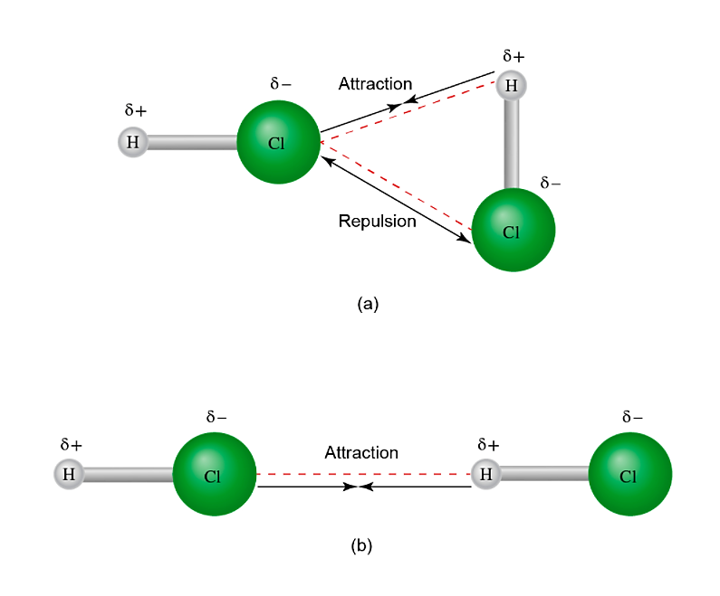
Orientation of Dipoles in Polar Molecules
δ⁺
δ⁻
Attraction
δ⁺
δ⁻
Repulsion
δ⁻
δ⁻
δ⁺
Attraction
δ⁺
Image: MacMillan Interactive General Chemistry 1st Edition ©2021

Slide 25
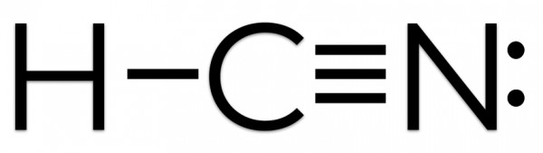
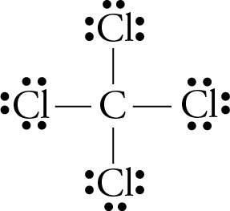
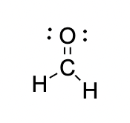
Evaluate each molecule and determine whether it will have dipole-dipole forces with other molecules
A.
B.
C.

Slide 26
Will this have dipole-dipole forces with other molecules
Yes; it is a polar molecule,
2.2 – 2.5 – 3.0

Slide 27
Will this have dipole-dipole forces with other molecules
No; it contains polar bonds, but it is symmetrical.
All the dipoles cancel out, making the molecule nonpolar.

Slide 28
Will this have dipole-dipole forces with other molecules
Yes; this is a polar molecule
3.5 – 2.5

Slide 29
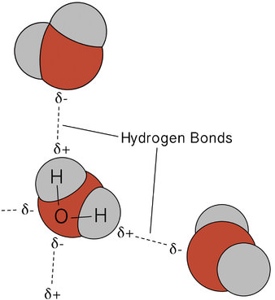
Hydrogen Bonds
Hydrogen bonds are special dipole-dipole attractions
It is stronger than other dipole-dipole attractions
Notes:
Hydrogen has to be bonded to N, O, or F. Common mistake.

Slide 30
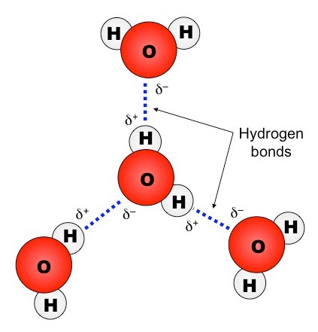
Hydrogen Bonds
Hydrogen bonding requires two very specific components:
A hydrogen bond donor molecule containing a partially positive H atom bonded to N, O or F
A hydrogen bond acceptor molecule containing a partially negative N, O or F with lone pair electrons
A hydrogen bond is the attraction between the δ⁺ H in the donor molecule and a lone pair of electrons on the δ⁻ O, N, or F of the acceptor molecule.

Slide 31
Hydrogen Bond Strength
Hydrogen bonds have ~5% of the strength of an average covalent bond, so they do not disrupt the bonds that hold atoms in a molecule together.
They are the 2nd strongest IMFs.

Slide 32
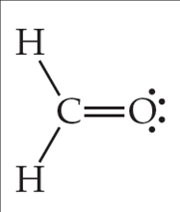
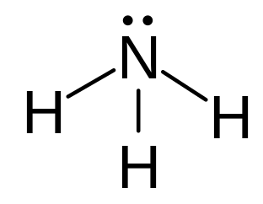
Evaluate each molecule and determine whether it will form hydrogen bonds with other molecules
A.
B.

Slide 33
Will this form hydrogen bonds with other molecules
A. No; although the molecule contains hydrogen and oxygen, they are not DIRECTLY bonded together. Thus, no hydrogen bonding possible.

Slide 34
Will this form hydrogen bonds with other molecules
B. Yes; the hydrogens are directly bonded to nitrogen, so this molecule will engage in hydrogen bonding.

Slide 35
London dispersion forces
Occur when e- are not evenly distributed around a particle
Increase with the size of atoms as well as in longer molecules.

Slide 36
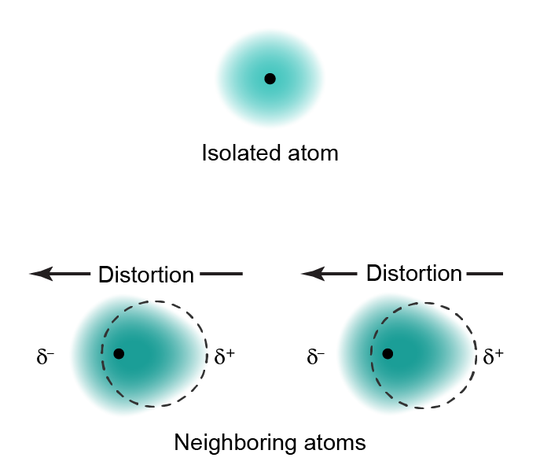
Dispersion Forces Are Instantaneous Dipole-Induced Dipole Attractions
Isolated atom
Neighboring atoms

Slide 37
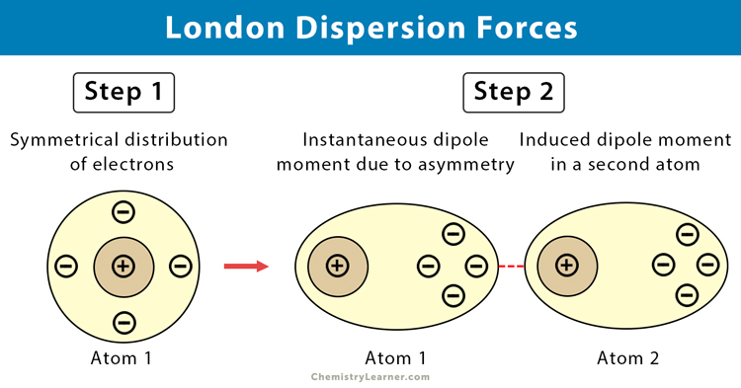

Slide 38

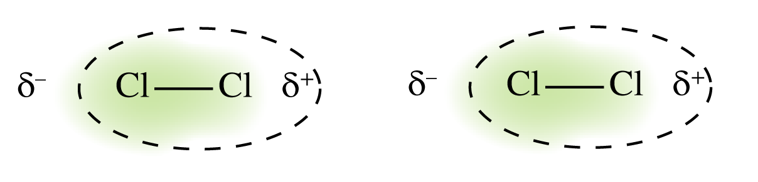
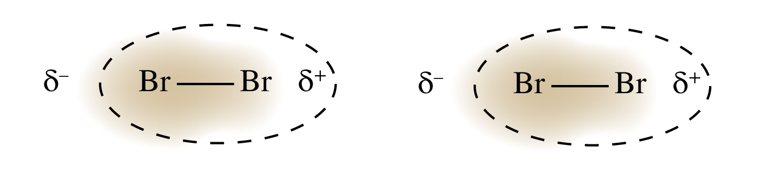
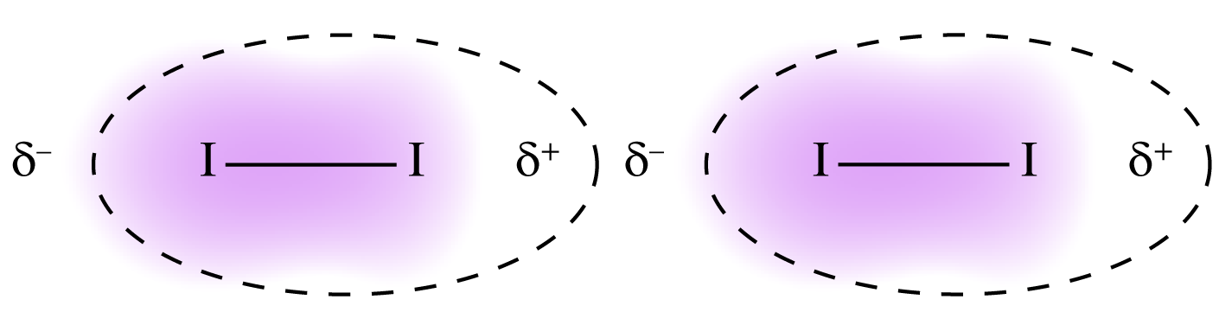
Atomic Size and Polarizability
Halogen | Atomic Radius (pm) | Boiling Point (K) | Diagram
Fluorine | 60 | 85
Chlorine | 100 | 239
Bromine | 117 | 332
Iodine | 136 | 457

Slide 39
London dispersion forces
Weak forces of attraction between all molecules.
The more e- there are in an atom or a molecule, the more POLARIZABLE the molecule is.
(Click yellow text above to open the hyperlink for a video about LDFs)

Slide 40
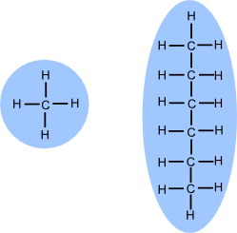
Dispersion Force strength increases as the mass of a molecule’s atoms increase.
It also increases as surface area of a molecule increases.
This is hexane. It has a higher mass and larger surface area. Its DFs are stronger, holding the molecules together. It is a liquid at room temp
This is methane. It has a low mass and small surface area. Its DFs are weak, so it is a gas at room temp

Slide 41
Which Substance has stronger dispersion force?
C₂H₆ or C₈H₁₈
Why?

Slide 42
IMFs and boiling points
The stronger the intermolecular forces, the more energy it takes to separate the molecules
The higher the MP and BP

Slide 43
Identify the IMF in these molecules.
Which is strongest?
PCl₃
CH₃F

