Slide 1
Warm-Up
Titanium(II) phosphate
        # Elements
        # Ions
        # Atoms
        Molar Mass
3
5
13
333.58-g
Ti₃(PO₄)₂

Slide 2
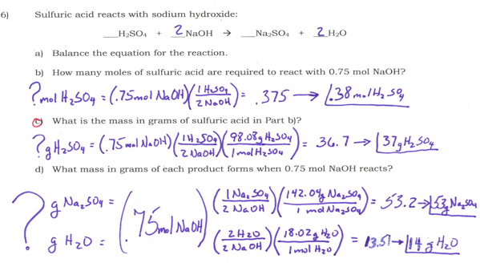

Slide 3
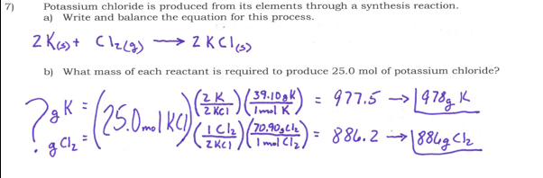

Slide 4

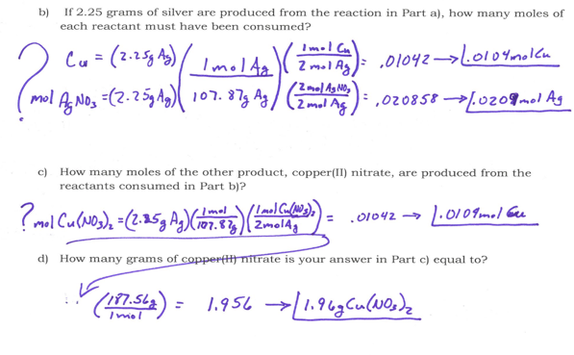

Slide 5
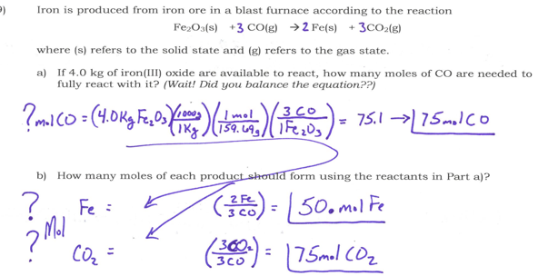

Slide 6
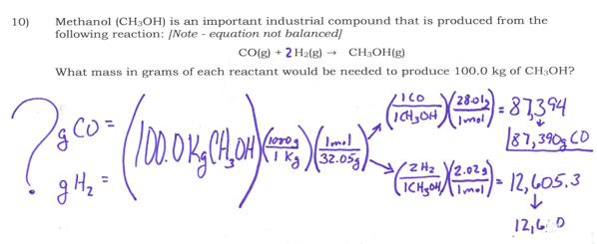

Slide 7
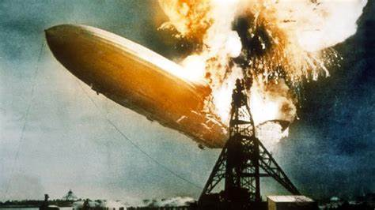
Heat of Rxn
Live_audio_recording_from_the_scene_of_the_Hindenburg_disaster_1937-05-06_19-25_EST.oga
Thermochemistry is the study of heat change in chemical reactions.
2H₂ (g) + O₂ (g) → 2H₂O (g) + energy
Notes:
May 6, 1937 New Jersey during landing 400 ft high, dropped cables, winched down to ground. 10 previous flights, this first flight of new season.

Slide 8
Heat of Rxn
The system is what we study
The surroundings is everything else
The rxn is exothermic if the system gives off heat and the surroundings absorb heat
The rxn is endothermic if the system absorbs heat and the surroundings release heat

Slide 9
Heat of Rxn
Enthalpy is the energy change in a system and the work done on or by the system.
Measured in kilo Joules (kJ)
Exothermic rxn show heat as a product
Endothermic rxn show heat as a reactant
ΔH = the abbreviation for change in enthalpy
Ex/ Write the balanced equation for the
production of water from its elements.
2H₂ + __O₂ → 2H₂O
+ 572 kJ
ΔH = -572 kJ

Slide 10

Heat of Rxn
Ex/ How much energy is released when .728
moles of water is created?
2H₂ + O₂ → 2H₂O + 572 kJ
(_{2-mol H2O} )
?kJ = (.728 mol H₂O)
-572-kJ
= -208.2-kJ

Slide 11

Heat of Rxn
Ex/ How much energy is absorbed when .728 moles
of water is decomposed?
2H₂O + 572 kJ → 2H₂ + O₂
(_{2-mol H2O} )
?kJ = (.728 mol H₂O)
+572-kJ
= +208.2-kJ

Slide 12
Heat of Rxn
Gatorade has 34.0 grams of sugar (we will assume a monosacharide, C₆H₁₂O₆) in its 20 ounce drink. How much energy would you expect to get from this sports drink?
C₆H₁₂O₆ (s) + O₂ (g) → CO₂ (g) + H₂O (l)
ΔH = -2,801 kJ
?kJ =(34.0g C₆H₁₂O₆)
1Cal = 4.184kJ
6
6
6
( _{180.16g} )
( _{1-mol} )
1mol
-2,801-kJ
= (-529kJ)

Slide 14

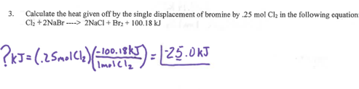

Slide 15
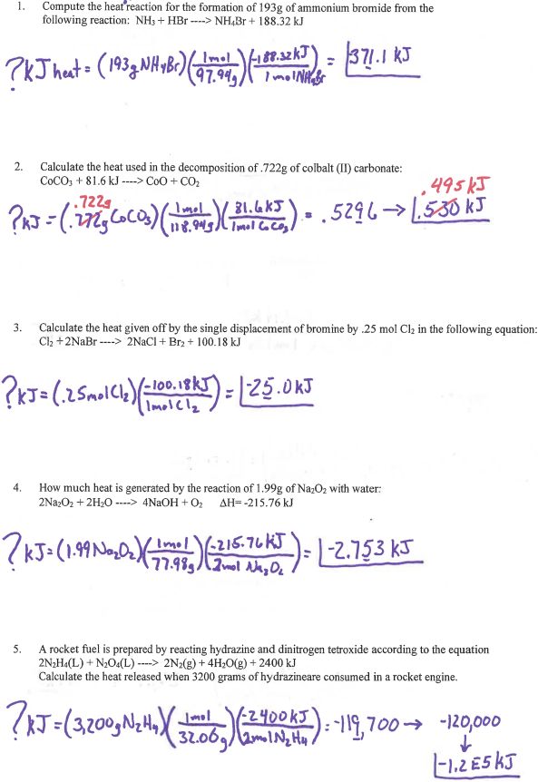
Stoichiometry
2
2

Slide 16
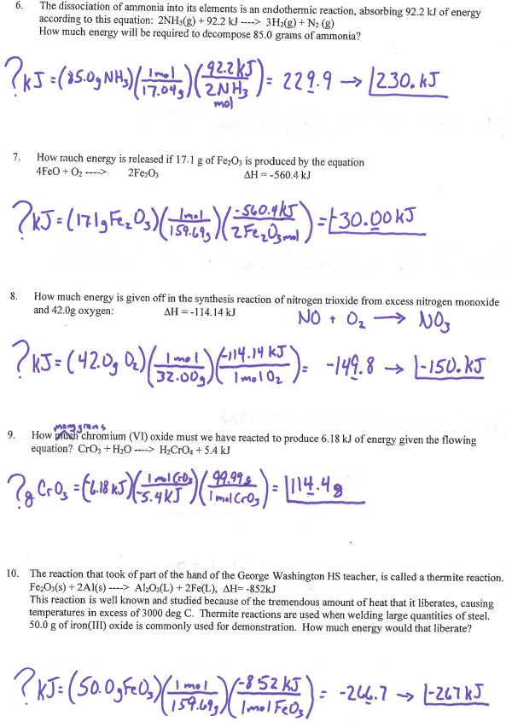
Stoichiometry
2
2

